Slide 1
The influence of office location on commuting behaviour
Peter Wyatt

Slide 2
Background and context
Transport activity accounts for ¼ of all UK CO₂ emission
To fully appreciate the environmental impact of an office building, transport-related CO₂ emissions resulting from its location should be considered in addition to the emissions that result from the operation of the building
Decentralisation of residential and economic activity
Cheap land
Easier development
Firms externalise transport costs
Workers trade off rapidly rising housing costs against slowly rising transport costs by decentralising

Slide 3
Commuting trends
On average commuters travel approx. 2,000 miles a year in the UK
70% of trips (73% distance) by car
Total UK CO₂ emission is falling but transport emission is rising

Slide 4
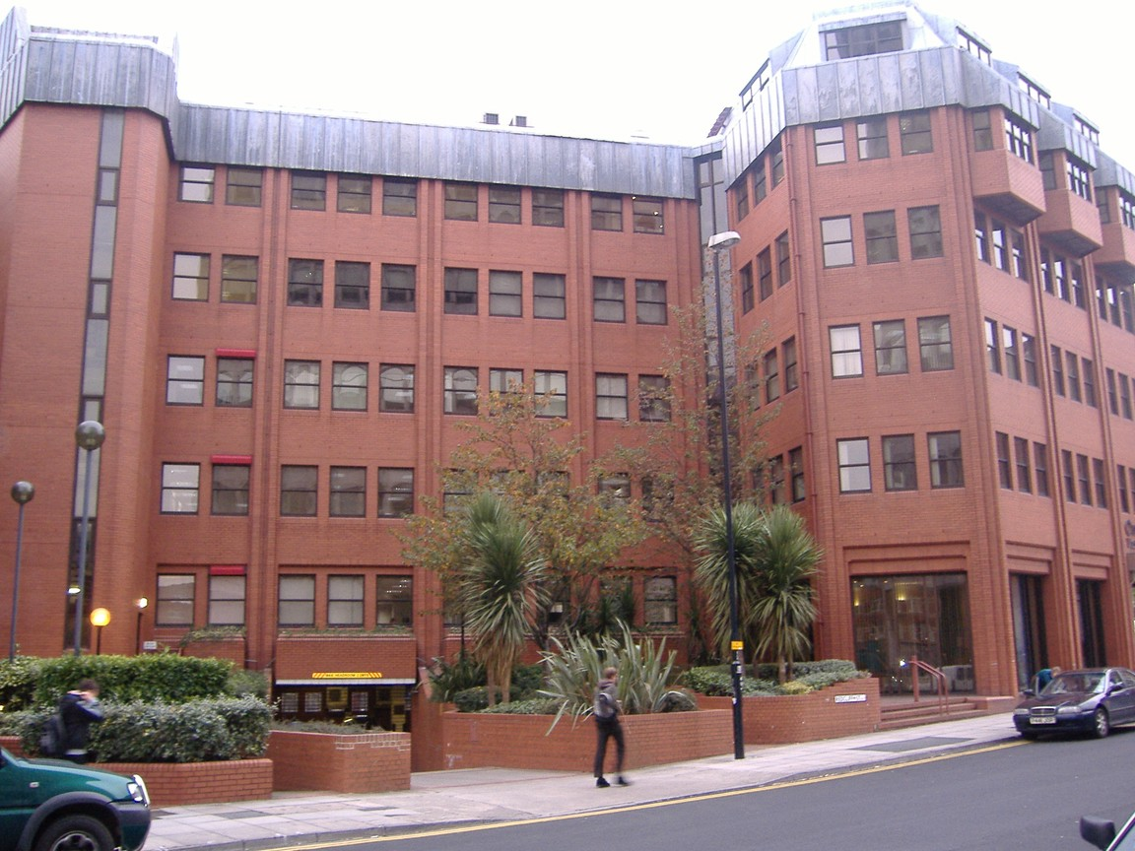
1 Victoria St, Bristol
– 46,000 square feet
– 1983
- Air conditioned Standard

Slide 5
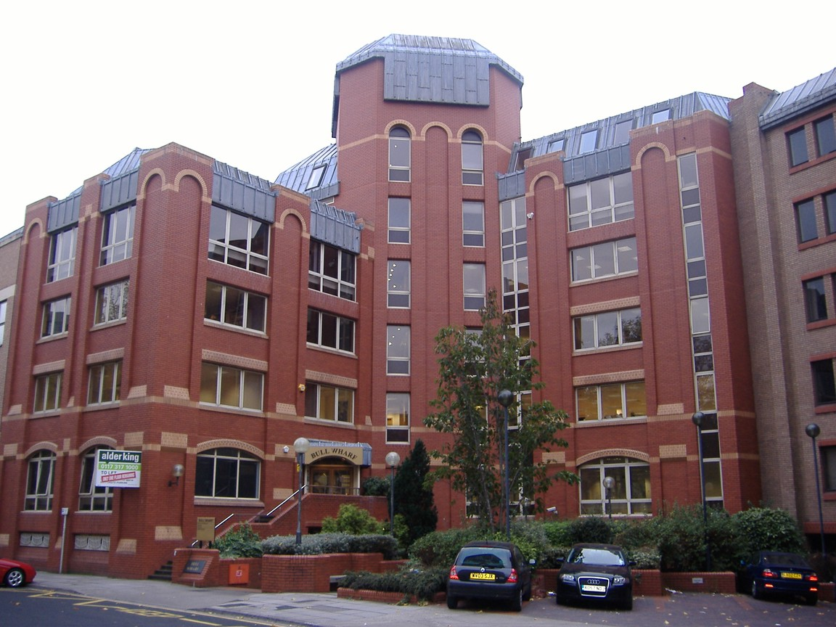
Bull Wharf, Redcliff St , Bristol
38,000 square feet
1985
Air conditioned Standard

Slide 6
From in town to out of town: Bristol
Notes:
Increasing out of town development at low densities – increasing need for car-based transport

Slide 7
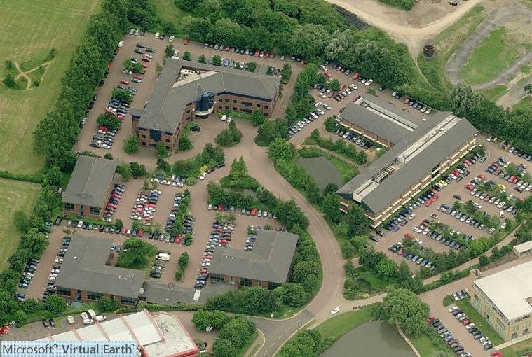
700 Aztec West

Slide 8
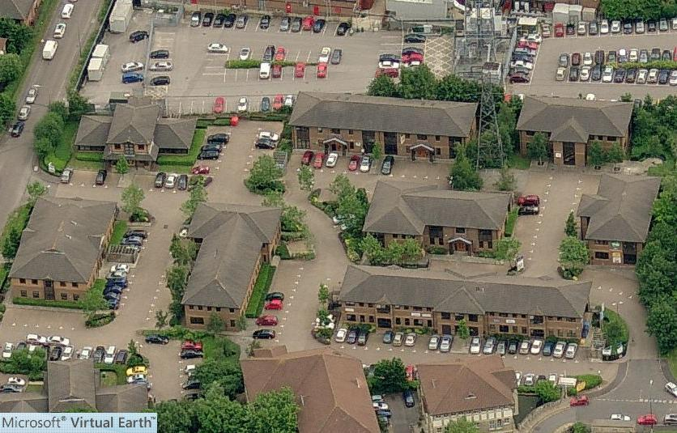
Almondsbury Business Centre

Slide 9
Theory - rent
If we assume homogeneity of attitude towards access to customers and agglomeration economies, land rent is a function of access by workforce
Access by workforce is a function of distance, availability and cost of travel modes and frequency of attendance (assume equal)
So looking to minimise distance and cost (car is preferred and cheapest mode)

Slide 10
Theory
Commuting is a function of 3 criteria:
Physical:
location of office relative to location of workforce
availability and cost of transport modes
Business:
frequency of visits
Commuting emits CO₂ and, other things equal, emissions will be higher from office locations that
require longer commutes
encourage car-based commuting

Slide 11
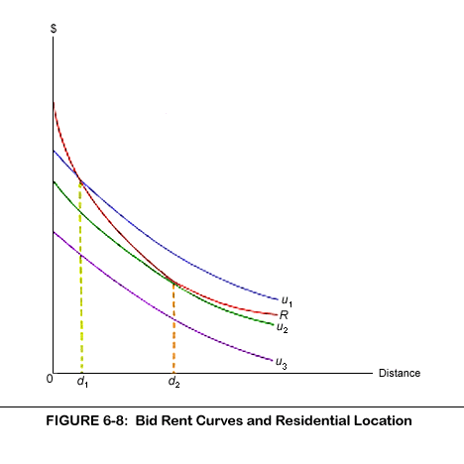

Slide 12
Literature
Author(s) | Date | Focus, findings
Banister | 1992 | rural areas, hinterlands of large cities, car dependency
Breheny | 1990, 93, 94 | rural areas, growth areas
Cervero | 1988 | decentralisation, longer commutes, more car dependency
Cervero & Murakami | 2010 | negative correlation between population density and vehicle miles travelled
Konings et al | 1996 | infill development, public transport
Frost et al: | 1997 | increased work-travel due to decentralisation
McQuaid et al | 2004 | transport developments, better access to suburban and exurban locations
Titheridge & Hall | 2006 | growth areas again
Neilsen & Hovgesen | 2007 | widening commuter corridor

Slide 13
Aims
To determine whether workers based on business parks display different commuting behaviour to those based in town and city centres
To estimate CO₂ emissions associated with commuting to business park and town centre office locations

Slide 14
Method
To estimate annual CO₂ emissions per person for each transport mode, three inputs are required:
the proportion of workers that travel by each mode
the distance that they travel
CO₂ emissions per kilometre
Census records people’s residence, usual workplace and mode of transport between them
Distance and mode of travel were calculated for a sample of city centre and out-of-town office locations

Slide 15
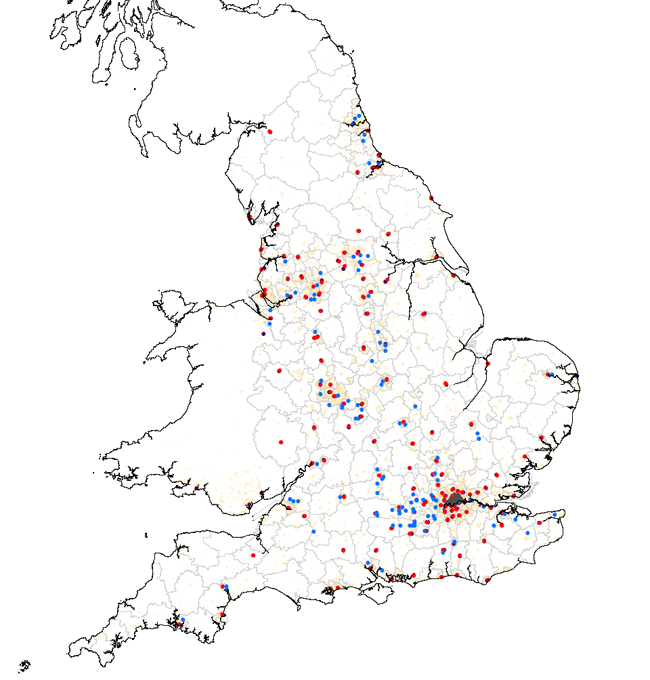
3 types of work-place
140 town centres
105 business parks
95 London wards
Notes:
354 LAs used as destinations
141 ATCAs used to define town centres: non-retail cores and > 40ha and work-place wards were selected if they contained a town centre polygon centroid
London treated separately: selected workplace wards if they were contained inside London town centre polygon (95 wards)
105 business park locations selected from businessparks.net and work-place wards selected if they contained a business park location point (mapped via postcode)

Slide 16
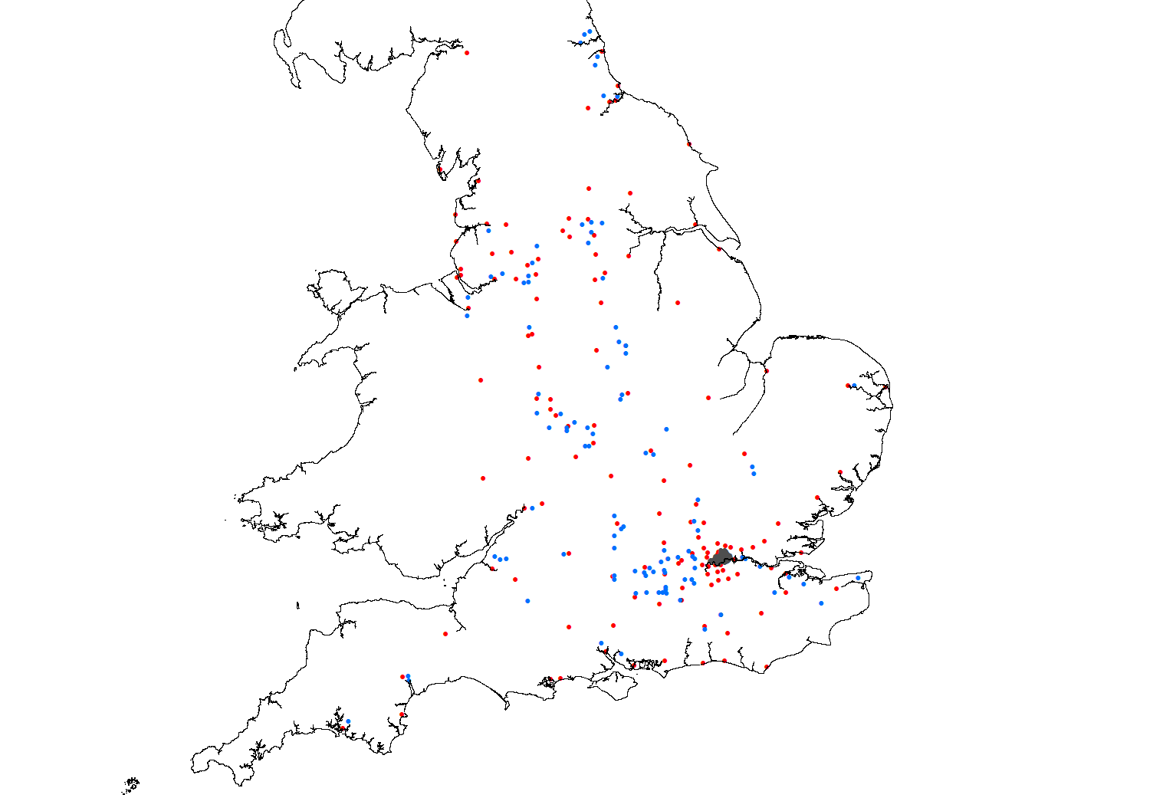

Slide 17
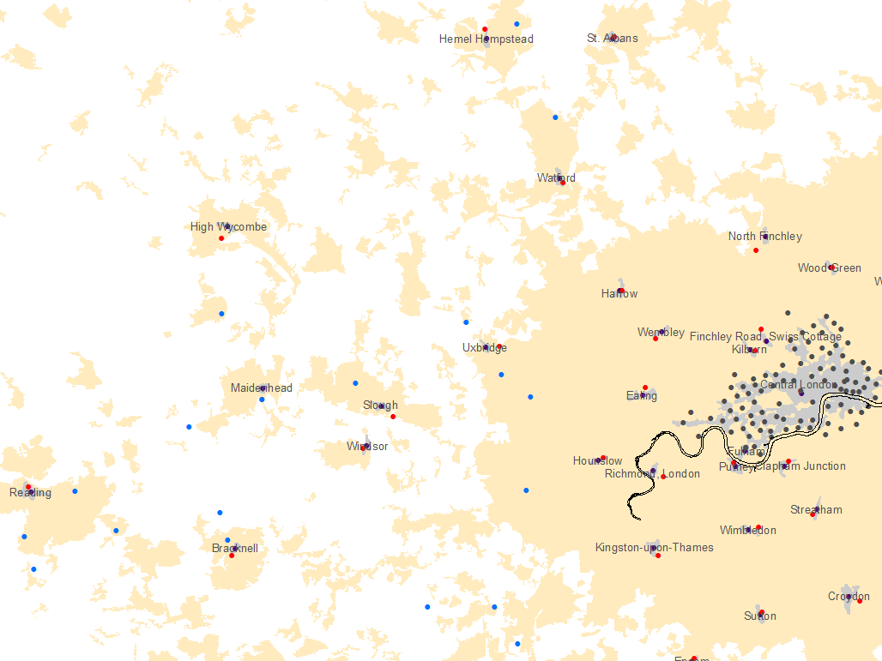

Slide 18
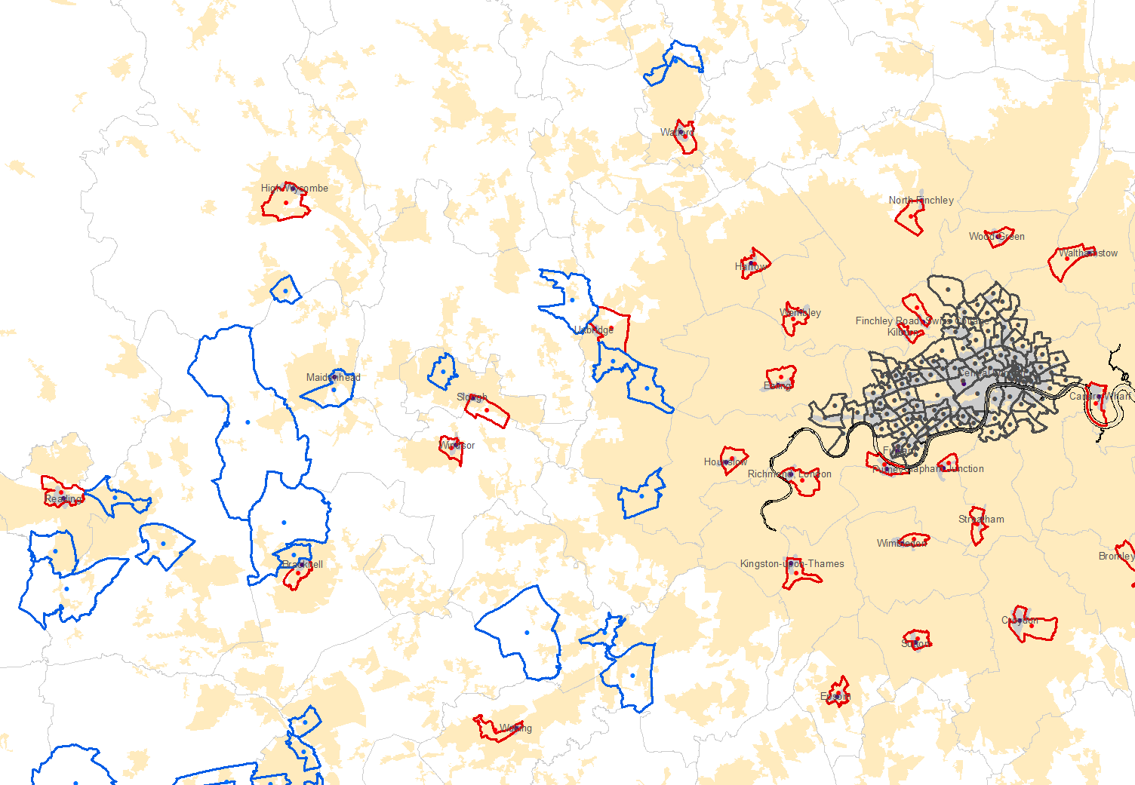

Slide 19
Transport CO₂ emissions by mode of travel (kgCO₂/km)
Source | Car driver (inc taxi) | Car Pass’r | Train | Motor-cycle | Walk/ bike | Bus | Under-ground
AEA (2009) | 0.20282 | 0.10141 | 0.07305 | 0.11606 | 0 | 0.10351 | 0.065
DfT (2009) | 0.1276-0.257 | 0.063-0.1288 | 0.0577 | - | 0 | 0.1035 | 0.0780

Slide 20
Work-place calculations
For each mode:
(a) Commuters
(b) Distance
(c) Commuter weighted distance

Slide 21
Short distance bias
Actual destination
Local authority area (origin)
a
b
Ward area (destination)

Slide 22
Commuters
 | Number |  |  | Percentage
 | Towns / Cities | Business Parks | London | Towns / Cities | Business Parks | London
Underground | 97,204 | 6,080 | 434,299 | 5% | 1% | 32%
Train | 156,043 | 15,312 | 469,843 | 8% | 2% | 34%
Bus | 272,844 | 47,506 | 104,991 | 14% | 7% | 8%
Taxi | 8,843 | 2,089 | 6,482 | 0% | 0% | 0%
Car | 1,002,598 | 465,685 | 183,532 | 52% | 72% | 13%
Car-pass | 109,676 | 37,236 | 14,000 | 6% | 6% | 1%
Motorbike | 22,937 | 7,973 | 27,170 | 1% | 1% | 2%
Bike | 52,987 | 15,023 | 31,973 | 3% | 2% | 2%
Walk | 162,139 | 26,107 | 66,316 | 8% | 4% | 5%
Home | 32,337 | 24,388 | 28,463 | 2% | 4% | 2%
Other | 7,027 | 1,619 | 4,458 | 0% | 0% | 0%
TOTAL | 1,924,635 | 649,018 | 1,371,527 | 100% | 100% | 100%

Slide 23
Distance travelled (km)
 | Distance |  |  | Percentage
 | Towns / Cities | Business Parks | London | Towns / Cities | Business Parks | London
Underground | 2,552,898 | 223,868 | 10,788,342 | 4% | 1% | 18%
Train | 8,881,222 | 931,210 | 32,172,364 | 14% | 4% | 54%
Bus | 5,311,812 | 942,550 | 2,409,372 | 8% | 4% | 4%
Taxi | 171,010 | 62,602 | 145,110 | 0% | 0% | 0%
Car | 37,885,672 | 20,286,370 | 10,266,000 | 60% | 81% | 17%
Car-pass | 2,792,346 | 1,013,254 | 749,748 | 4% | 4% | 1%
Motorbike | 674,638 | 253,312 | 912,252 | 1% | 1% | 2%
Bike | 875,092 | 278,968 | 596,882 | 1% | 1% | 1%
Walk | 2,900,570 | 494,826 | 1,175,502 | 5% | 2% | 2%
Home | 279,124 | 332,072 | 115,830 | 0% | 1% | 0%
Other | 924,580 | 140,988 | 419,256 | 1% | 1% | 1%
TOTAL | 63,248,964 | 24,960,020 | 59,750,658 | 100% | 100% | 100%
Notes:
No. Commuters x dist travelled

Slide 24
Distance travelled / commuter (km)
 | Towns / Cities | Business Parks | London
Underground | 26 | 37 | 25
Train | 57 | 61 | 68
Bus | 19 | 20 | 23
Taxi | 19 | 30 | 22
Car | 38 | 44 | 56
Car-pass | 25 | 27 | 54
Motor-bike | 29 | 32 | 34
Bike | 17 | 19 | 19
Walk | 18 | 19 | 18
Home | 9 | 14 | 4
Other | 132 | 87 | 94
TOTAL | 33 | 38 | 44
Notes:
Round trip dist travelled per commuter

Slide 25
Annual emissions / commuter
Transport mode | CO₂ emission (kgCO₂/km) | Emission (kg CO₂/commuter/yr*)
 |  | Towns / Cities | Business Parks | London
Underground | 0.06500 | 393 | 550 | 371
Train | 0.07305 | 956 | 1,022 | 1,150
Bus | 0.10351 | 463 | 472 | 546
Taxi | 0.20282 | 902 | 1,398 | 1,044
Car | 0.20282 | 1,763 | 2,032 | 2,609
Car-pass | 0.10141 | 594 | 635 | 1,249
Motor-bike | 0.11606 | 785 | 848 | 896
Weighted average |  | 1,129 | 1,573 | 938
*assuming workers commute for 46 weeks per annum and five days per week
Notes:
Weighted ave is the emissions weighted by the proportion of commuters using each mode.

Slide 26
Results
Reveal the extent of the difference between transport-related CO₂ emitted by commuters to edge and out-of-town and city centre locations
Re-evaluation of the sustainability of out-of-town locations in view of their dominant contribution to CO₂ emissions caused by their generation of individual car movements
Increasing objections to out-of-town development and unrestrained vehicle use may influence demand for business park office space - locations that generate increased road traffic may fall out of favour

Slide 27
Further work
Output area level origins
Compare results with ‘travel-to-work areas’ (TTWAs)
Use network distances rather than straight lines
Try and control for occupation type
Investigate price impact?

