Slide 1
Effect of rent deregulation on tenure choice and homeownership rate in Czech Republic
Ing Petr Zemcik , Ph.D.
Ashot Tsharakyan , M.A., M.Sc.
ERES 2010 Annual Meeting

Slide 2
Rent regulation evolution in Czech Republic, recent deregulatory changes 1/3
Until the present day , existing rent regulation in Czech Republic applied to “old” tenancies represents first-generation non-targeted rent control
Permanent right of living in the apartments with low regulated rents was assigned in 1980s by means of so called Housing right , which cannot be canceled but can only be passed to family member
The Ministry of Finance bill from 1993 determined the maximum monthly rent per square meter based on category of the apartment and economically justified costs connected with building.
This bill also determined maximum coefficient of growth for regulated rent which was based on monthly growth of price index of construction work

Slide 3
Rent regulation evolution in Czech Republic, recent deregulatory changes 2/3
As a result shortage of rental housing on a free market (since regulated rent apartments represented around 1/5 of total housing stock ) and free market rent appreciation
Difference between regulated rents and free market rents of up to several hundred percentages
Public concern and discussion about how justified is the presence of two separate segments of rental market from the social perspective
In 2002 provision of government , prohibiting rise in the rents of the apartments regulated by maximum rents after three months from entering into force
In 2003 proposition of group of senators to Supreme Court to cancel the government’s decision about prohibition of rise in regulated rents

Slide 4
Rent regulation evolution in Czech Republic, recent deregulatory changes 3/3
In 2006 New Act of Unilateral Rent Increase was approved , which presupposes gradual increase of regulated rents and complete removal of regulation by year 2011
It defines target level of regulated rents which was based on basis housing prices published by Ministry of Local Development , which directy connected with market housing prices
The regulated rent is determined by the formula :
Maximum growth rate of regulated rent was determined for each year based on percentage difference between actual rent and target rent (NC)
Very important policy change because regulated rent growth became connected with housing price appreciation which accelerated considerably in Czech Republic since 2005

Slide 5
Potential deregulation effects on tenure choice of households
For households living in regulated rent apartments the rise in regulated rents represents clear stimulus to move and change their tenure choice from renting to owning , since renting is not as affordable as before
Rent deregulation also implies certain decrease in free market rent due to increased availability of rental housing . This can potentially make some younger households delay their first ownership of housing and start with renting
Decrease in rents can also induce some current owners to switch to renting

Slide 6
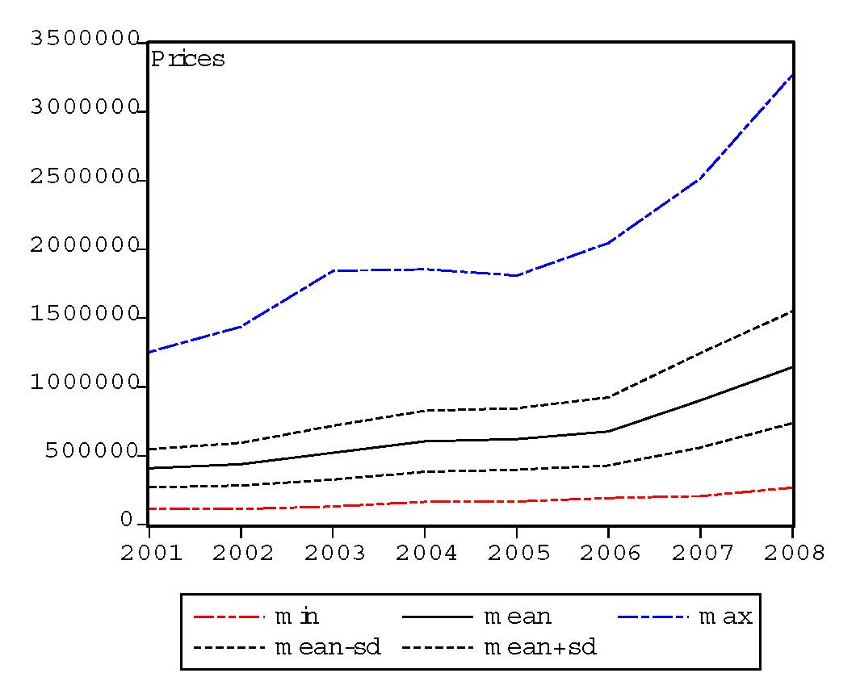
Market rent and housing price dynamics in Czech Republic 2/2
Petr Zemcik “Is There a Real Estate Bubble in the Czech Republic?”

Slide 7
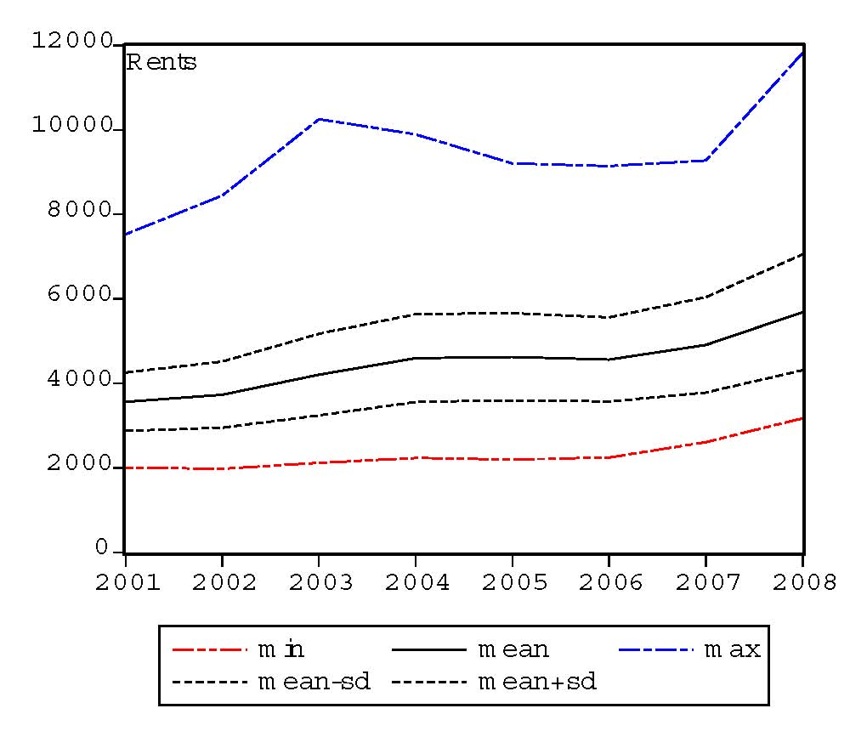
Market rent and housing price dynamics in Czech Republic 2/2
Petr Zemcik “Is There a Real Estate Bubble in the Czech Republic?”

Slide 8
Objectives of the research
Determine the effect of rent deregulation on tenure choice of non-regulated renters , regulated renters and owners
Determine the probability of owning for each of three groups separately using logistic regression
Based on results of the regression determine the effect of rise in regulated rents and eventual rent deregulation on homeownership rate in Czech Republic
Use present value model of renting vs owning decision and compare its prediction with results of logistic regression

Slide 9
Employed dataset and regression equations 1/3
The dataset used for estimations includes Czech Household Budget Survey for years 2001-2008
Each year’s survey includes 3400 households around 20 % of which are living in rented apartments regulated and non-regulated
Each year 25 % percent of the households in the dataset change . Thus ,for providing the adequate number of observations for each group, the data is divided into two year adjacent panels
The presented results include 2006-2007 and 2007-2008 panels

Slide 10
Employed dataset and regression equations 2/3
The performed regression is logistic regression.The dependent variable in all regressions is log of probability of owning in the next period ( t+1) . The dependent variables are from period t.
The regression equation for regulated renters has the form
The regression equation for free market renters has the form
The regression equation for owners has the form

Slide 11
Regression results : Non-regulated and regulated renters 1/2
 | c | Y | mpay | fs | Rentapr | tdum
2006-2007 regulated | -0.138 (0.045) | 0.221 (0.052) | -0.113 (0.023) | 0.092 (0.025) | 0.231 (0.071) | 0.086 (0.022)
2006-2007 non regulated | -0.162 (0.051) | 0.207 (0.071) | -0.124 (0.021) | 0.083 (0.034) | - | 0.103 (0.031)
2007-2008 regulated | -0.125 (0.032) | 0.232 (0.057) | -0.118 (0.025) | 0.104 (0.038) | 0.352 (0.102) | 0.064 (0.038)
2007-2008 non regulated | -0.145 (0.042) | 0.252 (0.062) | -0.138 (0.036) | 0.112 (0.024) | - | 0.075 (0.03)

Slide 12
Theoretical investigation of deregulation effects: present value model
Given that entire information about household demographics and income sources is available it is possible to calculate the maximum possible mortgage for each household that it can get
Given this , we are going to employ present value model of renting vs owning in both risk averse and risk neutral version to compute for each household after how many years owning becomes profitable than renting ( present value of cash flows from owning exceeds present value of cash flows from renting)
Then the prediction of the present value model can be compared with choice of the households according to actual data

Slide 13
Conclusion

