Slide 1
Real Estate Investment in British Provincial Cities: Too Much or Too Little?
Neil Dunse, Colin Jones and Michael White
Heriot-Watt University
Edinburgh
Research funded by Scottish Widows Investment Partnership

Slide 2
Introduction
Institutional investment in the UK is focused in London and the South East region.
The City of London office market exhibits the most variable returns of any local property market in the UK and hence is amongst the riskiest (Dunse et al, 2010).
The City of London has a strong inter-linkage between occupational and investment markets that means that its office market is vulnerable to exogenous cycles in financial services as well as the endogenous property market cycle (Lizieri, 2008).
This suggests there is a case for more investment in provincial cities not least because of the portfolio diversification benefits.

Slide 3
Spatial Diversification

Slide 4
Spatial Disaggregation
Byrne and Lee (2009, 2010) examine local authority level data and reveal even greater concentration of institutional investment within the 376 local authority districts in England and Wales.
Just over half and 84% of the value of retail and office investment respectively in only 30 local authorities (not necessarily same areas).
The authors report increasing spatial concentration of institutional investment in offices and shops between 1998 and 2003.

Slide 5
Property Grouping
Hoesli et al (1997) analyse the extent to which property returns can be grouped by area or by property type.
The analysis is based on the premise that if the urban area is appropriate for diversification, clusters of similar locations would be expected.
The research results are dominated by the importance of property type/sector as a diversifier rather than area.
Hamelink et al (2000) find that London office markets behave distinctly and there is a broad split between office and industrial markets in the immediate fringe of London and all other ‘peripheral’ markets.
But all major provincial city office markets are included in the same cluster suggesting limited diversification potential

Slide 6
Rents or Yields
A range of studies have drawn attention to the role of national capital markets in influencing local yields (capitalisation rates) and hence returns.
MacGregor and Schwann (2003) argue that this may occur because a London-based real estate perspective is imposed on peripheral regions.
Henneberry (1999) similarly concludes that imperfections in the property capital market are driven by national factors with local rent trends/cycles ignored.

Slide 7
Analysis
Cities are the focus of analysis rather than regions or local authority districts.
Spatial property markets are taken to be essentially urban as differences in the structures of local economies, and hence economic growth combined with variations in local supply responses lead to individual city rent trends (Jones and Orr, 1999; Orr and Jones, 2003).
National influences would be present in the form of monetary and fiscal policies, macroeconomic cycles.
Given the existence of local cycles/trends it is possible to postulate that there is scope for diversification.

Slide 8
Provincial Cities
Examining Birmingham, Edinburgh, Glasgow, Leeds, and Manchester
Analysis of each city in terms of:
Economic background (GDP, Employment, consumer spending)
Property market – rental growth
Identification of patterns of correlation, causation in movements in rental change across cities and sectors
Identification of direction of relationships – which cities/sectors lead/lag

Slide 9
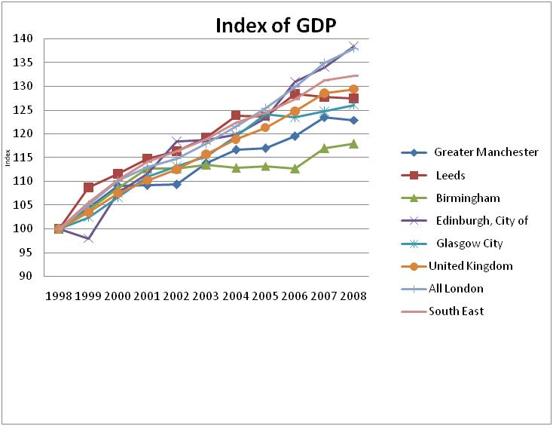
GDP

Slide 10
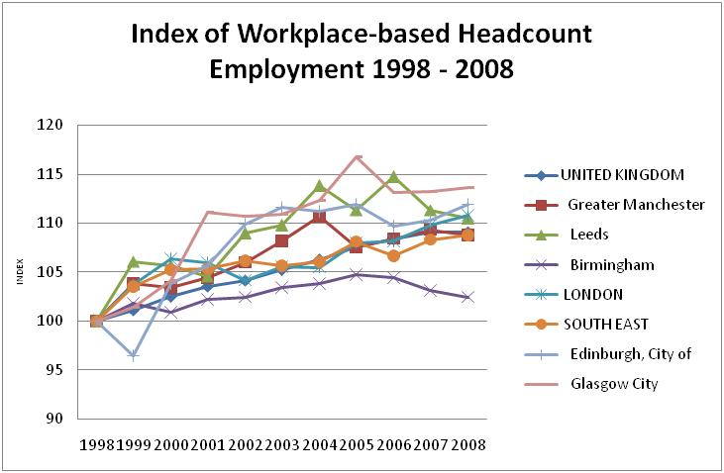
Employment

Slide 11
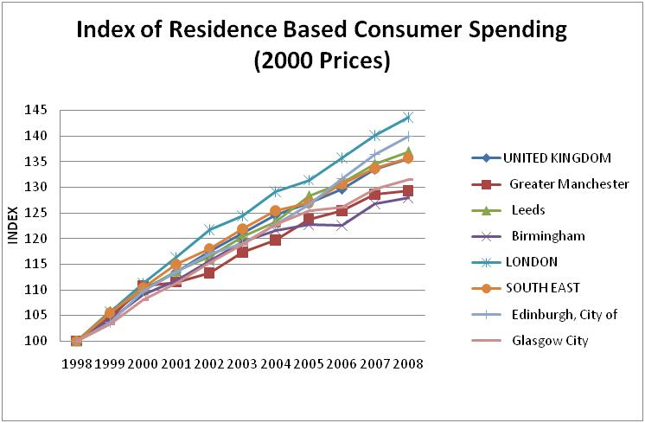
Consumer Spending

Slide 12
Means and Standard Deviations of Rental Growth 1981-2008

Slide 13
Correlation Analysis
Correlations over time across cities for rents
Most combinations of cities and sectors show statistically significant correlations except for:
between South East offices and Leeds offices
between South East offices and industrials in Birmingham, Edinburgh, Glasgow, Leeds, Manchester
South East retail had insignificant correlations with offices in Leeds and Manchester, and with industrials in Birmingham, Edinburgh, Glasgow, Leeds, Manchester, London

Slide 14
Direction of Causality
Granger-causality tests identify lagged relationships and assess the direction of such relationships across sectors and between cities over time
Where cj and sk are city j and sector k respectively
Run for all possible combinations of city and sector

Slide 15
Inter City and Inter Sector Comparisons

Slide 16
Overview
London, the South East and Edinburgh experienced faster term long term economic growth
Not translated into equivalent rental growth and returns because of the role of supply
In most sectors the highest average annual rental growth and returns occurred in provincial cities – with less volatility
Potential to diversify between regional cities
But is this happening to the extent justified by risk and expected return performance?

Slide 17
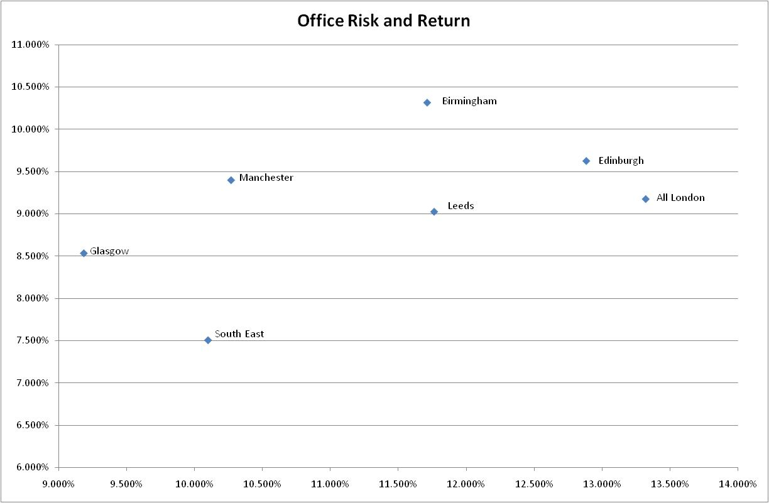
Risk and Return Plots: Offices

Slide 18
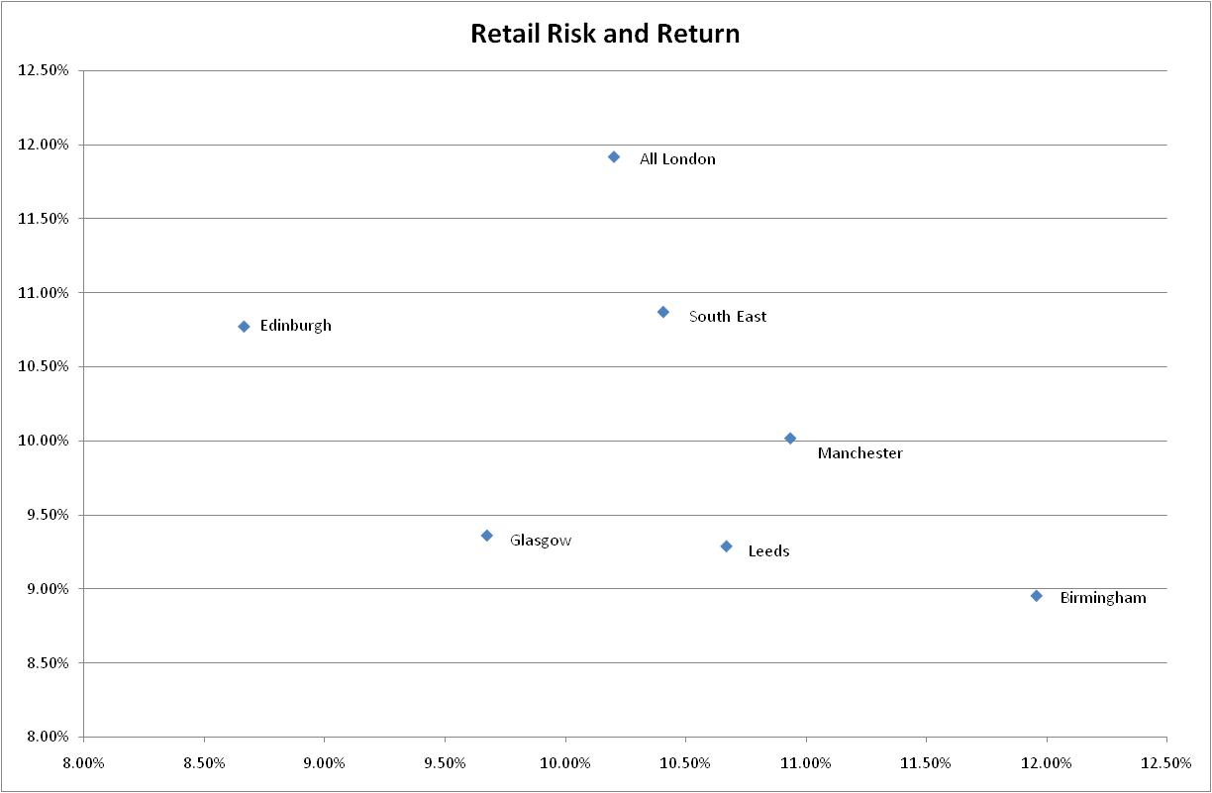
Risk and Return Plots: Retail

Slide 19
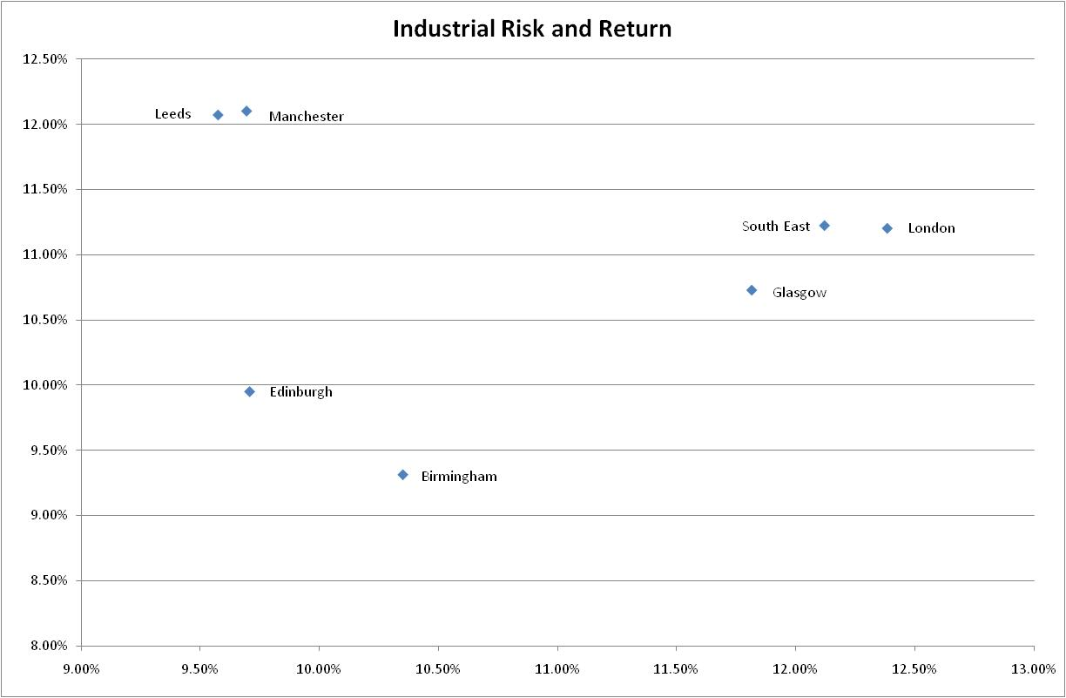
Risk and Return Plots: Industrial

Slide 20
ARCH Processes
Risk may be an inaccurate estimate of volatility particularly if they are correlated over time
An ARCH model can be written as an ARMA (p, q) process.
If there is volatility clustering the error variance is time-varying and can be written as a function of its lagged values

Slide 21
GARCH
A generalised autoregressive conditional heteroscedasticity (GARCH) model begins by estimating conditional variance from an ARMA model and then is specified as:
The coefficient α (commonly known as the ARCH effect) captures the tendency for the conditional variance to cluster while the γ (commonly known as the GARCH effect) captures the tendency for shocks to have a persistent influence on the conditional variance.
We test ARMA models and associated ARCH/GARCH models as appropriate for total returns, income returns and rents.

Slide 22
Testing for Volatility Clustering and Shock Persistence
ARCH processes are found only in Birmingham and the City of London.
While the GARCH process is not found for Birmingham, it is statistically significant in the City of London market implying that exogenous events and shocks will cause persistence in conditional volatility.

Slide 23
Conclusions
If trends in GDP, employment, and consumer spending continue after recession in the same way as they had before, London and Edinburgh might be expected to outperform the UK average.
However new supply in these locations may weaken rental growth and capital value increases.
Volatility clustering in both Birmingham and the City of London may affect investor behaviour.
The volatility of the market and local economic performance both impact on investment strategy.

