Slide 1
Compliance of RICS Code of Practice for Commercial Service Charges
ERES Conference 2010
Thursday, 24 June 2010
Nazali Noor
School of the Built Environment
Liverpool John Moores University
UK

Slide 2
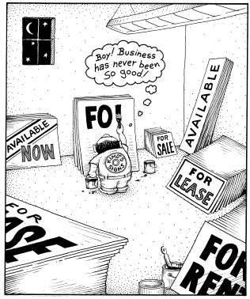
THE PRESENTATION FLOW
Overview on UK Commercial Service Charges
What is set in the Code?
What is achieved so far?
Conclusion

Slide 3
THE ISSUE WITH COMMERCIAL SERVICE CHARGES
Source: Calvert (2005

Slide 4
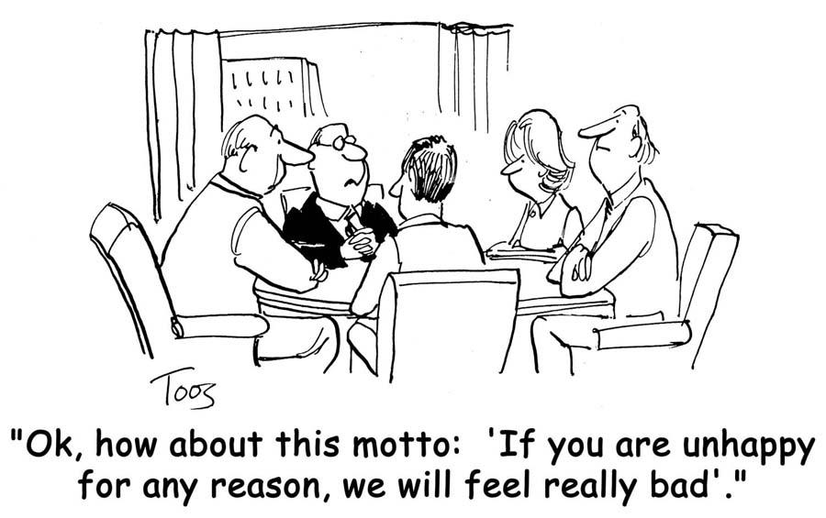
CONFUSION OVER SERVICE DEFINITION??

Slide 5
IDEAL SCENARIO
SERVICE
CHARGE
BUILDING
OWNERS
PROVIDES
FACILTIES
TENANTS
ENJOYS
FACILITIES
BUILDING
OWNER
TENANTS
Services Issues:
Service Variables
Quantity
Quality
Pricing/Charge
Delivery
Apportionment Basis
Services Issues:
Perception
Expectation
Value – Cost vs Value
Willingness
Quantity
Quality
Transperancy
Communication
BEST VALUE SERVICE
Not for profit, not for loss
Value for money

Slide 6
Key Facts on UK Commercial Service Charges
Annual value of commercial service charges (for offices alone) is estimated at £4.32 billion (Calvert et al., 2009)
UK commercial service charges are not governed by any legislation – strictly by interpretation of the lease (Noor ad Pitt, 2009)
Long outstanding issues – apportionment, value for money, management fees, transparency and administration are among the known areas of disputes (Noor and Pitt, 2009)

Slide 7
Proposed Solutions?
RICS code of practice for service charges in commercial property was introduced and come into force in April 2007
Almost 90 recommendations – divided under 6 main headings that are recognised as area of disputes
Management, Communication, Transparency, Service standards and provision, Administration and Additional Shopping Centre Services
Notes:
1.2 Research Questions
A.What is the most suitable FM definition for the Malaysian FM market?
Who are the FM stakeholders in the Malaysian FM market?
What is the level of understanding of the Malaysian FM stakeholders in regards to FM practices?
What is the current scenario of FM practice in Malaysia?
What is the perception of the FM stakeholders about FM in Malaysia?
What are the common issues and problems that surround the implementation of FM in Malaysia?
B. What is the perception of the Malaysian FM stakeholders about innovation in FM practices?
How do the Malaysian FM stakeholders perceive generic innovation in the practice of FM?
Is innovation management a critical element in the Malaysian FM practice?
What types of innovation management those are relevance to FM practice in Malaysia?
How FM innovation in the FM supply chain management is managed and implemented in the delivery of FM services in Malaysia?
C. Is ‘integrate to innovate’ (i2i) supply chain model applicable to deliver effective FM services for public office buildings in Malaysia?
What are the current practices of procuring and delivery of FM services for public office buildings in Malaysia?
How do FM service providers collaborate to assure effective delivery of FM services for public office buildings in Malaysia?
How do the FM service providers for public office buildings in Malaysia implement innovation strategies in their collaboration?
Is the application of ‘i2i’ supply chain model able to aid the FM providers to deliver FM services effectively to the occupiers of the public office buildings in Malaysia?

Slide 8
What is achieved so far?
Calvert et al (2009)

Slide 9
Other Calvert et al (2009)findings
-Reduction in standard cost headings from 2,394 (in 2006) to 2,094 (in 2008)
-However it is still way above the standard as set in the Code (maximum 22 headings)
No significant improvement achieved since it’s inception in 2006 and implemented in 2007
Positive signs of improvement but the pace is too slow. Way below the ‘best practice’ standards as set in the Code.
Self-regulatory enforcement for the Code is yet to get positive response from commercial property stakeholders.
Probably it is too early to gauge its performance (only 2 years from it was introduced)

Slide 10
Other findings
Service Charge budget and certification:
- Budget: Only 12% budget arrived one month earlier prior the financial period.
- Certificate: Only 24% arrived within the 4 months period as set by the Code.
- Shockingly even 6.5% arrived 20 months AFTER the financial year ended.
- 52.6% failed to comply the set 2% variance on budgeted vs. Actual service charge figures
Management Fees, Basis of Apportionment and Standard Cost Codes
- Only 16.2% complied to Code requirement of Flat Management Fee Structure
- Most of the certificate are still using the percentage fee method
- Reduction in percentage on compliance to basis of apportionment (only 62% in 2008 as against 79% in 2007)
-Very little progress on adhering the 22 cost headings for service charges
Interest and Service Charge Accounts
- 20.5% of service charge certificate shows interest credits (£7 million credited back out of £65 million potential interest payment).
- Lack of transparency in refunding the service charge interest.
- Calvert (2009) put up 3 recommendations;
a. To operate separate interest bearing accounts for all service charge payments
b. All interest received from this account to be credited to the service charge account
c. All costs of operating back accounts (i.e borrowing to fund the shortfall) are separately identified in the certificate

Slide 11
Occupier satisfaction of value for money gained from service charges
Source: adapted from Property Industry Alliance and Corenet Global UK (2009))
Source: adapted from Property Industry Alliance and Corenet Global UK (2009))
Source: adapted from Property Industry Alliance and Corenet Global UK (2009))
Source: adapted from Property Industry Alliance and Corenet Global UK (2009))
Source: adapted from Property Industry Alliance and Corenet Global UK (2009))
Source: Adapted from Property Industry Alliance and Corenet Global UK (2009) in UK Occupier Satisfaction Index 2009

Slide 12
Conclusion
Huge gap exists towards full compliance of RICS Code
Even though the are signs of positive progress but the speed of response are too slow.
Value for money, transparency, lack of communication, speed of response and lack of flexibility are still remain the critical issues in commercial service charges
It is only practical to assume that the base line as set by the code will significantly improved after 5 years of its inception.

