Slide 1
Judgemental Bias and Housing Choice
Peter Scott
University of Cambridge
June 2010

Slide 2
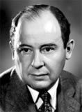
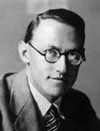
Examining biases in housing choice
1) Motivation
2) Judgemental Bias I: Asymmetric Dominance
3) Judgemental Bias II: Anchoring
New focus: housing choices
nature of biases
role of estate agents as choice architects
von Neumann
Morgenstern
Kahneman
Tversky

Slide 3
Motivation: understanding housing choice
1) Motivation
2) Judgemental Bias I: Asymmetric Dominance
3) Judgemental Bias II: Anchoring
Why study choice behaviour?
Foundation for microeconomic theory
Make better choices
Why housing?
High stakes
Unique context
I) limited experience
II) preference uncertainty
III) little feedback

Slide 4
Experimental study: two biases
1) Motivation
2) Judgemental Bias I: Asymmetric Dominance
3) Judgemental Bias II: Anchoring
Asymmetric dominance
Anchoring

Slide 5
Judgement Bias I: Asymmetric Dominance
1) Motivation
2) Judgemental Bias I: Asymmetric Dominance
3) Judgemental Bias II: Anchoring
Target
Decoy

Slide 6
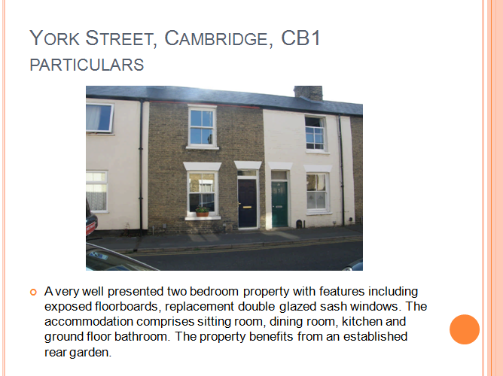
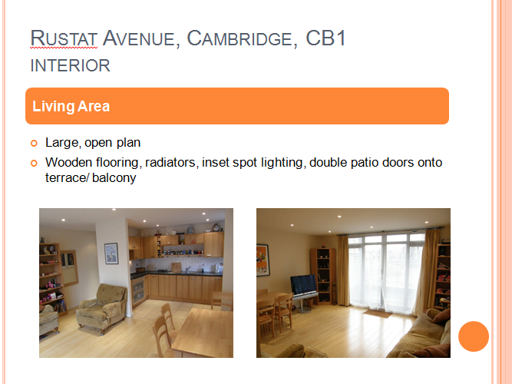
Methodology: economic experiment
1) Motivation
2) Judgemental Bias I: Asymmetric Dominance
3) Judgemental Bias II: Anchoring
Classroom setting with paid student volunteers
Paper-based
‘Visual’ version

Slide 7
Results: indicate evidence of choice bias
1) Motivation
2) Judgemental Bias I: Asymmetric Dominance
3) Judgemental Bias II: Anchoring
**significant at 1% level
Strong evidence of asymmetric dominance
“Choice pollution effect” in visual experiment
 | A | B | C | D | n
1a | 58 % | 42 % |  |  | 57
1b | 41 | 59** | 0 |  | 64
1c | 67 | 33 |  | 0 | 49
2a | 42 | 58 |  |  | 83
2b | 60** | 39 | 1 |  | 109

Slide 8
Results: ordering effects
1) Motivation
2) Judgemental Bias I: Asymmetric Dominance
3) Judgemental Bias II: Anchoring
**significant at 5% level * significant at the 10% level
Ordering effects potentially important
 | A | B | C | D | n
{A, B, C} | 46 % | 54 % | 0 % |  | 39
{C, B, A} | 32** | 68 | 0 |  | 25
{A, B, D} | 75 | 25 |  | 0 | 24
{D, B, A} | 60* | 40 |  | 0 | 25

Slide 9
Anchoring: a further potential source of judgement bias
1) Motivation
2) Judgemental Bias I: Asymmetric Dominance
3) Judgemental Bias II: Anchoring
Taking cognitive “short cuts” leads to biased judgements
Ariely, Loewenstein and Prelec (2003)
Anchoring in the housing context
Experiment: value judgements over housing
Incentive structure
Anchor

Slide 10
Anchoring is present in value judgements
1) Motivation
2) Judgemental Bias I: Asymmetric Dominance
3) Judgemental Bias II: Anchoring
Estimate £000s
Anchor Bucket
Anchor Bucket

Slide 11
Conclusion
1) Motivation
2) Judgemental Bias I: Asymmetric Dominance
3) Judgemental Bias II: Anchoring
Broadening the scope of research into consumer decision-making
participant group: first-time buyers?
Results
Asymmetric dominance
Anchoring
Ordering
Future research
Thank you!

