Slide 1
THE RELEVANCE OF REAL ESTATE MARKET TRENDS FOR INVESTMENT PROPERTY FUNDS ASSET ALLOCATION: EVIDENCE FROM FRANCE,GERMANY ITALY AND UK
Gianluca Mattarocci
University of Rome “Tor Vergata” – School of Economics
Lecturer of Economics and Management of Financial Intermediaries
Georgios Siligardos
University of Rome “Tor Vergata” – School of Economics
PhD candidate in Banking and Finance

Slide 2
CONTENTS
Introduction
Literature Review
Empirical Analysis
Sample
Methodology
Results
Conclusions and Implications
Real Estate Trends
Property Funds
Optimal Asset Allocation

Slide 3
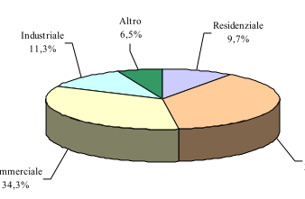
Introduction (1/2)
An increasing number of real estate portfolio managers, manage several property classes because they recognize the benefits of an intra-asset diversification. From surveys emerge that almost 89% of institutional investors diversify by property type (Louargand, 1992).
The trends identified in the real estate market are influenced by business cycles (local, regional, national and international); socio-economic factors and levels of inflation and interest rates (McGreal, 2005).

Slide 4
Introduction (2/2)
Investors and portfolio managers have recognized the critical importance of real estate cycles, their pervasive and dynamic impacts on investment returns and risks, and their strategic implications for project and portfolio decisions (Pyhrr, 1999).
The aim of the paper is to compare the optimal portfolio asset allocation with the real strategy adopted by fund managers in order to evaluate the advantages/losses related to a detailed analysis of the real estate asset market trends.

Slide 5
Literature Review (1/3)
The literature is divided primary in two subcategories;
The first part investigates the construction and evaluation of long series regarding the performance of the sector and how it can be achieved an optimized asset allocation by taking them under consideration.
The second part is oriented to management strategies and portfolio diversification issues within real estate sector.

Slide 6
Literature Review (2/3)
Mueller and Laposa (1994) investigated the cyclical movements of fifty-two office markets in the U.S. By examining average vacancy and deviations from this average as an indication of market risk or volatility, they classified and captured the nature of cyclical risk inherent in these markets. They found that there were cycle differences between markets and that by examining the duration, amplitude and timing of the market cycle.
Gallo et al. (2000) examined the asset allocation decisions of REMFs and find that the allocation of fund assets across the property-types explains most of the abnormal performance.

Slide 7
Literature Review (3/3)
Lee and Byrne (1998) discussed the importance of property type in constructing property only portfolios. They compared a range of efficient frontiers based on sectors, super regions, administrative regions, and functional groups
Morrell in 1994 underlined the critical role of a performance index in the definition of objectives and suggested to pay particular care when defining the investment objectives of a property portfolio given the long-term nature of the asset class and the relative inability of a fund manager to make significant changes to portfolio composition in the short term.

Slide 8
Sample Description
The sample comprises data regarding the yearly portfolio composition for an extended number of funds for each country and the trends in each sector of the real estate market.
Funds Sample
Main Sources : “Assogestioni”,“Scenari Immobiliari”, “Institut de l'Epargne Immobilière et Foncière”(IEIF), Info promoted by funds

Slide 9
Sample Description
Italian market: the sample for year 2008 is composed by 45 funds against the almost 180 activated in the same year, a number that is decreasing evidently by going towards to years 2000. The total assets owned by the funds under consideration amount at nearly 15bln € for the latest year of our interval.
French market: a number of almost 90 funds have been enquired out of 140 operating in 2008. The sample gathers assets of approximately 16bln euro, almost the 90% of the total property fund market in France.
Uk market: a mean number of 30 property funds per year have been investigated, collecting the data mostly in singular way by the information promoted for each fund; the pooled property funds operating in year 2008 were nearly 65 collecting assets of 32bln euro.
Germany market: almost 40 open ended property funds completed the sample. In Germany are operating almost 45 open ended funds managing assets of circa 83bln euro.

Slide 10
Sample Description
For the second part of our sample, regarding the real estate performance indices, we made use of different type of property indices provided by the International Property Databank (IPD).
The indices utilized measure total returns for all directly held real estate assets (All Property) and for the four main market sectors - retail, office, industrial and residential
Time Interval 1998-2008
Observation Frequency : yearly

Slide 11
Empirical Analysis
Methodology
The analysis considers first of all the asset allocation of the real estate funds and compare the weight assigned to each type of asset (office, retail, industrial, residential and other) with the real estate trend.
The analysis is released using a standard pairwise correlation measure and a F test for the significance of the relationship

Slide 12
Empirical Analysis
Methodology
After analysing the overall sample, we classify each fund on the basis of its asset allocation respect to a benchmark constructed on the basis of the standard mean variance Markowitz approach.
Looking at the portfolio composition, a standard distance measure is computed comparing each fund with all efficient ones.
All funds are classified for the percentile of the distance measure and for each percentile a correlation measure is computed

Slide 13
Results
Normal Correlation Results between the single weights and the index per sector for each country ( lagged of 0,1,2 years)
Corr t |  |  |  |  | Corr t-1 |  | GERMANY |  |  | Corr t-2
Office | Retail | Industrial | Residential | Other | Office | Retail | Industrial | Residential | Other | Office | Retail | Industrial | Residential | Other
0.570602 | 0.637541 | 0.48401 | 0.620276 | 0.612496 | 0.570602 | 0.663251 | 0.574537 | 0.623295 | 0.546415 | 0.570602 | 0.612885 | 0.555909 | 0.576188 | 0.578352
Corr t |  |  |  |  | Corr t-1 |  | FRANCE |  |  | Corr t-2
Office | Retail | Industrial | Residential | Other | Office | Retail | Industrial | Residential | Other | Office | Retail | Industrial | Residential | Other
-0.0213 | -0.1273 | -0.2455 | -0.17665 | -0.33194 | -0.0213 | -0.13204 | -0.22866 | -0.12041 | -0.33273 | -0.0213 | -0.1431 | -0.23479 | -0.10349 | -0.33505
Corr t |  |  |  |  | Corr t-1 |  | UNITED KINGDOM |  |  | Corr t-2
Office | Retail | Industrial | Residential | Other | Office | Retail | Industrial | Residential | Other | Office | Retail | Industrial | Residential | Other
0.567467 | 0.512353 | 0.544073 | - | 0.6516 | 0.567467 | 0.696884 | 0.698237 | - | 0.545387 | 0.594462 | 0.745181 | 0.715725 | - | 0.507099
Corr t |  |  |  |  | Corr t-1 |  | ITALY |  |  | Corr t-2
Office | Retail | Industrial | Residential | Other | Office | Retail | Industrial | Residential | Other | Office | Retail | Industrial | Residential | Other
0.20733 | 0.348759 | -0.91205 | 0.383546 | -0.25529 | 0.148394 | 0.330159 | -0.93205 | 0.375566 | -0.31702 | 0.116865 | 0.313558 | -0.91201 | 0.564636 | -0.52973
The France and Italy are the countries in which the funds management is less interested in the current and past performance of the market
German funds are more sensible to the signs of market and in UK the attention is given prevalently to the retail sector dynamics
F- statistics show that for almost all the markets the relationship are not statistically significant

Slide 14
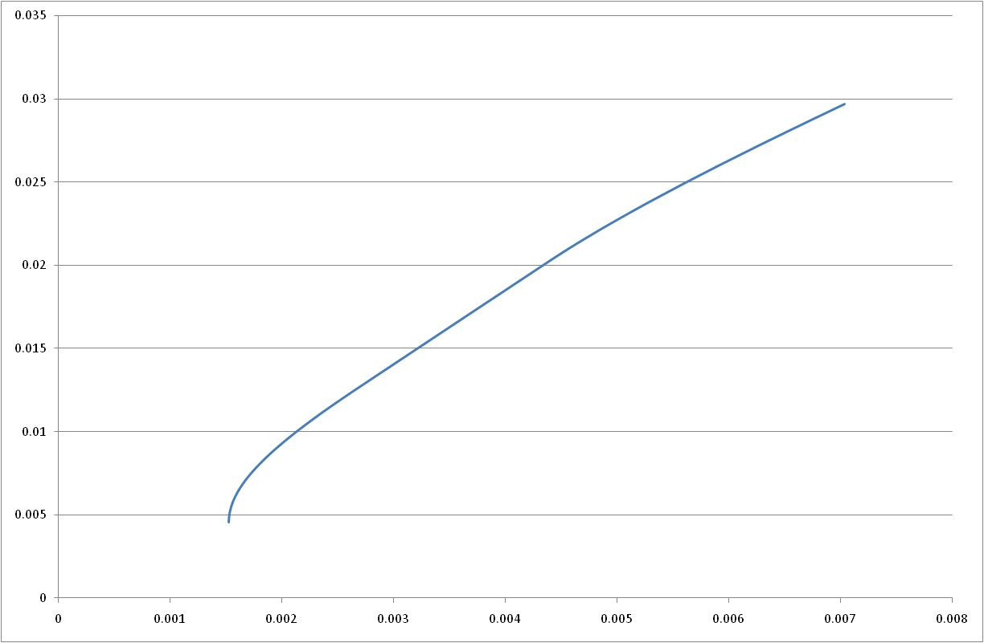
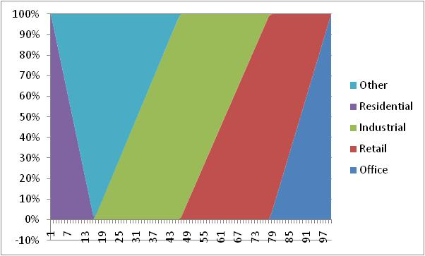
Results
Efficient Frontiers
1 efficient frontier for each country for each year (9 years x 4 countries) on IPD indices
Sample of analysis released for each year
Procedure
Construction of the efficient frontier for each market and for each year
Analysis of the portofolio composition of 100 portfolios in each frontier
Comparison of the real asset allocation and all theoretical ones

Slide 15
Results
Distance Percentiles
For each fund in each market we compute the difference of the real asset allocation respect to the theoretical ones (all portfolios in the frontier) and we take the minimum distance obtained in order to classify funds in percentiles
Germany
10% | 0
20% | 0
30% | 0
40% | 0.006813
50% | 0.062929
60% | 0.069468
70% | 0.079942
80% | 0.084672
90% | 0.094109
100% | 0.297014
France
10% | 0.044156
20% | 0.091997
30% | 0.152823
40% | 0.243308
50% | 0.351374
60% | 0.46259
70% | 0.589026
80% | 0.674432
90% | 0.765252
100% | 1
U | K
10% | 4.546815
20% | 5.089062
30% | 5.319275
40% | 5.386653
50% | 5.48164
60% | 5.763348
70% | 5.996893
80% | 6.356358
90% | 11.40903
100% | 12.25368
Italy
10% | 0
20% | 0
30% | 0
40% | 0.04558
50% | 0.087158
60% | 0.146093
70% | 0.241011
80% | 0.335629
90% | 0.501576
100% | 0.615898
The UK market is the one in which there are more misallinegment between the theoretical asset allocation and the real one (problem of data)
The German asset manager seem to adopt a more Markowitz approach in order to construct their portfolios

Slide 16
Results
Correlation Between percentiles from 1 to 10
 |  |  | GERMANY
 | Office | Retail | Industrial | Residential | Other
0% | - | - | - | - | 0.793092
10% | - | - | - | - | 0.793092
20% | - | - | - | - | 0.793092
30% | - | - | - | - | 0.793092
40% | 0.547723 | 0.618895 | 0.514053 | 0.621463 | 0.728361
50% | 0.547723 | 0.618895 | 0.514053 | 0.621463 | 0.691884
60% | 0.547723 | 0.618895 | 0.514053 | 0.621463 | 0.658473
80% | 0.547723 | 0.618895 | 0.514053 | 0.621463 | 0.631403
90% | 0.547723 | 0.618895 | 0.514053 | 0.621463 | 0.610746
100% | 0.570602 | 0.637541 | 0.48401 | 0.620276 | 0.612496
 |  |  | UK
 | Office | Retail | Industrial | Residential | Other
0% | 0.502079 | 0.487209 | 0.515282 | - | 0.68944
10% | 0.524901 | 0.470466 | 0.505455 | - | 0.67846
20% | 0.548437 | 0.497835 | 0.534696 | - | 0.643423
30% | 0.548307 | 0.489814 | 0.527593 | - | 0.645532
40% | 0.557267 | 0.508095 | 0.545485 | - | 0.653243
50% | 0.565567 | 0.516938 | 0.554838 | - | 0.634902
60% | 0.563584 | 0.509915 | 0.548259 | - | 0.646794
80% | 0.561998 | 0.504295 | 0.542996 | - | 0.660138
90% | 0.570159 | 0.520348 | 0.550679 | - | 0.649726
100% | 0.568289 | 0.514796 | 0.546091 | - | 0.652209
We released a percentile correlation in order to point out if the portfolios near the frontiers are more sensible to the market trends-
For Germany and UK there are not founded relevant differences between the first percentiles and the last ones.

Slide 17
Results
Correlation Between percentiles from 1 to 10
 |  |  | ITALY
 | Office | Retail | Industry | Residential | Other
0% | 0.119159 | 0.339611 | - | 0.663085 | -0.03554
10% | 0.119159 | 0.339611 | - | 0.663085 | -0.03554
20% | 0.119159 | 0.339611 | - | 0.663085 | -0.03554
30% | 0.119353 | 0.375101 | - | 0.663085 | -0.03554
40% | 0.267819 | 0.221558 | -0.91205 | 0.663085 | -0.25529
50% | 0.401628 | 0.270231 | -0.91205 | 0.663085 | -0.25529
60% | 0.292517 | 0.303047 | -0.91205 | 0.663085 | -0.25529
80% | 0.298259 | 0.316041 | -0.91205 | 0.225323 | -0.25529
90% | 0.155961 | 0.298296 | -0.91205 | 0.36991 | -0.25529
100% | 0.20733 | 0.348759 | -0.91205 | 0.383546 | -0.25529
 |  | FRANCE
Office | Retail | Industrial | Residential | Other
-0.13556 | 0.044932 | -0.59398 | - | -0.21631
-0.54772 | 0.556772 | -0.46306 | - | -
-0.43188 | -0.11317 | -0.64184 | -0.42497 | -0.39512
-0.32761 | -0.0717 | -0.45282 | -0.62526 | -0.4312
-0.23325 | -0.12199 | -0.33641 | -0.62526 | -0.35029
-0.10855 | -0.13397 | -0.21306 | -0.22808 | -0.3162
-0.02049 | -0.11391 | -0.28979 | -0.17665 | -0.35737
-0.0213 | -0.1273 | -0.2455 | -0.17665 | -0.33194
-0.0213 | -0.1273 | -0.2455 | -0.17665 | -0.33194
-0.0213 | -0.1273 | -0.2455 | -0.17665 | -0.33194
For France and Italy, the funds asset allocation near the efficient frontiers is less sensible than those with wider distance.

Slide 18
Conclusions and Implications
The fund asset management in generally is not sensible to the market trends.
The efficient frontiers based on performance indices are not alligned to the effective fund asset allocation.
The results are quite similar for all the four countries of our sample.
The next steps attains the possibility to extend the observation time period and to collect some data that are currently missing (especially UK funds).
The inclusion of the funds’ performance as a parameter for the effectiveness in asset allocation.

Slide 19
Contacts
Gianluca Mattarocci
tel. +39-0672595911
e-mail: gianluca.mattarocci@uniroma2.it
Georgios Siligardos
tel. +39-0672595653
e-mail: georgios.siligardos@uniroma2.it

