Slide 1
EARLY STAGE OF INFRASTRUCTURE REITs: TURKEY EXPERIENCE AT LEGISLATIVE LEVEL
17th ERES Conference
23 – 26 June
Milan, Italy
Dilek PEKDEMIR
DTZ Pamir & Soyuer
Istanbul, Turkey

Slide 2
Agenda
Introduction
Infrastructure investment
Defination, categories
Public vs private investment
The Global experience: Infrastructure REITs
Japan : J-REITs
U.S.A : Expansion of rulling process in the REIT legislation
Infrastructure investments in Turkey
Infrastructure investments
Financing methods: privatization vs. PPPs
Turkish IREIC legislation
Outlook

Slide 3
Introduction
Global interest in infrastructure investments is growing rapidly, driven by;
not only investor demand,
but also the increasing need for governments to find alternative sources to fund new infrastructure projects and repair existing infrastructure.
One of the attractive alternative asset classes for institutional investors, searching for higher-yielding and stable investments
An increasing number of vehicles such as, direct investments, unlisted infrastructure funds, listed infrastructure funds, and unlisted infrastructure securities funds, focussing on assets such as toll roads, pipelines and utility assets

Slide 4
Definition of infrastructure
Introduction
The basic facilities, services, and installations needed for the functioning of a community or society, such as transportation and communications systems, water and power lines, and public institutions including schools, post offices, and prisons (American Heritage Dictionary).
The basic physical and organizational structures (e.g. buildings, roads, power supplies) needed for the operation of a society or enterprise (Oxford English Dictionary).
The physical structures and networks used to provide essential services to society

Slide 5
Infrastructure Investment
Infrastructure categories
Privatization
PPPs
PFIs

Slide 6
Infrastructure Investment
Public vs. Private investments
Traditionally governments have facilitated infrastructure investments, however this is becoming increasingly challenging (population growth, economic growth, competition, development costs, etc.)
The growing need for infrastructure investment and the budgetary pressures will force the governments to explore alternatives
An important role for the private sector to play in funding the development of these essential services.

Slide 7
Infrastructure Investment
Growing global infrastructure investments

Slide 8
Infrastructure Investment
Private investment opportunities

Slide 9
Infrastructure Investment
Governments will have to continue playing a major role in infrastructure investment globally,
But if they want to attract significant private investment, must create the right conditions, stable regulation and frameworks to improve reliability and establish standards.
Infrastructure investment in Europe and worldwide is becoming a challenging process for governments and private investors.
A wide range of institutional investors has unprecedented opportunities to invest in infrastructure worldwide through multiple channels.

Slide 10
Infrastructure REITs
Global experience
Infrastructure financed largely by governments, the demand for new infrastructure means the private sector investment will also be required.
Traditional project financing through bank debt is being overtaken by capital market financing solutions like infrastructure funds (US, Australia, India, Brazil, China)
Public-Private-Partnerships (PPPs) are popular in Canada, Australia and also Europe, to help the private sector keep up with infrastructure needs.
The recent arguments about new infrastructure financing source address that REITs may be an alternative method

Slide 11
Infrastructure REITs: Global Experience
Japan : J-REITs
In Japan, the first infrastructure REIT, the Industrial and Infrastructure Fund, Investment Corporation (IIF) was launched in 2007, under the Investment Trust Law.
IIF is the first J-REIT focused on acquiring and operating both industrial and infrastructure properties in Japan
As end of first quarter of 2010, three of ten properties in the IIF portfolio are infrastructure facilities
Transportation (Haneda Airport Maintenance Centre)
Telecom (Shinsuna Data Centre)
Energy (Kobe District Heating and Cooling Centre)

Slide 12
Infrastructure REITs: Global Experience
The U.S.
In 2007, Internal Revenue Service (IRS) determined that an infrastructure system qualified as a "real estate asset" (Ltr. Rul. 200725015).
The expansion of the definition of real property may allow REITs to hold many types of infrastructure assets that have not previously been considered suitable, particularly the case in the electrical transmission and distribution
Many hurdles must be overcome to make infrastructure REITs a reality, such as expanding current REIT law.
REIT structure would address some of the concerns and opposition related to privatization

Slide 13
Infrastructure Investments in Turkey
Traditionally, infrastructure investments have been financed by public sector
The contribution of private sector in infrastructure investments has been growing
Total investment value in infrastructure in 2009:
EUR 7.7 billion by public sector
EUR 15.3 billion by private sector

Slide 14
Infrastructure Investments in Turkey
Infrastructure investment financing :
Until 1980s, infrastructure investments have been financed by public sources
budget, foreign loan, bond issue
Like many fast-growing countries, Turkey faces a challenge in finding enough capital for infrastructure developments.
Privatization
PPPs

Slide 15
Infrastructure Investments in Turkey
Infrastructure investment financing :

Slide 16
Infrastructure Investments in Turkey
Privatization
Privatization Law No. 4046, dated 1994
Transfer of the operational rights of administrations with national and supplemental budgets and their properties, (dams, lagoons, highways, hospitals, ports, etc.)
Between 1984 – 2008, total gross revenues from privatization of infrastructure properties exceed USD 9.5 billion
public offering or block sale methods
Approximately 25% of total privatization revenues
The major privatization implementations; State Railway ports, Turkish Telecom, gas and electricity distribution companies.

Slide 17
Infrastructure Investments in Turkey
PPPs in Turkey
Turkey is one of the first countries in the world which developed its own PPP legislation.
The private sector involvement specifically in to power plants projects was allowed in 1984 (Law No: 3096).
Paralel to UK “PFI-Private Finance Initiative” in 1992, a general law for BOT has enacted in 1994 in Turkey, for different infrastructure areas like transportation, energy and water supply and treatment.
On this legal basis, first implementations of PPP projects in Turkey came on agenda and several projects, mainly for electricity production, drinking water facilities
Built – Operate – Transfer (BOT), later Built – Operate (BO)

Slide 18
Infrastructure Investments in Turkey
PPPs in Turkey : Legal framework

Slide 19
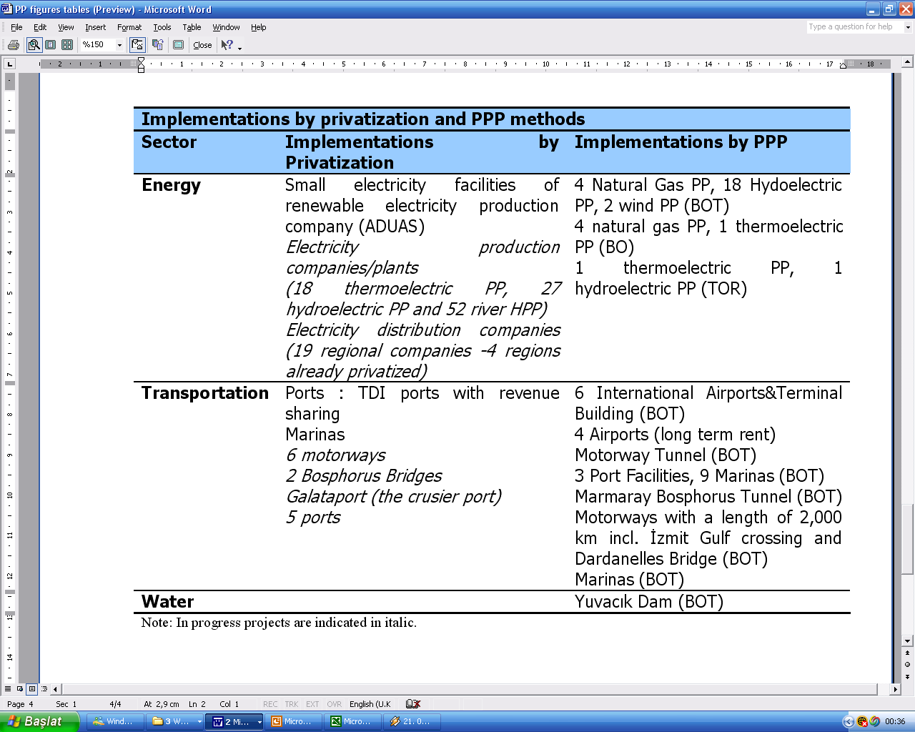
Infrastructure Investments in Turkey
Privatization vs PPPs implementations

Slide 20
Infrastructure Investments in Turkey
Infrastructure Real Estate Investment Companies
The Capital Markets Board of Turkey (CMB) published the Communiqué regarding Infrastructure Real Estate Investment Company ("IREIC") on 29 January 2009
Provide extensive rules for requirements to establish an IREIC, regulate operation of the IREIC, establishment methods, organization structures, clarification the public, knowledge of the investors.

Slide 21
Infrastructure Investments in Turkey
IREICs : definition of infrastructure investments and services
Agriculture, irrigation, mining, manufacturing, energy, transportation, communication, information technologies, tourism, residential, cultural, urban and rural infrastructure, municipality services, urban regeneration, environment, research & development services, education, health, justice, security and general administration infrastructure investments and services which are operated by public administration, local government, social and security foundations and government business enterprises

Slide 22
Infrastructure Investments in Turkey
IREICs : investment terms & capabilities
A certain period to invest in a specific project, an indefinite period or operate in a specific business segment
The IREIC investment capability includes investments to;
infrastructure projects or services, projects, other REICs, infrastructure projects receivables backed securities, operating companies and other securities deemed eligible by CMB which have to be above %75 of the total portfolio value.

Slide 23
Outlook
The Turkish government is looking to foreign and Turkish investors to play more of a role in infrastructure financing, development, operation and ownership to meet growing need for infrastructure capital
Privatization of the state-owned Turkish utility industry is still on the government’s agenda, especially energy and transportation facilities
In order to accelerate and extend the implementations of the PPP models, the government intents to establish a new legal and administrative framework for so called “Second Generation of the PPP Projects”.
IREICs should be an alternative method to develop or finance infrastructure facilities

Slide 24
Outlook
The legal and regulatory framework will encourage the emergence of fresh sources of capital and new business models for the construction, maintenance and operation of infrastructure.
As a capital market instrument, IREICs will help to securitization. The control mechanism on IREICs will provide transparency in the market.
Advantage for international investors
provide a solution to ownership problem
offers an effective corporate income tax burden of zero
Although no IREIC has not been established yet, the new framework can be considering as an embryonic stage for infrastructure REITs in Turkey.

Slide 25
THANK YOU !!!!
For further information;
Dilek Pekdemir, pekdemird@dtz.com.tr
Hakkı Yeten C., No:12/7, 34365, Şişli/İstanbul, TURKEY
Phone: +90 (212) 231 5530 ext.126

