Slide 1
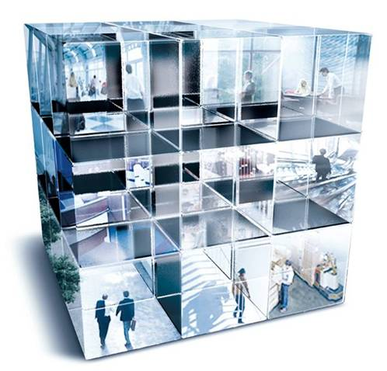
23-26.06.2010
17th Annual ERES Conference
www.reag-aa.com

Slide 2
Government Policy & Regulation in the Real Estate Sector
LIBERALISATION OF RETAIL TRADE IN MILAN’S NEW MASTER PLAN
Savino Natalicchio, MRICS
PhD Town Planning
Head of Retail Division - REAG S.p.A.
23-26.06.2010
17th Annual ERES Conference
Milan, Italy

Slide 3
INDEX
1. Introduction: the new P.G.T. [Piano di Governo del Territorio - Local Urban Planning Scheme]
2. Geography of Retail Units in Milan: Historical Evolution
3. The P.G.T. Strategies for Retail Planning
4. Accessibility
5. Land-use Liberalisation and 'Urban Mix'
6. Conclusion: Location Criteria for Commercial Services

Slide 4
1. Introduction: the new P.G.T. [Piano di Governo del Territorio - Local Urban Planning Scheme]
Contents of P.G.T.
According to Lombardy Region Law nr 12 dated 11th March, 2005, the P.G.T. consists of three acts:
the Strategic Development Plan [Documento di Piano], which indicates the strategies and general objectives of the local government town-planning policies;
the Regulations [Piano delle Regole], which govern the regeneration of the consolidated fabric of the city;
the Service Planning Scheme [Piano dei Servizi], which determines the urban facilities and services needed.
Approval discussion
P.G.T. represents the most important Administrative Act on a local level
it will replace the old Land-Use Plan [P.R.G.] after thirty years.
Early in 2010, Milan's Council started discussing about the possibility to adopt the new P.G.T.
Such discussion is supposed to be concluded within the summer, when the P.G.T. will be adopted.
Innovations: Retail Units and Liberalisation
As a matter of fact, Milan is one of the first cities in Italy to fully implement the National Law concerning
the Liberalisation of Retail Business (Legislative Decree nr 114/1998, Law nr 248 dated August 4th, 2006),
according to which the presence of retail premises can be allowed exclusively under town planning
compatibility principles, and no longer in relation to market share objectives or to the distance between stores.

Slide 5
2. Geography of Retail Units in Milan: Historical Evolution
Before the mid Nineties
Before analyzing the innovations brought by the P.G.T., it is necessary to explain the evolution
of the Geography of Retail Units in Milan, and the way it has developed in connection with the
town-planning and administrative events occurred in the city.
Milan's Council's resolutions have long hindered the presence of medium- and large-scale
retailing companies, by restricting the relevant admitted surface area.
As a consequence of this, such companies were forced to find a location in the surrounding
towns, particularly along the city borders, thus reducing retail trade turnover in Milan.
Moreover, the presence of large-scale retailing companies was limited by the shortage of new
constructible areas (before brownfield development)
Milan's first shopping centre was the “Bonola” Mall opened in the 80s in the Gallaratese District (North-West Milan) where also other facilities of public interest were located,
e.g. a municipal library, a community centre, a police station.

Slide 6
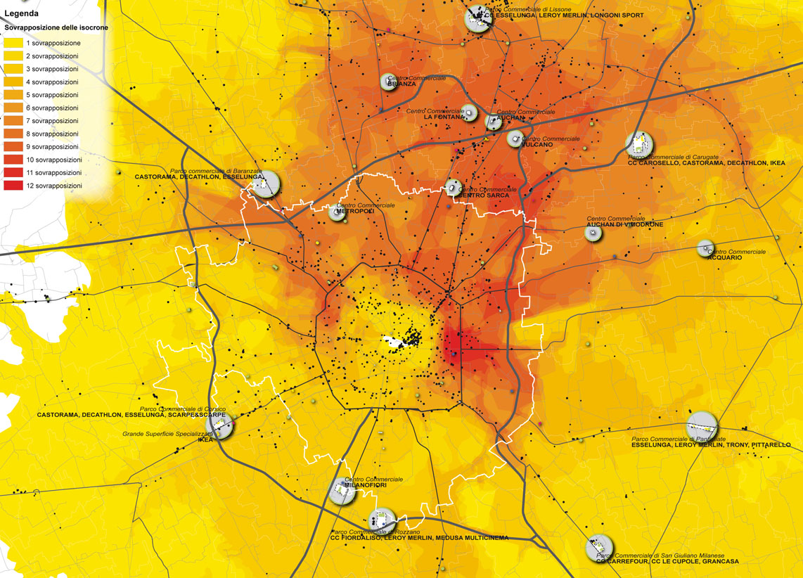
Commercial polarities along the city borders : overlap of catchment areas (car accessibility - 20 minutes distance)

Slide 7
2. Geography of Retail Units in Milan: Historical Evolution
After the mid Nineties
Late in the 1990s, and esp. thanks to the introduction of complex town-planning tools
(e.g. Urban Renaissance Programmes and Integrated Programmes of Intervention),
the transformation of brownfield started and, in 10 years' time, it led to the redevelopment
of a surface area of about 10 million sq m.
In a much shorter time than through an ordinary Variation to the Land-Use Plan, such tools
have enabled to develop projects implying the construction of mixed use: (affordable) housing,
public services, amenity green space, offices and commercial premises (esp. food superstores).
Such process has resulted in a retail supply considerably different from the one recorded before the mid Nineties: traditional shopping areas enriched with medium- to large-scale specializing retail units (flagship stores), as well as new development projects in central and suburban areas.
This significant renewal process has not been supported by an adequate adjustment
of the urban and commercial planning tools over the past decades. The new P.G.T. should be the right opportunity to upgrade these planning tools.

Slide 8
3. The P.G.T. Strategies for retail planning
Retail as a “public service”
The P.G.T.'s top-priority refers to a balanced presence of retail units and to the development of several
differently-sized stores in order to decrease the trend towards buying outside the city borders
The Strategic Development Plan underlines the need to build adequate services in
underprivileged districts, where the retail offer is actually represented mainly by small shops
The P.G.T. considers retailing as a service of public interest essential to people who cannot easily move from one place to another. So it considered easy procedures to increase the number of shops under 'special agreements' between retailers and the municipality, aimed at promoting additional services (extended opening times, home delivery, meeting points …).
The P.G.T.'s greatest innovation is that such retailing type is considered as a public 'service', which does not therefore account for the total floor area of buildings allowed on a certain plot, according to the Floor Area Ratio (FAR) in force.

Slide 9
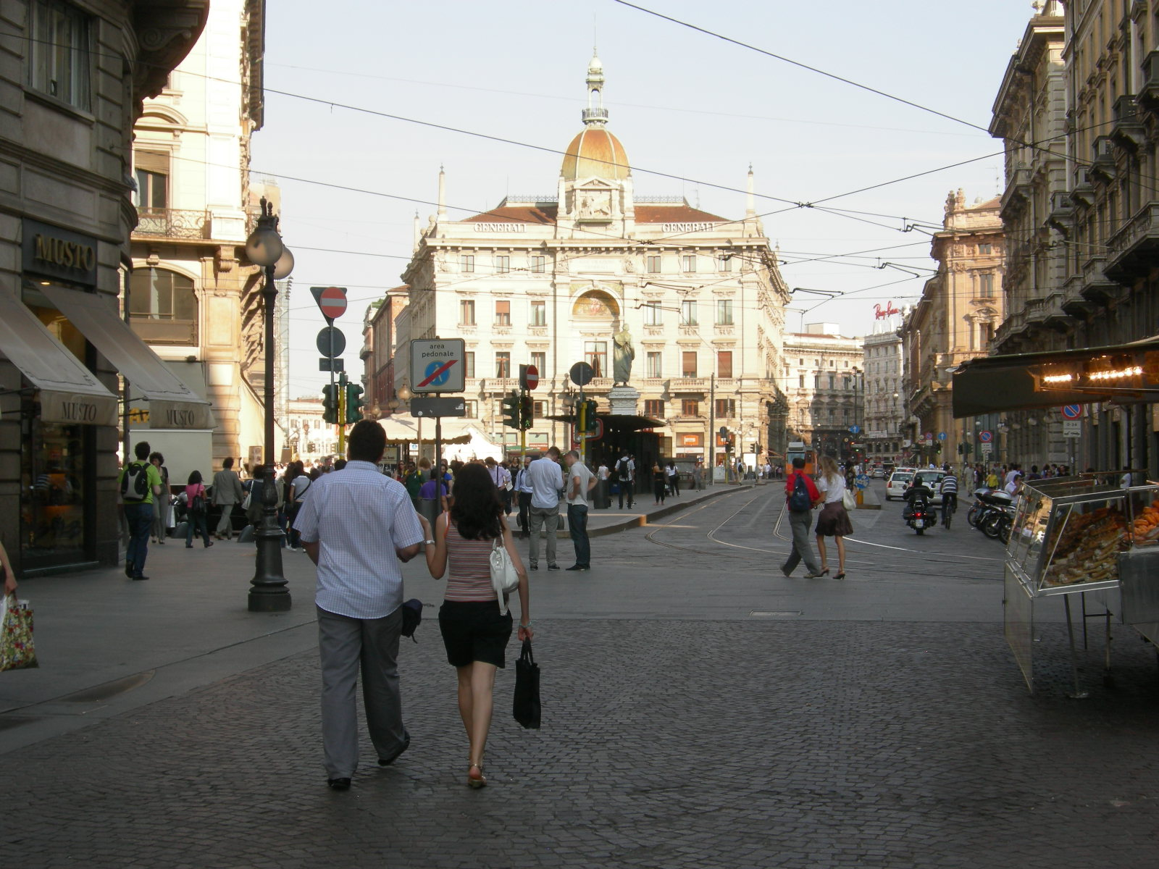
4. Accessibility
As the P.G.T. strategically aims at limiting vehicle traffic to shopping areas, it will carefully
analyze the possibility to access such areas through public means of transportation.
As a consequence of this, the P.G.T. introduces another important innovation about areas for urban facilities (the so-called 'standards’).
Through this measure retail units located in highly accessible areas, e.g. pedestrian streets, don’t need new public parking spaces.
Such principle has eliminated one of the biggest obstacles to the construction of large-scale stores in old town centres, where it is often difficult to build parking areas.

Slide 10
5. Land-use Liberalisation and 'Urban Mix'
Another strategic innovation that can strongly impact on the urban market is the elimination of the old 'zoning' concept and the introduction of Land-use Liberalisation criteria, which enable to freely determine which uses to apply to real estate developments, except for heavy industries.
The concept of 'Urban Mix‘ eliminates the old zoning criteria, related to the old Land-Use Plan, which determined fixed percentages of development for each land-use.

Slide 11
6. Conclusion: Location Criteria for commercial services
The location of commercial services (retailing and foodservice activities) is ruled by art. 27 of the P.G.T.'s Technical Regulations, according to the above-mentioned “Urban Mix” criteria, and in line with the national regulations in terms of liberalisation.
The principle is extremely clear: the larger the shop sales area, the more complex is the implementation method applied and, as a consequence, the stricter the authority control over the action.
This is also valid when making a distinction between old town centres, where the restrictions applied for cultural and landscaping reasons are higher, and
recently developed areas located in the first outer belt or in the suburbs.

Slide 12
THANK YOU FOR YOUR ATTENTION!
for any other info, please contact
snatalicchio@reag-aa.com
No part of this presentation may be reproduced or trasmitted in any form or by any means,
whitout written permission of REAG (Real Estate Advisory Group S.p.A.).
For any information please contact:
marketing@reag-aa.com

Slide 13
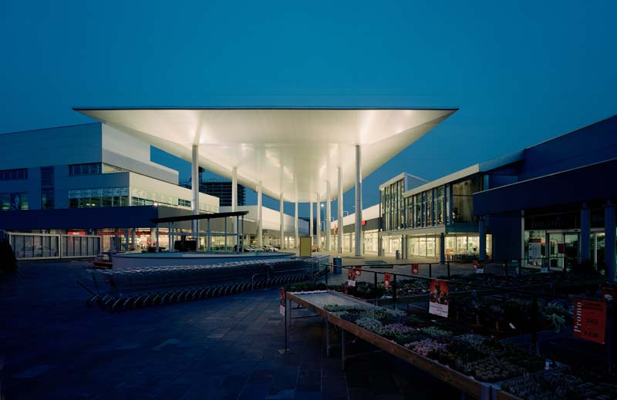
“Portello” Shopping center - best practice

Slide 14
“Portello” Shopping center - best practice
WJC
new develop.

Slide 15
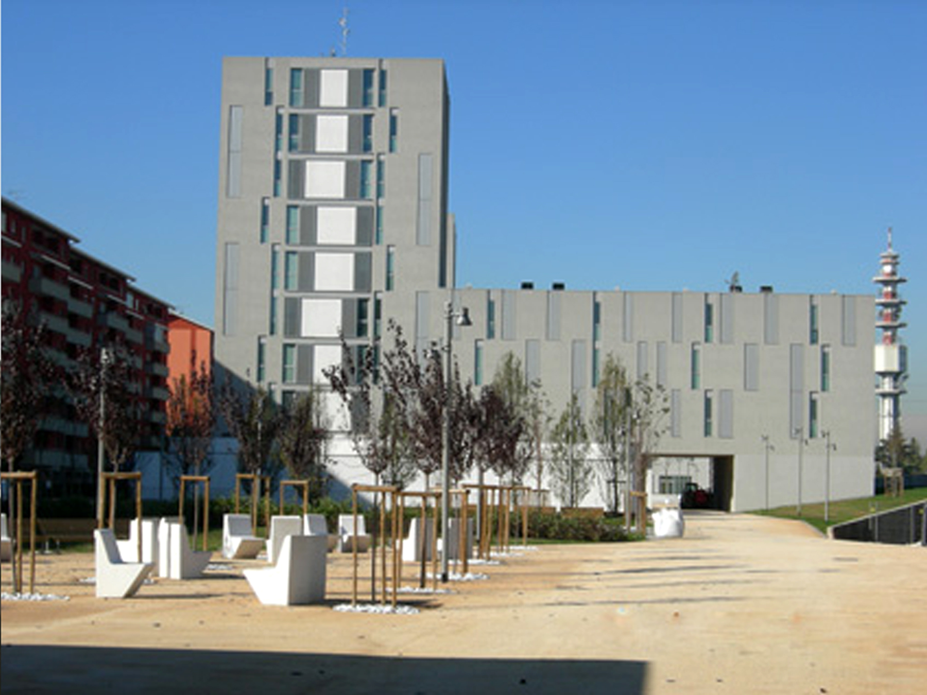
Affordable housing district

Slide 16
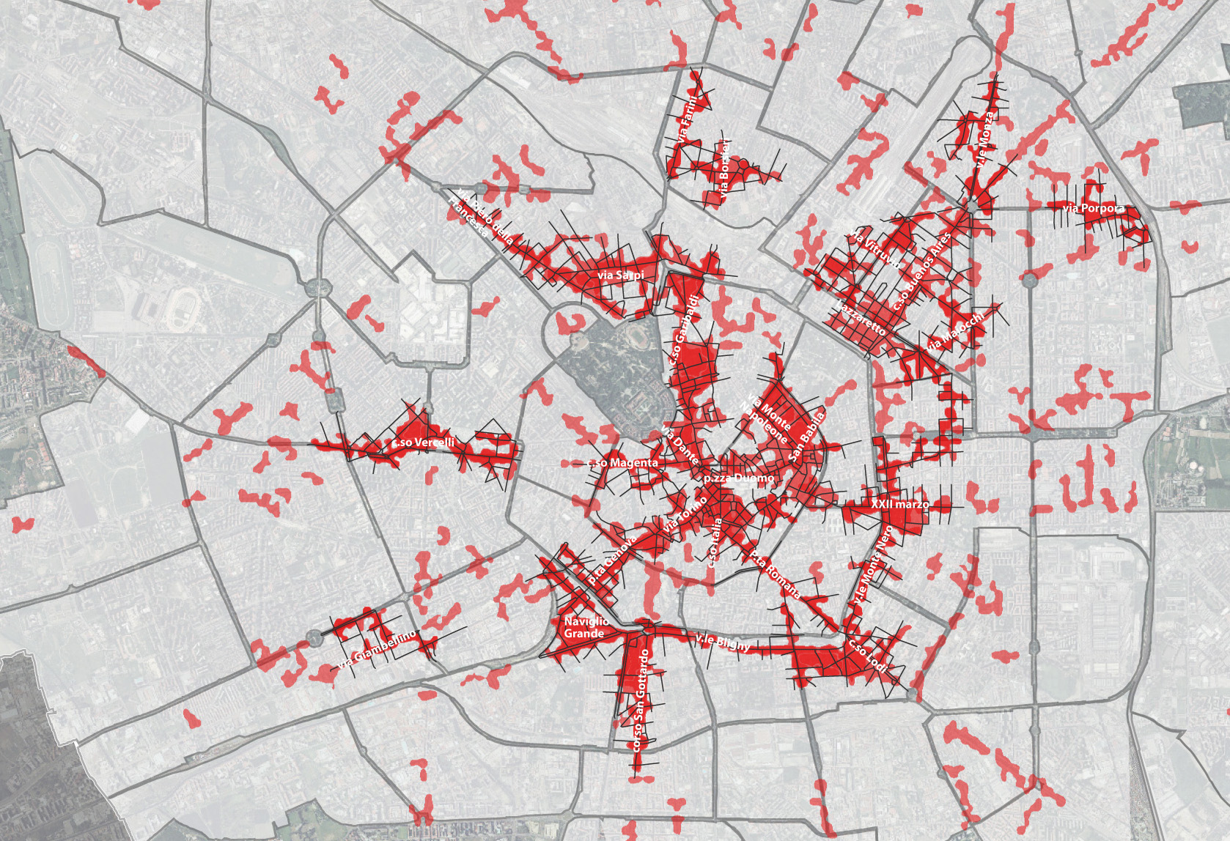
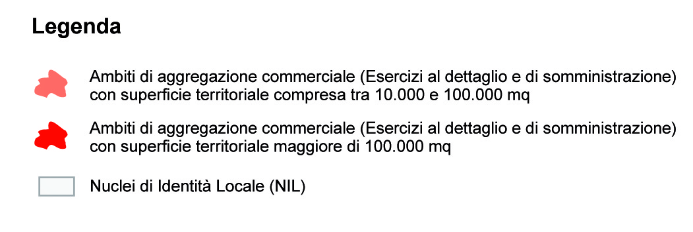
High Street in Milan city centre

