Slide 1
Impact of Olympic Games on Housing Markets: Empirical Evidences from Beijing, China
Mei Wang & Helen Bao
Department of Land Economy
University of Cambridge

Slide 2
Outline
Background
The 2008 Beijing Olympic Games
Urban structure of Beijing
Methodology
Data
Empirical findings
Conclusions

Slide 3
Background
The 2008 Beijing Olympic Games
Won the bid on 13 July 2001
Over 40 billion dollars investment in urban infrastructure and environment.
Subway network: 42 km -> 200 km
Expressway: 578 km new road
Two new terminals at the Capital International Airport
Forestation: 44% -> 51.6%
Coverage of green land: 38.8% -> 43%
Air quality: improved by 16.7%

Slide 4
Background
The 2008 Beijing Olympic Games
During and after the Olympics
Had the largest TV audience in Olympics history
Attracted approximately 2 million visitors
Generated 1.13 billion US dollars profits in tourism industry alone.
Achieved a total of 1.17 billion US dollars incomes through selling Olympic television rights, sponsorship, and licensees.
Boosted national pride
Improved awareness of energy efficiency and environment protection

Slide 5
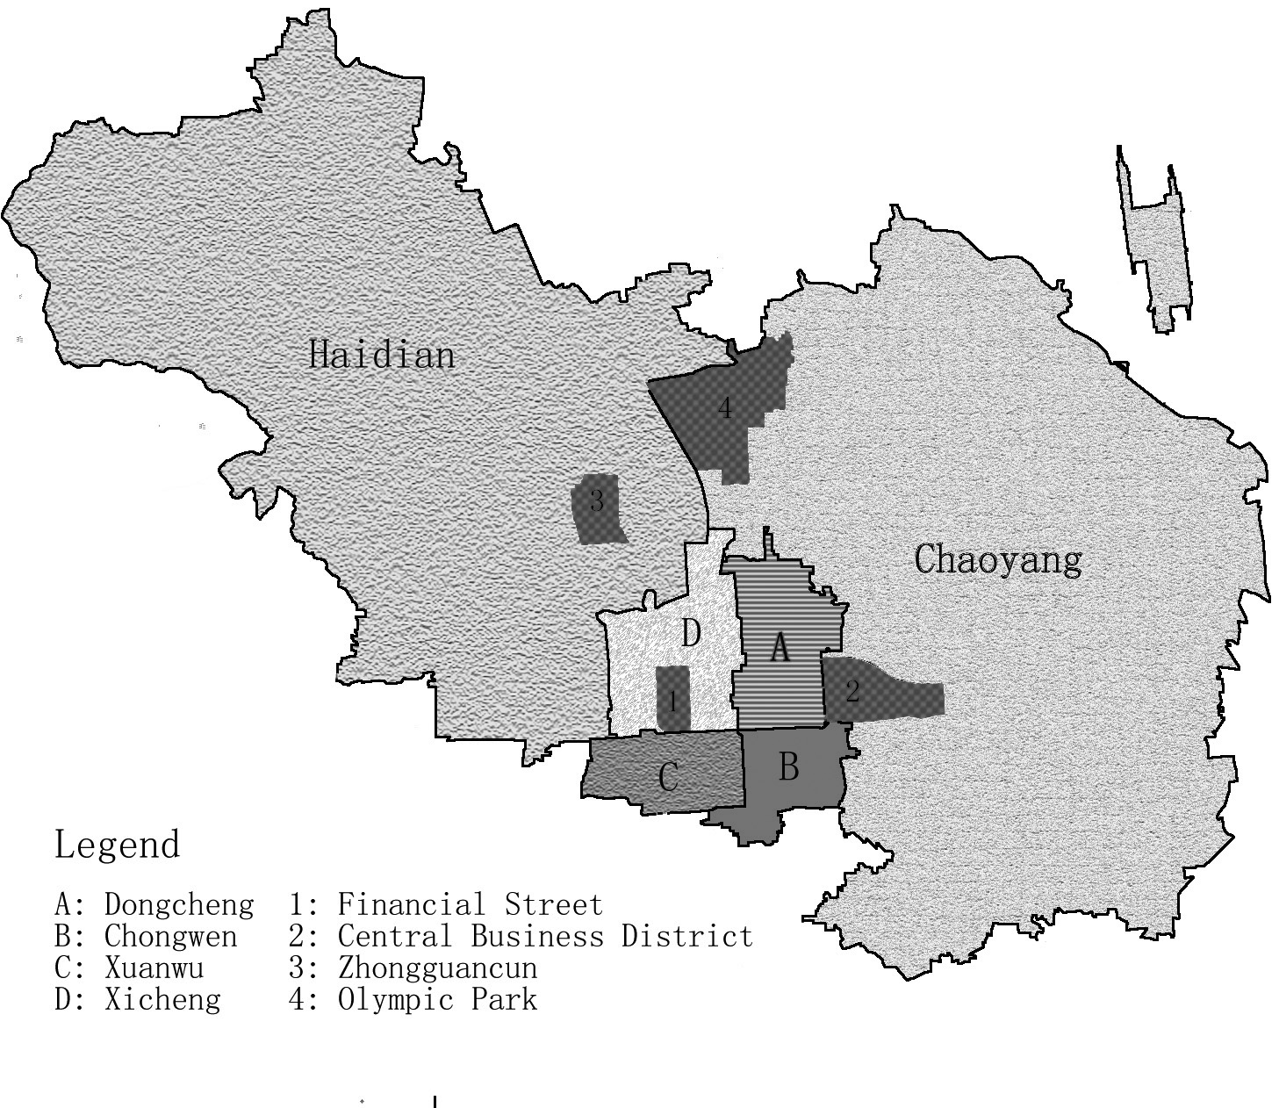
Background
Beijing’s urban structure

Slide 6
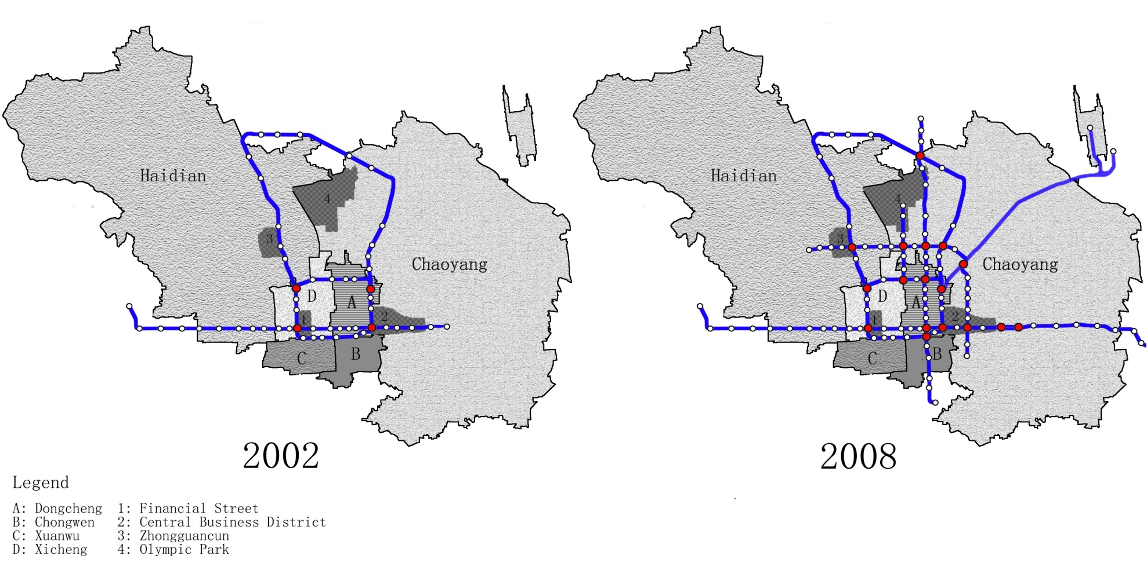
Background
Beijing’s urban structure
Subway network expansion

Slide 7
Methodology
Hedonic Price Modelling (Rosen 1974)
P: property prices
S: structural housing characteristics
N: neighbourhood housing characteristics
L: location housing characteristics
T: time dummies

Slide 8
Methodology
Hypotheses:
Beijing’s urban structure has been transformed from mono-centric to poly-centric. Olympic park has evolved as a new city sub-centre
Subway network expansion changed homebuyers’ preference towards transportation accessibility.
Improved environment awareness. A larger premium attached to green space ratio is expected

Slide 9
Data
3260 residential property transactions in Beijing from 1998 to 2008
Variables:
P: sale price per square meter in RMB
S: age, size, high-rise, decoration
N: amenity, green, estate management
L: bus, subway, sub-centres, district dummies
T: year dummies

Slide 10
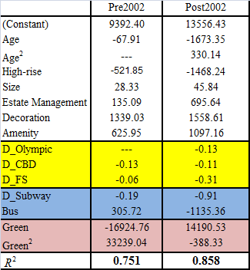
Empirical Findings

Slide 11
Conclusions
Significant impact from the 2008 Olympic Games are identified
Olympic park as a new city sub-centre
Homebuyers’ preference towards subway transportation
Improved environment awareness

