Slide 1
Buildings condition assessment procedure and its influence to the collateral activities and operations
Kärt Hindriksoo, MSc Estonian Agricultural University Kaarel Sahk, lecturer Estonian Agricultural University

Slide 2
These presentation is based on the MSc thesis written under the auspices of Estonian Enterpreunership Foundation

Slide 3
Environment of expetize
Planning Act, forced in 2002
Building Act, forced in 2002
Buildings Expertize Decree, forced in 2002
Buildings Design Expertize Decree, forced in 2002
Regulation of Buildings Inspection, forced in 2002

Slide 4
Environment of expetize
Regulation of Buildings Surveying, forced in 2002
Forensic Examination Act, forced in 2004
But – the procedural regulations or standards are absent

Slide 5
Importnace of problem
Exponential and rapid growth of construction market during the first past of last decade
As a result of boom and bubble the luck of qualified projects, certified construction firms and diligent supervisors.
An increased need for expertise, including the need of adapting and refurbishment of existing stock

Slide 6
Importnace of problem
Assessment on suitability of existing buildings use and conditions
Construction of new buildings at a settlement of disputes arising
What sort of assessment methods are used by currently active experts for expertise arrangement?

Slide 7
Problem and goal
Do there exists a need for common and general method of buildings conditions assessment?
Is there in the use some applicable methods or regulations for buildings conditions assessment?
If the suitable method isn’t worked out or isn’t in the use then develop the needed one

Slide 8
Built up of questionary
Two pairs of hypotheses were controlled:
Buildings expertise regulations standard i.e. buildings conditions assessment method is necessary or not?
If the standardized approach is necessary do this approach is existing in practice or not?

Slide 9
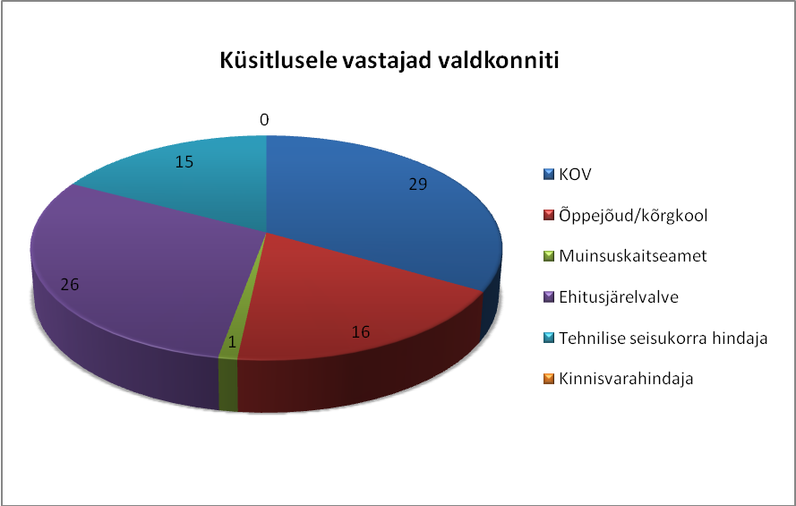
Divison of respondents
Local authorities 29%
Universities 16%
Heritage department 1%
Buildings supervisors 26%
Experts 15%
Appraisers 13%

Slide 10
Applied methodologies
Literature analyzes
Methodologies of different countries (USA; GB; Denmark, etc)
Questionary representatives proposals during the workshops
Legal foundation of building environment

Slide 11
Buildings conditions assessment methodology connections
Standard of property management
Standard of buildings cost assesment
Approach of buildings conditions assessment
GAAP (national editions)
Standard of building project design

Slide 12
Suitcase for expertize
Based on the practical experience
Preliminary manual instruments for preliminary field survey
Allows to mange the first step ox expertise and to plan the needed deeper field (nondestructive) or laboratory experiments

Slide 13
Triangulum of expertise
User of expertise
buildings expertise i.e. conditions assessment
subscriber of expertise
executorr of expertise

Slide 14
Users and using
Institutions like local authorities
Engineers who are involved in expertise
Real estate appraisers and other market participants
Different firms
Owners of real estate
Academically persons

Slide 15
Users and using
Training different specialists on the all of LLL levels
Facilitating work of experts
Satisfaction of investors and other interested in parties or institutions
Substrate the following researches and recommendations for several equipment

Slide 16
Further activity
General plan, theme plans, master plans
Decree of Land use
Essential part of property – building & structures
Designed
Existing building
New building
Heritage building
Mulieu building
Existing building
Common building
Intended use of buildings
Decree of use
Contemporary
building

Slide 17
Future development
Short term use – development of expertise rules diversificated by use or structure buildings
Medium term horizon - basement for further work out of decrees, legal acts etc.
Long term horizon – standardisation and harmonizing with EU members basic principles in area

Slide 18
Information
This presentation is based on the master thesis of Mrs. Hindriksoo “Guidlines for the Structural Condition Assessment of Buildings”
Thesis were defended in June 2010.

Slide 19
Further information
Contact adresses for further information: Hindriks@emu.ee Kaarel.Sahk@emu.ee
According the current presentation the empirically paper will be copiled.

Slide 20
THANK You!

