Slide 1
ICME Study 2010: Post-crisis-strategies for the Corporate Real Estate Management - New requirements for CREM through the crisis in 2009 -
Milano, 24th June 2010
Abu Dhabi
Berlin
Milan
Munich
Paris
Vienna
Zurich

Slide 2
Index
A.
ICME
1
B.
Introduction of the study
5
C.
The crisis in 2009
Initial situation
Effect for corporates and CREM
Targets for CREM
7
D.
Activities at the crisis
Activities undertook in 2009
11
E.
Recommendation for 2010
26
20100624_ICME-Study_Post-Crisis-Strategies for CREM

Slide 3
ICME Profil
ICME is a management consulting company of European tradition and culture
ICME is a fully independent niche consulting firm with European size and philosophy
ICME is the trusted advisor and counsellor to senior management in managing business excellence
The group started in Switzerland in 1954 and developed in Germany and France, and now Italy and Austria as well
ICME serves its Customers in all European Countries from its offices in Berlin, Milano, Munich, Paris, Vienna, Zurich and Abu Dhabi
ICME employs 70+ consultants both with proven industry knowledge, sound consulting experience and from leading business schools and universities
ICME´s approach focuses on niche experts with proven industry track record and the provision of high qualified and tailor-made solutions for leading market players
20100624_ICME-Study_Post-Crisis-Strategies for CREM

Slide 4
ICME Client Structure
Leading management consultancy for Real Estate and Investment Management
ICME Real Estate Management – Client Structure
ICME Services
Finance
Real Estate
Facility Management
Identification of trends in Real Estate Management and derivation of managerial implications
Analysis of existing structures and processes regarding best-in-class-approaches in Real Estate Management:
Real estate activities
Business design
Structures and processes
Target groups and specific requirements
Selection of external partners and service provider
etc.
Corporates
Pension
Public Sector
Funds
Financial Sector
Service Provider &
Facility Manager
Professionalization in Real Estate Management through development and implementation of customized best-practice-solutions
Property& Investmentmanager
20100624_ICME-Study_Post-Crisis-Strategies for CREM

Slide 5
ICME References
Selected references of our consultant team in Real Estate and Investment Management
Property & Asset Manager
Service Provider & Facility Manager
Corporates
Public Sector
BayWa
Beiersdorf
Bombardier
Deutsche Telekom
Daimler
EADS
EDF
EnBW
E.ON
Ford
France Telecom
Gas de France
Kaindl
Lufthansa
Metro
MGVV
Orange
Sulzer
Thales Aerospace
RWE
Siemens
VW
Bundesministerium der Finanzen
Italienisches Finanzministerium Agenzia del Demanio
Bundesländer/ Landes-regierungen von:
Brandenburg
Hessen
Niedersachsen
Mecklenburg- Vorpommern
NRW
Sachsen
Steiermark
Städte:
Düsseldorf
Hamburg
Arbeitsmarktservice Österreich
LMBV – Lausitzer und Mitteldeutschen Bergbau- Verwaltungsgesellschaft
Bank Austria Real Invest
Bayerische Immobilien Gruppe
Bayerische Landesbank (LWS, Telos)
Bouygues Immobilier
CA Immo / Vivico
Catella
CBB Holding
CorpusSireo
Die Schweizerische Post Immobilien
E.ON Invest
ERGO Trust
iii-investments
MEAG Assetmanagement
Raiffeisen Immobilien KAG Österreich
Pirelli RE, BauBeCon
PSP Swiss Property
Union Investment
DeTe Immobilien
InfraServ
E.ON FM
Dekonta
PharmaServ
Johnson Contol
Krankenhaus München Harlaching
Krankenhaus Charitè
LIVIT
MIBAG
HSG-Zander
RWE Systeme Immobilien
Siemens (SGM)
Stadtwerke Wuppertal
Stadtwerke München
Stadtwerke Duisbrug
Strabag PFS
Universitäts Klinikum Hamburg-Eppendorf
Vivantes
20100624_ICME-Study_Post-Crisis-Strategies for CREM

Slide 6
Index
A.
ICME
1
B.
Introduction of the study
5
C.
The crisis in 2009
Initial situation
Effect for corporates and CREM
Targets for CREM
7
D.
Activities at the crisis
Activities undertook in 2009
11
E.
Recommendation for 2010
26
20100624_ICME-Study_Post-Crisis-Strategies for CREM

Slide 7
Structure and targets of the study
Effects and „lessons learned“ from the crisis for Corporate Real Estate Management (CREM)
Procedure
Description and Results
Topic
& target
The basic questions of the study :
How strong was the influence of the crisis for CREM?
What were the reasons for the lower effects for CREM?
Which measures were in use and which one have positive long term effects for the company as well as for CREM?
Which requirements are necessary for future CREM?
Procedure
Online interviews with selected panel
68 companies were invited to the internet survey:
30 German companies, 15 Italian, 15 Austrian, 8 Suisse
Focus on: Germany, Austria, Switzerland, Italy
12 experts (companies, service provider, and science) were interviewed by our consultants
Results have been confirmed by additional research and experience
Rate of return
Rate of return of 54% (as of 01th June 2010)
37 companies (54%)
9 Italian companies are included
20100624_ICME-Study_Post-Crisis-Strategies for CREM

Slide 8
Index
A.
ICME
1
B.
Introduction of the study
5
C.
The crisis in 2009
Initial Situation
Effect for corporates and CREM
Targets for CREM
7
D.
Activities at the crisis
Activities undertook in 2009
11
E.
Recommendation for 2010
26
20100624_ICME-Study_Post-Crisis-Strategies for CREM

Slide 9
The year of crisis - 2009
The real economy was banged by the crisis in 2009. This is also confirmed by the gross domestic product
Market environment
Comments
Change of GDP in percentage
The Real estate market was strongly affected by the crisis
Strongest economical crisis in almost than 100 years
The economic levels of 2007 will be reached in many years from now
Soft or Hard “ Landing” ? → prospect of a slowly rebound (U formation)
Neck-shoulder-formation possible, new crisis can´t be excluded
Long-term orientation and strategic interventions are necessary to exploit the upcoming rebound and/or to manage the next crisis
0
?
2004
2005
2006
2007
2008
2009
2010
2011
?
Return
Transaction volume
Vacancy
2004
2005
2006
2007
2008
2009
2010
2011
8
20100624_ICME-Study_Post-Crisis-Strategies for CREM

Slide 10
Effects of the crisis for CREM
How was the effect of the crisis in 2009 for corporates and especially to the CREM?
Effect of the crisis for corporates and to CREM
Comments
3,5
1 out of 3 companies saw equal impact of the crisis on the core-business and CREM.
1. CREM positioning at the company
RE is not the core focus of top-managers
Low integration grade of company decisions
Translation of real estate to the financial management isn´t very common
2. Missing transparency
Missing global transparency and comparability of costs and assets
Missing ratios and comprehensive control mechanisms
Missing definition of international standard processes as well as responsibilities and interfaces
3. Missing active portfolio management
Missing continuous management over the total portfolio
short sighted measures
Corporates
2,9
Reasons
CREM
Delta
0
1
2
3
4
5
non influence
strong influence strong influence
CREM
Corporates
Source: n= 37, percentages are rounded
20100624_ICME-Study_Post-Crisis-Strategies for CREM

Slide 11
CREM targets during the crisis
What were the targets of CREM crisis management?
Targets of the CREM
Comments
Italy: only 72 %
CREM was integrated in the overall cost cutting programs of the company (93%)
However just 1/3 of the corporates have provide extra liquidity
Due to the bad situation of the international real estate markets
Difficult identification of options at asset levels
Nearly 50 % of the corporates undertook structural and personnel measures during the crisis
Current CREM structures aren´t able to focus on the organization's costs and assets immediately
Modern solutions of transactions for further optimization of asset structures aren´t in wide usage
Reduction of
cost
Italy: only 29 %
Structural adaptations
Questions of personnel
Italy: no HR adaptions
Others
Ambition of
liquidity
Italy: only 14 %
20100624_ICME-Study_Post-Crisis-Strategies for CREM

Slide 12
Index
A.
ICME
1
B.
Introduction of the study
5
C.
The crisis in 2009
Initial situation
Effect for corporates and CREM
Targets for CREM
7
D.
Activities at the crisis
Activities undertook in 2009
11
E.
Recommendation for 2010
26
20100624_ICME-Study_Post-Crisis-Strategies for CREM

Slide 13
1
Activities and measures during the crisis
Measures of maintenance and repair
Measure
Effect
Interpretation
Reduction
of maintenance
No
strong effect
The basis for maintenance or repair wasn´t requested and evaluated
The result of the reduction of service levels are:
Short dated cost reduction but
Fall in value and higher efforts for repairs
Shorter life cycle for facilities in the future
The transfer of repair comes to:
Short dated cost reduction
Higher burden of the budgets in the following years
Fall in portfolio value
Effects of measures are short dated, this could mean: increased costs in the following years
Need of a lasting strategy of main-tenance and repair
Italy: only 30 %
Yes
few effect
No
strong effect
none effect
Transfer
of repairs
Italy: no transfer
Yes
few effect
20100624_ICME-Study_Post-Crisis-Strategies for CREM

Slide 14
About 50 real estate related savings leavers are to be assessed for their economic potential and implementation requirements
1
Savings leavers
Savings Leavers
CREM- Savings leavers
FM-Costs
Utilities
Rental costs
Organizational costs
Costs of equity capital
Project example
recommendation
Standardization Service Levels
Reduction Service Levels
Price negotiations
New tender offers
Service provider bundling
Introduction of standardized contracts
Outsourcing
Management of service providers
Bonus/ Malus- systems for external mngt,
Quality inspection and defining Malus-regulations
Renegotiation
Effective maintenance strategy
Consumption management
Retrofitting of the property
Costs of utilities
Bundling of purchases
Form of contract
Lease term/ Extension
Reduction of the rent
Additional services
Space optimization
Relocation
Rate of internal services
Fixtures
Rent-free periods
Space reduction
Evaluation rent vs. ownership
Capacity evaluation
Level of administrative tasks
Reduction of duplication of work
Definition of interfaces
Evaluation of service scope
Evaluation of competencies
Identification of process breaks
Defined responsibilities
Management mechanisms
Reporting
Internal Benchmarking
Reduction of repeated process steps; short decision making processes
IT-costs
Portfolio adjustments
Space optimization
Sale/ relocation
Extension
Ownership vs. rents
Off-Balance -strategies
Optimization of financing*
Tax optimization*
High
Potentials
Low
Leverage
Low
Practicability
High
Consideration of all real estate costs
Comprehensive cost-reduction by reviewing more than 50 leavers per property
Individual appraisal with regard to potentials and feasibility
Identification of Quick Wins
20100624_ICME-Study_Post-Crisis-Strategies for CREM

Slide 15
2
Activities and measures during the crisis
Sourcing strategies
Measure
Effect
Interpretation
Outsourcing
of FM
No
strong effect
The trend of in sourcing is increasing , if compared to the outsourcing :
Decisions by level of resources
Socially acceptable measure but
Long dated relationship between FTE and capital
No clear defined borderline between in sourcing and outsourcing („market line“)
In sourcing can be an indication for missing configuration of the interfaces between service provider and customer. That's an essential reason for missing the targets.
It is necessary to have a clear sourcing strategy and a well defined „market line“
The interfaces between service provider and company must become more efficient and professional (e.g. clear management mechanism)
JA
NEIN
Yes
no effect
No
strong effect
no effect
In sourcing
of FM
Yes
few effect
20100624_ICME-Study_Post-Crisis-Strategies for CREM

Slide 16
A management approach for FM service providers enables the full control of the activities involved
2
FM Management model: managerial approach
Holding
Management function
Scope FM
Service provider
Aims PM
KPI FM
Controller
Aims FM service provider
KPI FM service
provider
Real Estate- strategy
Deduction Real Estate- targets
Parameter of
Quality = targets FM
Aims KFM
Aims IFM
aims TFM
Aims ...
CREM Cockpit of basis BSC
Balanced Scorecard
Balanced Scorecard
Leverage of business portfolio
Service Level Agreements
15
20100624_ICME-Study_Post-Crisis-Strategies for CREM

Slide 17
3
Activities and measures during the crisis
Strategies of service provider
Measure
Effect
Interpretation
Adopted service provider model:
Service provider as partner
Service level reduction
Service level is overrated → adaption is useful
Service level is exhausted → short dated measure
Post-price negotiations
Potentials like pooling of service provider and –efforts are not used
Partner-like models with service provider are future-oriented
Modern models which aren´t oriented at the individual facilities, but at the allocation of the property will be more used in the future
The industry approached a further wave of service provider pooling, which will be responsible for further concentrations at the FM business
ReductionSLA
Yes
No
Price negotiations with service provider
Pooling of service provider
Exchange of service provider
Exploitation of Malus rules
no effect
few effect
strong effect
Service provider model based on partnership
20100624_ICME-Study_Post-Crisis-Strategies for CREM

Slide 18
Through in-depth knowledge of the FM market and FM companies, ICME provides a significant contribution regarding the successful M&A process
3
Selection of partners
Portfolio strategy
&
Property identification
Company analysis & Indicative valuation
Identification of potential partners of the transaction
Contact with potential investors
Due Diligence
Buy/ sale strategy
Negotiation & signing
Integration Planning & Implementation
Conceptual Competition
Transaction
PMI-Phase
Restructuring Concept
Screening FM-Market
Attendance Due Diligence
...
Tendering of concept competition
Merger Integration
Support negotiation strategy
SWOT-analysis & Market positioning
Valuation Matrix
Legal DD
Search for potential partners
Tax DD
Selection of offers
Financial DD
...
...
Market screening and pre-selection of potential partners based on deep FM-expertise
Integrated and pragmatic project management
Fast and optimized implementation of the PMI phase
17
20100624_ICME-Study_Post-Crisis-Strategies for CREM

Slide 19
4
Activities and measures during the crisis
Real estate management & transparency
Measure
Effect
Interpretation
Measures of cost and portfolio transparency were the basis for implemented cost cutting programs
A further internationalization of CREM wasn´t implemented because of the fast efficiency of the measures
Guarantee of the allocation and care of the reached transparency of cost and portfolio
Stop of increasing bureaucracy at CREM
Integration of the data and their interpretations into the financial management of the companies, i.e. translation of the property into financial ratios e.g. by DCF methods
Further internationalization of CREM, but as a strategic escort function (e.g. coordination model)
Transparency of costs and portfolio
Transparency of costs and portfolio
Yes
No
Increase of Real estate controlling
Increase of Real estate controlling
Increase of intern. Real estate management
Increase of intern. Real estate management
no effect
few effect
strong effect
20100624_ICME-Study_Post-Crisis-Strategies for CREM

Slide 20
Due to four different dimensions, the management of real estate is very complex
4
Management levels
Management levels
Comments
Concern
Level I – Management CREM Procedure to integrate Real Estate Management into the group’s overall management
Level II – Internal invoicing Internal real estate specific cost allocation (e.g. asset costs, operating costs)
Level III – Portfolio Management Management tools to optimize (e.g. risk, return, value, transparency of the portfolio)
Level IV – Management of service providers Management of external service providers through result- and performance-oriented tools
Level I
Core business
Level III
Level II
Level IV
Portfolio
CREM
Service Provider
Different management levels with different tools and objectives
Different objectives have to be combined in one overall management concept
19
20100624_ICME-Study_Post-Crisis-Strategies for CREM

Slide 21
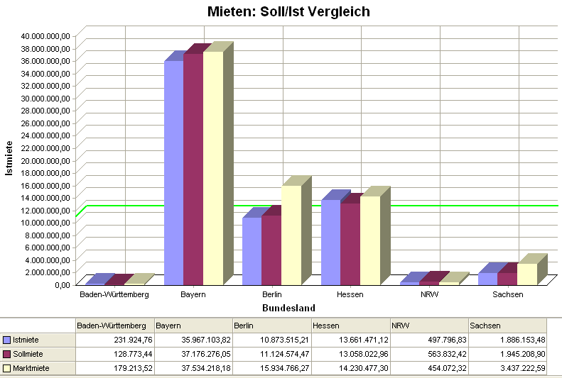
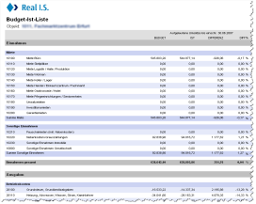
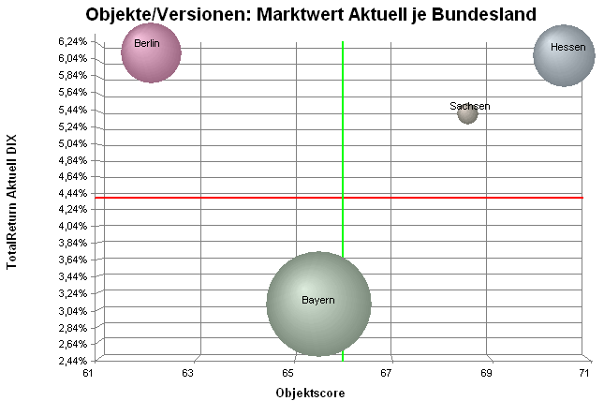
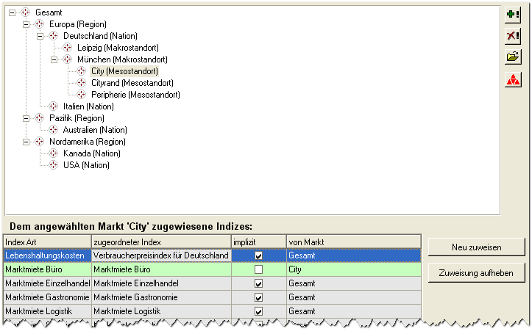
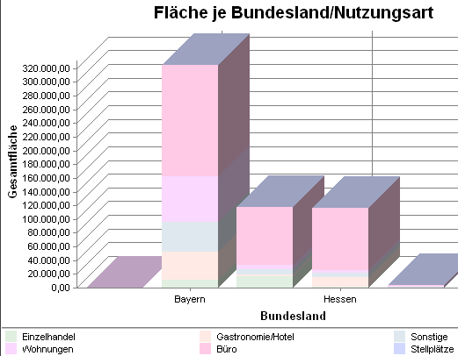
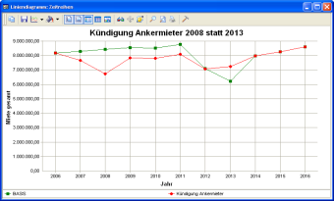
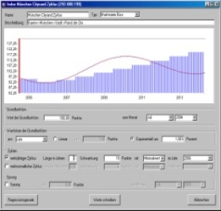
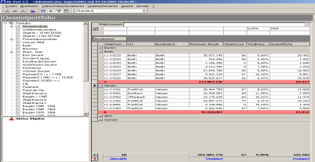
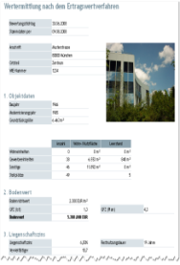
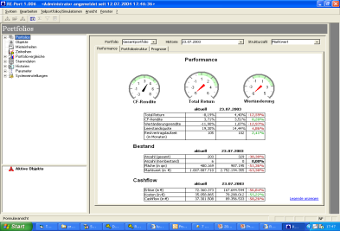
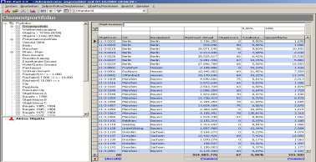
Portfolio management systems can be individually adapted to tasks and needs of the customer
4
Portfolio management - individual configuration and alignment
Investment Management
Investment-strategy
Financial Engineering (financial, law, taxes)
Requirements and control of PM
Reporting
Risk management
Research for investment level
Portfolio Management
Portfolio- strategy & planning
Portfolio-analyses u. -appraisal
Real Estate strategy
Redeployment
Reporting controlling
Risk management portfolio level
Research for portfolio level
Asset Management
Object strategy & planning
Budget planning/ -management (object)
Valuation (object)
Letting strategy
Acquisition/sale
Property mngt.
Controlling & reporting
Property Management
Realization object strategy
Tenant support / letting
Property book & finance
Control FM-DL
Up keeping & Restoration
Representation towards public authorities
Reporting
Facility Management
Commercial FM
Technical FM
Infrastructural FM
Secundary processes
Liquidity plan
Scorings
Benchmark
Reporting
Simulation Scenarios
Gruppierung
Teilportfolios
Filterfelder
Ratios
Filtering Analysis
Appraisal
Aggregatzeile
Documentation
20
20100624_ICME-Study_Post-Crisis-Strategies for CREM

Slide 22
5
Activities and measures during the crisis
HR - management
Maßnahme
Wirkung
Interpretation
Short-term work:
Short dated potential
Release of FTE:
Long term measure for cost optimization and for starting further strategically options (e.g. outsourcing)
Reaction of a non ideal positioned organization structure
Risk of understaff ing
Risk of unawareness of important strategic processes
Cost of personal and administration are max. 10% of total real estate costs
Therefore, HR measures are not solving the savings problems.
The nurturing and allocation of the necessary know how for further optimization at CREM is a much better solution
Release of full-time equivalent
Release of full-time equivalent
Yes
No
Exploitation of short-term work
Exploitation of short-term work
no effect
few effect
strong effect
20100624_ICME-Study_Post-Crisis-Strategies for CREM

Slide 23
5
Activities and measures during the crisis
Processes
Measure
Effect
Interpretation
Process optimization
No
strong effect
no effect
Process optimizations were implemented nearly in all companies, but mostly at the level of partial activities for further optimizations of the employment levels
CREM has been somehow “blocked” and not reactive
The property has always the function of serving; therefore it must be oriented at the interface of core business and CREM
Processes and efforts of CREM will become clearer in the next years
CREM has to be developed out of the actual portfolio
“Not the ideal process, but the necessary process is responsible for the CREM efficiency”
NEIN
JA
Yes
few effect
20100624_ICME-Study_Post-Crisis-Strategies for CREM

Slide 24
Focus for the short or medium term optimization of real estate cost structures
5
ICME‘s integrated approach for effective cost cutting
Leverage – short term
Initial situation - Cost structure CREM
Leverage - medium term
A
FM costs → Benchmark → +/- variance
Disproportional high prices?
SLAs not in line with the market?
DL-structure too heterogeneous?
Service scope?
Property/ region not marketable?
Media → Benchmark → +/- variance
See above
Leasing contracts/ Spaces/ Relocation → Benchmark → +/- variance
Disproportional high rents?
Property/ region not marketable?
Contract very user-specific?
High degree of flexibility is desired?
D
Property values
Decision rent vs. ownership (ex ante)
Variance book vs. market/ estimated value (ex post)
Labor & administrative/ process costs → Benchmark → +/- variance
Employee capacity? m²/ employee?
Overall, in line with the market management?
Degree of outsourcing?
Uniform, overall standards?
Bundling opportunities?
Adjustment of organization?
FM &
Maintenance
25-30%
Depreciation & Interests
25-30%
Labour cost &
other admin.
costs
5-10%
E
B
Utilities
5-10%
Rents
30-35%
C
~ 30-35 % medium term effect
23
~ 65-70 % short term effect
20100624_ICME-Study_Post-Crisis-Strategies for CREM

Slide 25
6
Activities and measures during the crisis
Liquidity
Measure
Effect
Interpretation
Properties have no relevance to ensure company´s liquidity
Boost of transactions in spite of the difficult market situation
Nearly 40% of the companies are still using sale and lease back transactions
Modern transactions instruments wasn´t used because of
Missing preparation
Missing know-how
Implementation’s stress
In the future, CREM will manage the property as own asset classes and apply owner rates and alternative instruments
The aim is a fast and cheap reaction of the financial demand of the company
Credit collateral
Credit collateral
Sale und Lease Back
Sales und Lease Back
Activities of application
Activities of application
Yes
No
no effect
few effect
strong effect
20100624_ICME-Study_Post-Crisis-Strategies for CREM

Slide 26
Creating an employers’ fund is an ideal opportunity to get liquidity without losing the portfolios controllability
6
Liquidity vehicle - Real estate funds
Employee share ownership model
Advantage
Corporate
Portfolio
annuity
insurance
Increase in liquidity through selling core real estates (e.g. production facility )
simultaneously keeping the operational steering of the real estate including a buyback option
raising employers loyalty
improving the corporate image and Identity
„Quasi-employee benefit”
Cheaper than Sales & Lease-Back
Real Estate co-management within the corporate
Buyback after 10 years
Company takes over Fond management
1% management fee
4% assured return to employee
Fund structure
Employee share ownership
5 % guaranteed
Equity yield rate
In partnership with service provider
External Service Provider
25
20100624_ICME-Study_Post-Crisis-Strategies for CREM

Slide 27
Index
A.
ICME
1
B.
Introduction of the study
5
C.
The crisis in 2009
Initial situation
Effect for corporates and CREM
Targets for CREM
Model of explanation
7
D.
Activities at the crisis
Activities undertook in 2009
11
E.
Recommendation for 2010
26
20100624_ICME-Study_Post-Crisis-Strategies for CREM

Slide 28
Recommendation for 2010
Targets and requirements for 2010
Recommendation for 2010
Targets
Lasting savings and space optimization
Portfolio oriented CREM
Modern service provider models
Lasting management mechanism
Modern portfolio management
Modern liquidity instruments
Optimization of
efficiency and costs
1
2
Integration to group controlling
(closer to core business)
3
4
Management of the properties
as asset
5
Preparation for the next crisis
6
20100624_ICME-Study_Post-Crisis-Strategies for CREM

Slide 29
ICME – Your partner in Corporate Real Estate Management
Excellence by Experience
Abu Dhabi • Berlin • Milan • Munich • Paris • Vienna • Zurich
www.icme.com
ICME office Munich:
Possartstraße 13
D-81679 München
Telefon: +49 89 55 05 95-0
E-mail: info@icme.com
Your contact person:
Arnd Reifenrath, Associate Partner

