Slide 1
The Value of Green Buildings
New Evidence from the United Kingdom
Andrea Chegut
Maastricht University
Finance Department a.chegut@maastrichtuniversity.nl
Presented June 23, 2010 for the
2010 International ERES Meeting

Slide 2
Notes:
My names is Andrea Chegut and I am a researcher at Maastricht University. My research is on the economic performance of sustainable real estate in the international real estate markets. My presentation today is on The Value of Green Buildings New Evidence from the United Kingdom. I am concurrently working on this research with my promoter Piet Eichholtz and co-authors Nils Kok and John Quigley.
Stage: Right

Slide 3
The United Kingdom
Towards a Sustainable Built Environment
Corporate Social Responsibility and Environmental Sustainability
  Financial, legal and government service sectors,
  Main contribution to environmental sustainability is in the building they occupy.
Regulations and Incentives
  Energy Performance Buildings Directives
  U.K. & EPCs
Economic preferences of commercial occupants
  Occupants of commercial space have shifted from “owners” to “renters”.
  Demand Shift
Third Party Certification
  BREEAM UK
  LEED
Notes:
The United Kingdom Commercial Real Estate sector is shifting towards sustainability. There are multiple factors at work on the UK Commercial Real Estate Market. First, Corporate Social Responsibility and Environmental Sustainability have come to the forefront of corporate policies. For the financial, legal and government service sectors, who are the principal occupants of commercial real estate, there main contribution to environmental sustainability is in the building they occupy. Consequently, these sectors’ contribution to environmental sustainability is the building that they occupy. It is a part of their corporate profile and a feature that signifies quality and responsibility to the public. Second, Regulations and Incentives are at work to transform the built environment. At the EU level, there is the Energy Performance Buildings Directives, which mandates that all buildings above 1,000 m² display the energy performance data of their buildings. Forthcoming legislation is expected to drop this threshold and is anticipated to expand to all public buildings and prominent commercial space. The U.K. is on board with this legislation and is already drafting regulation to implement these new changes at the member state level. Third, the economic preferences of commercial occupants has changed. Over the course of the past ten years, occupants of commercial space have shifted from “owners” to “renters”. Indicating, that the owners of real estate are property investment companies and not the law firm of old. Thus, any demand for the features and characteristics of space is driven by tenants and not by owners of real estate. Tenants mind you that are using their space to communicate their “sustainability” to the public. Lastly, since 1990 BREEAM U.K. has acted in the market as a independent third party rating agency for the environmental performance of buildings. Since that time, 1, 610 buildings have been certified amounting to approximately 5.5 million square meters of space.
TRANSITION: Now, with these developments in the U. K. market we have a setting to investigate the economic performance of energy efficient and sustainable real estate.

Slide 4
Measuring the Financial Performance of
Green Real Estate
Empirical performance:
Find a certification premium for rents 2%, effective rents 6% and transactions 16%.
    Eichholtz, Kok and Quigley (2010a)
Results hold over the course of the financial crisis and the stock of green space expands.
    Eichholtz, Kok and Quigley (2010b)
Notes:
Transition into : Currently, we have some understanding on the performance of Energy efficiency and sustainability in the built in environment in the U.S.

Slide 5
Green Real Estate Performance in the UK
Limited studies on the financial performance of environmentally certified buildings outside of the U.S. market.
Interesting Developments within the UK lead to a testable environment – Is the financial performance of UK environmentally certified real estate statistically different from zero?
Fill this gap in the literature by evaluating the financial performance of environmentally certified buildings in the U.K commercial real estate market.
Notes:
Research on U.K. green commercial office space in the U.K. is limited. To my knowledge, there is only one study, a RICS Real Estate Report by Pett et al., (2004) found only 26 low energy buildings from company reports and after cross referencing these observations in the U.K. Investment Property Database (IPD) only seven valuation observations could be found. Ultimately, the small number of observations was too few to make any sound conclusions on rental increases or sales premiums.
More recently, some have pointed to the limited number of buildings that are certified within the U.K.’s institutionally owned property sector and the lack of additional quality information on commercial buildings in general. Together, these issues inhibit the amount of green building valuation data that can be cross referenced in pre-existing property valuation databases (Eichholtz, Kok and Quigley, 2009).

Slide 6
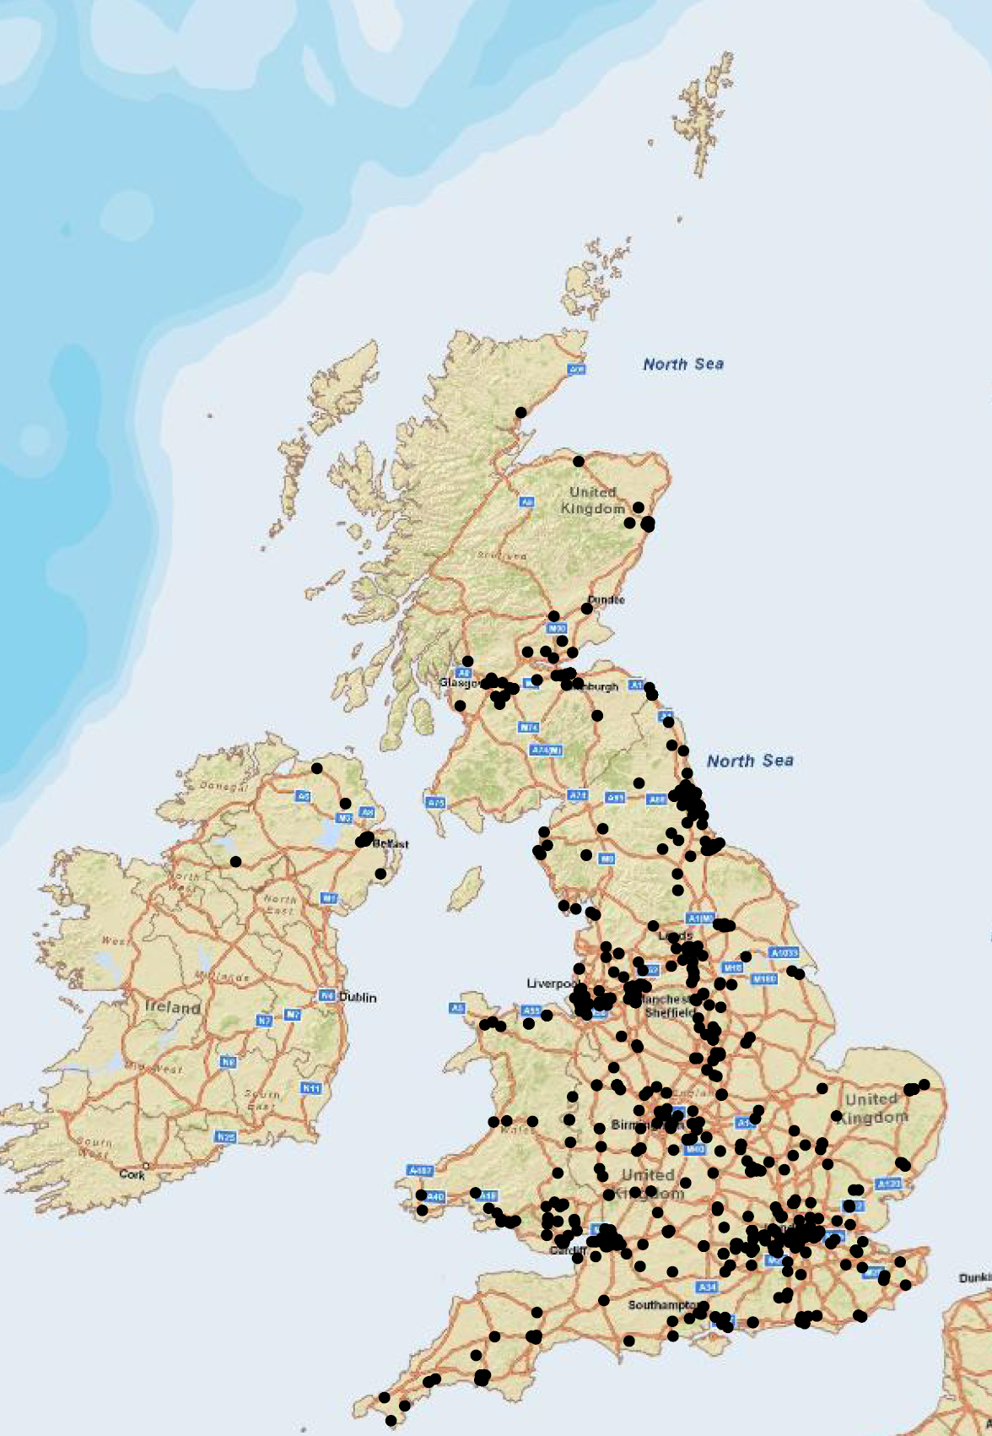
Geographic Distribution:
BRE Certified Real Estate
500 Buildings before 2000
1,618 buildings in 2010
Geographically diverse
Knowledge of certification and BREEAM rating achieved : Excellent, Very Good, Good and Pass
Black Points – BRE Certified
Notes:
We use BRE certified real estate as a proxy for environmentally performing real estate. BRE is a third party non-profit organization that independently certifies the environmental performance of buildings within the United Kingdom.

Slide 7
Data Resources and Sample Size
Transaction Information and Hedonics
Real Capital Analytics –
Commercial Real Estate Sales Transaction
Database
CoStar Focus U.K. – Commercial Real Estate Rental Transaction Database
Estates Gazette International – London Offices Data Set
Sales Sample
Rental Letting Sample
1, 219 Total Transactions
78 BRE Certified Transactions
1, 141 Control Transactions
26,114 Total Transactions
1,016 BRE Certified Transactions
25,098 Control Transactions
Notes:
My principal sales sample comes from Real Capital Analytics, a commercial real estate database which holds information on individual buildings and their hedonics which have transacted over the period 2000-2010. My rental sample comes from the CoStar Focus UK commercial real estate database which I pull individual rental transaction and their hedonic characteristics over the period 2005 to 2010. Lastly, I have a supplementary hedonic and descriptive data from the Estates Gazette International commercial real estate database. These combined data sets resulted in a complete sales sample of 1, 219 total transactions, of which 78 were BRE certified and the remainder were left as controls AND a rental sample of 26, 114 total transactions, of which 1,016 were BRE Certified Transactions and again the remainder is left as the control sample.

Slide 8
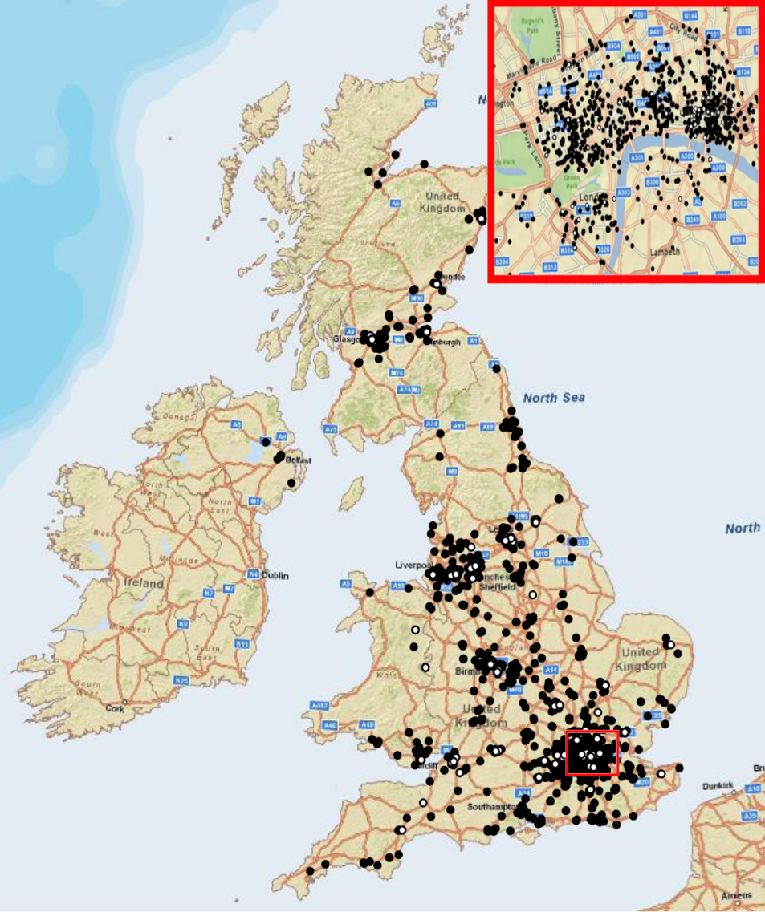
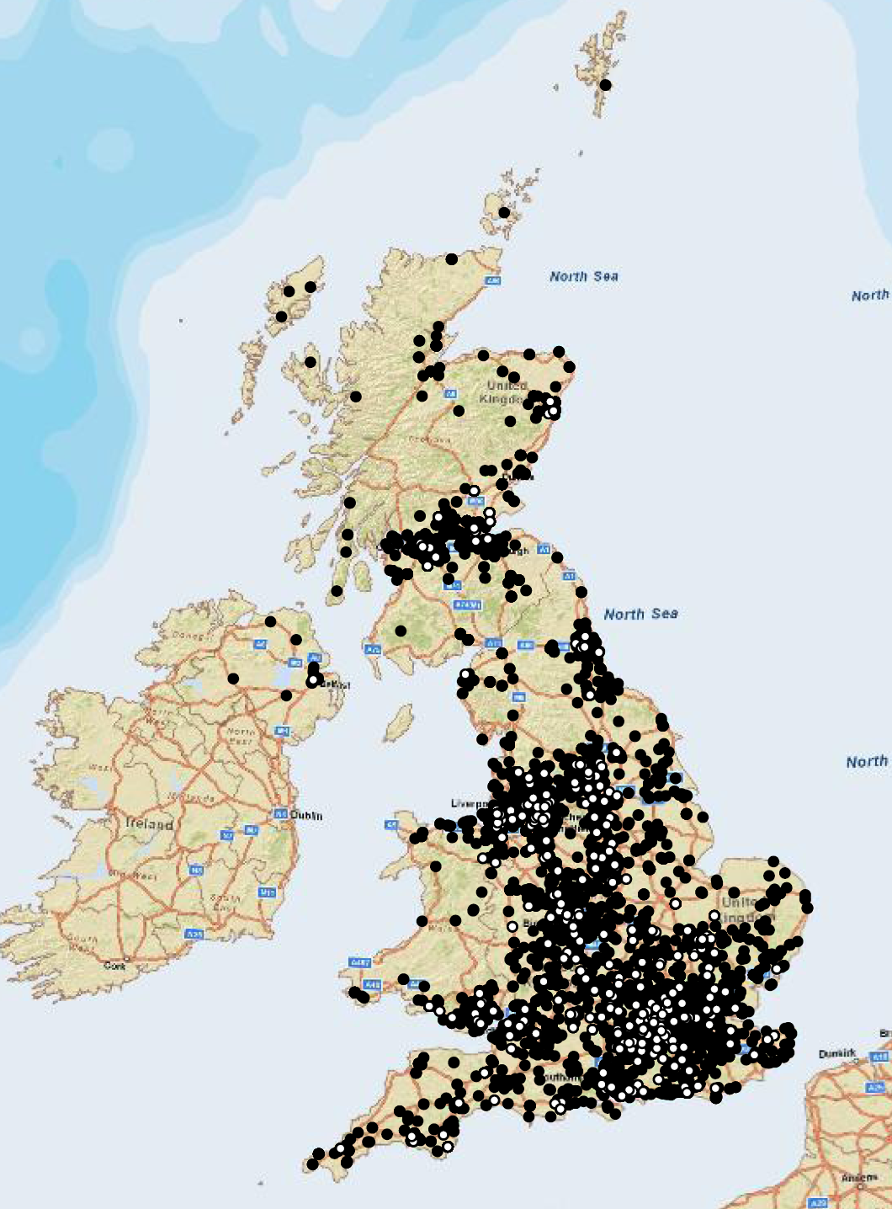
Sample Geographic Characterisitics
Sales Sample
Rental Sample
White Points – BRE Certified
Black Points – Control Buildings
Notes:
First, I conduct a spatial analysis of my sample. BRE certified transactions are represented by white points and control buildings by black points. From the map, I learn from the dispersion of the sales transactions that BRE and Control transactions are taking place primarily in the Central Business Districts of tier 1 cities like London and tier 2 cities like Manchester, Birmingham and Leeds. The map of rental transactions shows a different geographic distribution, the certified and control lettings are occuring all over the United Kingdom, not just in the CBDs.

Slide 9
Certified Buildings are …
Larger, Taller and Younger
Sales Transaction Sample
Sales Price Per Square Meter
Notes:
From the mean statistics, I see that certified buildings are on average larger by about 5 square meters, taller by about 2 stories and younger by about 13 years. In addition, their price per square meter is on average higher with a lower variation than the control sample.

Slide 10
Certified Lettings are …
Larger and Newer
Rental Transaction Sample
Rents Per Square Meter
Notes:
From the mean statistics of the rental sample, I see that certified lettings are on average larger by about 400 square meters and 42 percent of the sample is newer. In addition, the rental price is on average higher, but the rental price per square meter is on average marginally lower and has substantially lower variation than the control sample.

Slide 11


Method (1): Traditional Specification
The Model
Hedonic Characteristics
  Age, Size, Stories, ect.
Neighborhood Controls
  Sales Sample: Major Cities and Central Business Districts
  Rental Sample: City Fixed Effects
Transportation Networks
  Distance to Airports and Train Stations
  Number of Airports and Train Stations
where,
is a vector of hedonic characteristics of building i.
is a vector of neighborhood and transportation network controls for building i.
is a dummy variable with a value of 1 if building i is rated by BRE and zero otherwise.
and are estimated coefficients and is an error term.
Notes:
Our first regression analysis is a classic hedonic model with controls for hedonic characteristics and transportation networks. The dependent variable in the sales specification is the logarithm of the sales price per square meter and for the rental sample the rental price per square meter. Hedonic controls include the age, size and number of stories a commercial building has. Transportation networks include the geographic distance to the nearest airport that is within 50 kilometers and number of aiports within that distance. In addition, the distance to the nearest train station and the number of train stations within 1 kilometer is also used.

Slide 12
Results: Traditional Specification
Sales Transaction Results
Rent Transaction Results
Notes:
Results of the Sales specification indicate that there is a premium for certified real estate of more than 8 percent. In addition, BREEAM “Excellent”Rated buildings sell for a 20 percent premium over non-rated buildings. In addition, as expected buildings located in London, the Central Business District and in London’s Central Business District have premiums.

Slide 13


Method (2): GIS Specification
The Model
Hedonic Characteristics
  Age, Size, Stories, ect.
Adjacency Based Neighborhoods
  500 meter radi neighborhood boundaries
  Weight Matrix of 1 for buildings in the neighborhood and 0 otherwise
where,
is a vector of hedonic characteristics of building i.
is a dummy variable with a value of 1 if building i is located in cluster n and zero otherwise.
is a dummy variable with a value of 1 if building i is rated by BRE and zero otherwise.
and are estimated coefficients and is an error term.

Slide 14
Results: GIS Specification
Sales Transaction Results
Rent Transaction Results

Slide 15
Method (3): Propensity Score Matching
The Model
Hedonic Characteristics
  Age, Size, Stories, ect.
Neighborhood Controls
  Sales Sample: Major Cities and Central Business Districts
  Rental Sample: City Fixed Effects
Transportation Networks
  Distance to Airports and Train Stations
  Number of Airports and Train Stations
where,
is a vector of hedonic characteristics of building i.
is a vector of neighborhood and transportation network controls for building i.
is a dummy variable with a value of 1 if building i is rated by BRE and zero otherwise.
and are estimated coefficients and is an error term.

Slide 16
Results: Propensity Score Matching
Sales Transaction Results
Rent Transaction Results

Slide 17
The Bottom Line
Certified Green Building Premium
  Transacts for 8.7 percent more per square meter than the control sample, but not robust to other specificaitons
  Rents for 16 to 20 percent more, dependent upon the specification
Translated to the bottom line
  The average selling price for the 1,141 control buildings in the sample is £63.6 million
  The premium paid on a green certified building relative to a comparable building is £5.47million, ceteris paribus.
  The average rent per square meter is £232 and the premium for a certified building is £35 per square meter
  The average size of a BREEAM-certified rental transaction is about 723 square meters, and the annual rent increment on a certified space at this average size is some £193,000, ceteris paribus.
Notes:
Translating the results into real financial performance. A certified building in the UK sells, ceterius paribus, on average for a 8.7 percent more per square meter and rents for 16 to 20 percent more dependent upon the specification. If I translate this into figures applicable to this sample, then this translates into a large effect. The average control building for this sample transacted at 63.6 million pounds. A certified building will transact for 5.47 million more. The rent increment for an a certified building is about 232 pounds. At the average size of green buildings of about 723 square meters this translates into 193,000 pound more in rent per year.

Slide 18
Notes:
Now this has very interesting implications for the community of academics ands practioners engaged in the United Kingdom’s sustainable built environment. This research is the first look at the economic outcomes of this new type of product in the UK commercial real estate market. As a result, we can use these first results as a guide to financial returns in the market place. Repeat sales for green certified office space in the U.K. In the next stage of this research I will conduct a repeat sales analysis of certified real estate which will increase the accuracy of estimates on the financial performance of green buildings over time, and decrease the reliance on scarcely available hedonic characteristics. In addition, I will enhance the study with hand collected hedonic features for the United Kingdom. Lastly, I will introduce more spatial analysis and robustness checks into the analysis.
So far this portion of the presentation is complete, I now invite you to ask question and make comments and suggestions.

