Slide 1
Inspirational Learning
John Kirkwood
Sheffield Hallam University
ERES Milan 2010

Slide 2
Context
Blackboard: v1 → v9

Slide 3
Conversion
From this → to this!

Slide 4
Feedback
Clear and legible
Timely
Consistent
Reflects learning outcomes
Basis for discussion

Slide 5
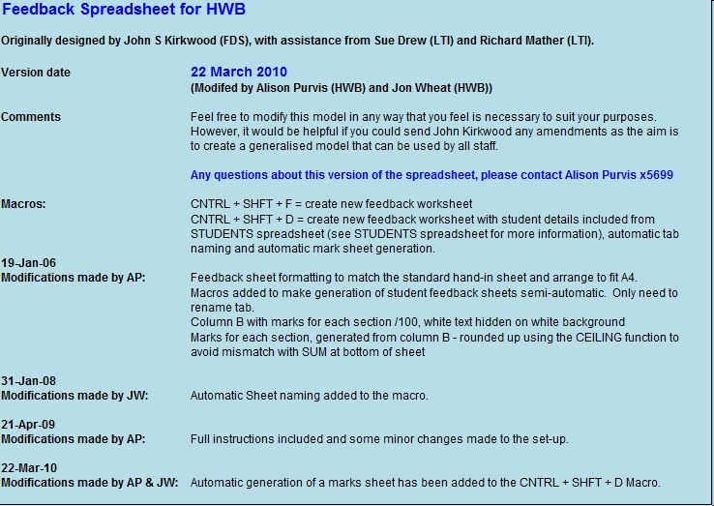

Slide 7
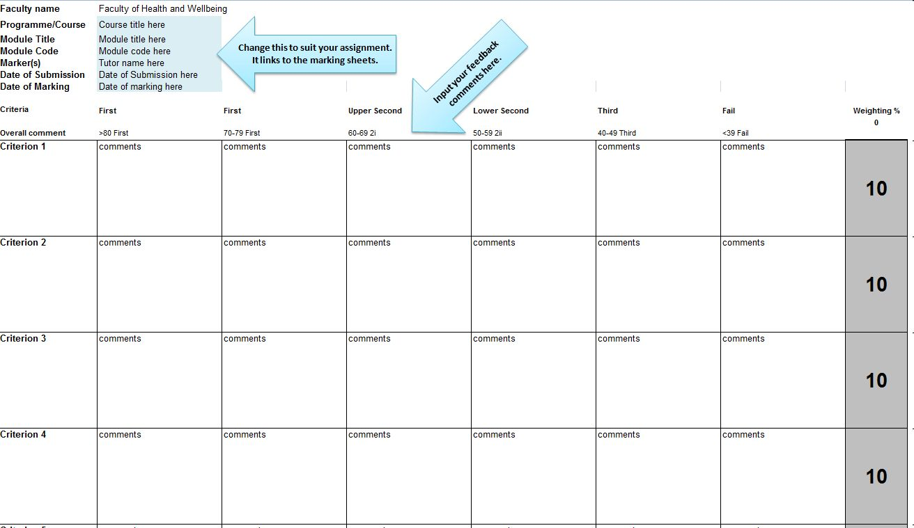

Slide 8
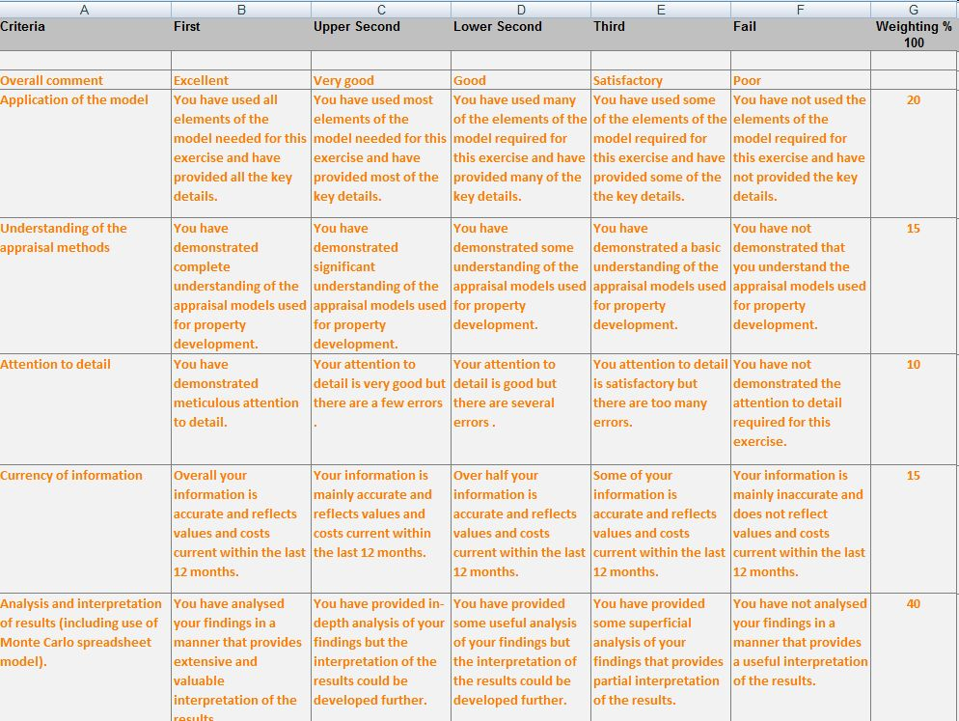

Slide 9
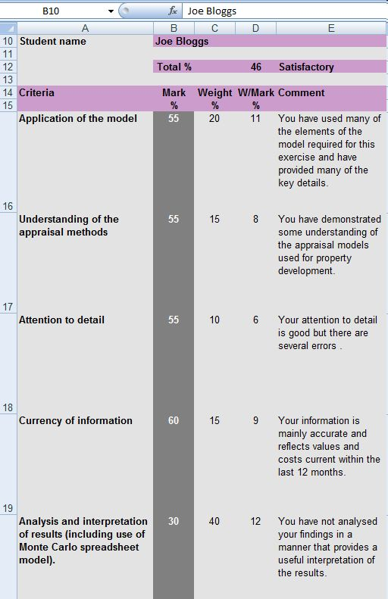

Slide 10
Development Appraisal
Concepts → Training

Slide 11
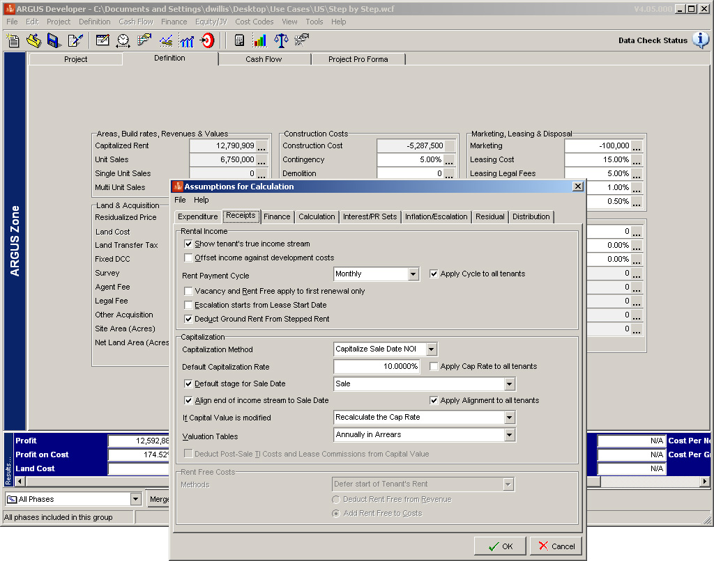

Slide 12
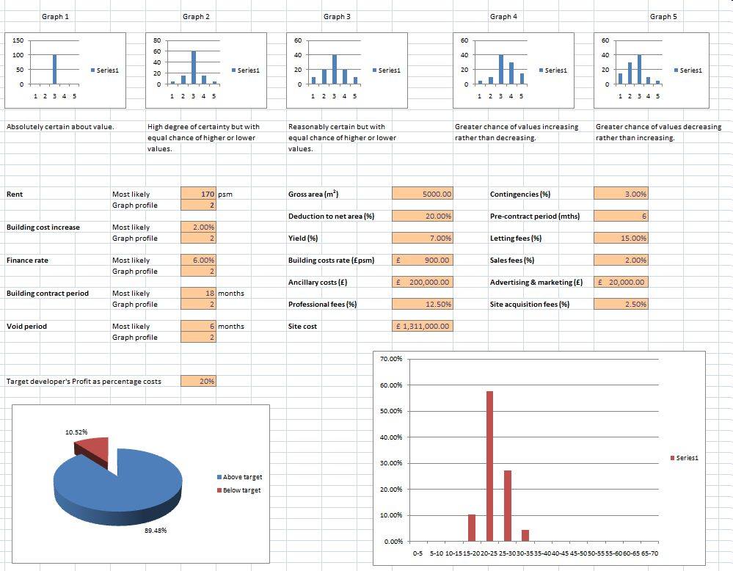

Slide 13
Concepts
Odds → Probabilities

Slide 14
References
Students → Tutors

Slide 15
Communication

Slide 16
Student Video Clips
Group 1: develop.
Group 2: Avenir
Group 3: Aliens

Slide 17
Conclusion

