Slide 1
Would reputation and behaviour of the Chinese stock exchange be a disincentive to investors considering a Chinese REIT?
Mary Lou Downie, Lulu Wang and Peng Xiao
ERES June 2010 Milan

Slide 2
Scope of research
Introduction and literature
Significance of property market and institutional demands in China
Progress on the launch of Chinese REITs
Chinese REITs listing in Hong Kong and Singapore
Characteristics of the Chinese Stock Markets
Questionnaire survey and conclusions

Slide 3
Future growth in a global context
Source: EIU, IMF, Pramerica Real Estate Investors Research 2010

Slide 4
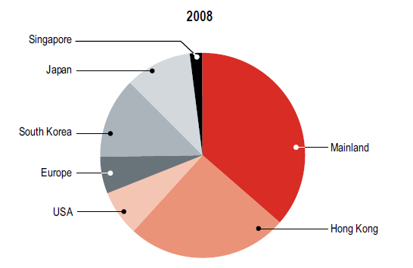
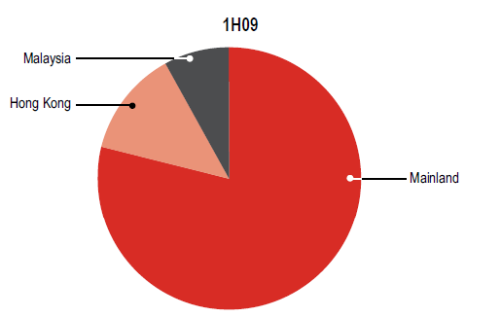
The rise of institutional investors
Source: Jones Lang LaSalle Research 2009

Slide 5
REITs: Will they be a substitute for direct property?
The literature has established that REIT returns are affected not only by their underlying property asset returns but also by stock market volatility.
In China, there was no evidence to suggest that property companies Granger-causing the performance of property markets, it indicated opportunities existed separately within direct and indirect property (Newell et al, 2005 and 2009)

Slide 6
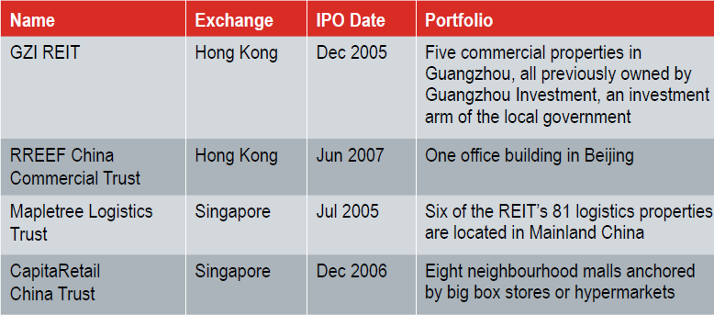
REITs with Chinese property components
Source: companies’ websites, Whiting (2006) and Jones Lang LaSalle (2009)

Slide 7
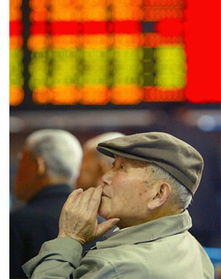
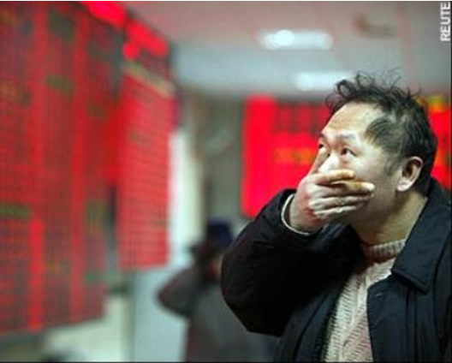
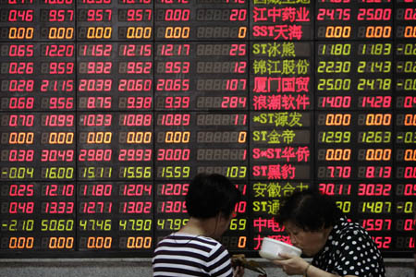
Notes:
A woman blows a bubble gum at a stock exchange market in Shanghai May 29, 2007. China has raised stamp tax on securities trading has been raised from 0.1 percent to 0.3 percent beginning Wednesday, May 30, in an effort to cool the overheated stock market. (Reuters)

Slide 8
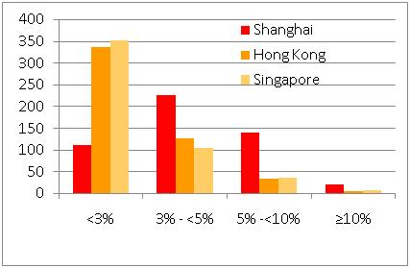
Weekly Volatilities Ranges

Slide 9
Questionnaire survey and results
Online survey of 60 presidents or senior managers of Chinese property companies in August 2009, 56 valid responses were received.
All respondents were familiar with the concepts of Chinese property REITs and 71% would like to invest in REITs.
All respondents agreed that the returns and risks of potential Chinese REITs would be affected by the performance of the underlying property markets and that of the stock market where they are listed.

Slide 10
Questionnaire survey and results
Reason for investing in Chinese REITs:
Perceived nature as equity type investments with potential high returns, liquidity, low risk and stable dividends.
Reasons for not investing:
Perceptions that Shanghai Stock Exchange did not offer profitable investment opportunities and it was too complicated to invest in the other available options

Slide 11
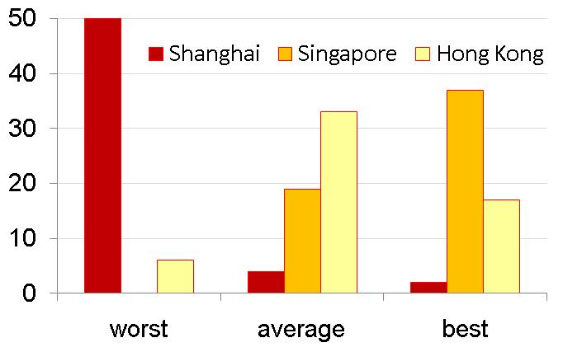
Questionnaire survey and results
86% thought that the regulation of the stock market was a very important influence on investor’s willingness to invest in REIT and 14% rated as quite important.
Quality of stock market regulation

Slide 12
Questionnaire survey and results
Respondents’ expectations of improvements to
Shanghai Stock Exchange regulations

Slide 13
Questionnaire survey and results
75% of respondents were aware of how to invest in other countries’ stock markets and repatriate their returns, but only 63% perceived the Hong Kong and Singapore exchanges as conveniently accessible.
17% claimed that they were familiar with the REITs tax status, 58% said they knew a little and 25% had no knowledge.

Slide 14
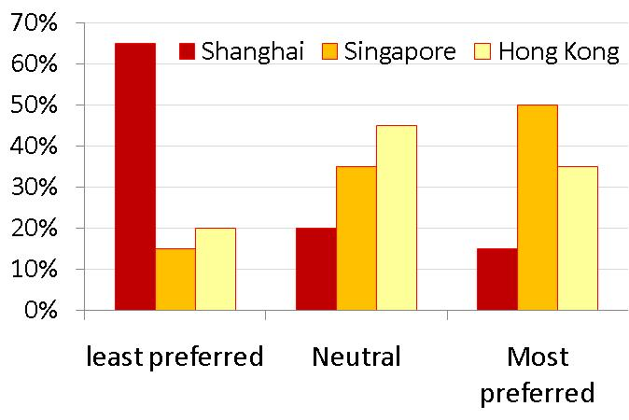
Preferred stock markets for investing in Chinese property REITs Factors considered: stock market regulation, capital and currency restrictions, perceived accessibility of the Singapore and Hong Kong REIT market and knowledge about their tax transparency.

Slide 15
Conclusions
Both the literature and our survey results suggest REITs based on Chinese real estate would be in high demand should they become available.‬‪
The survey confirmed that Chinese real estate professionals recognise that the performance of the stock market where they are listed affects REIT returns, and regulation was an important factor influencing their willingness to invest. ‬‪
Overall, the Shanghai Stock Exchange was their least preferred investment location for Chinese REITs and Singapore was the most preferred. The attitudes of the survey sample show that any REIT listing on the Shanghai market is likely to be met with caution amongst domestic professional investors. ‬‪
Notes:
though some said they would invest via the former if it improved its governance to the extent that they came to trust it.

