Slide 1


Liquidity Pricing in
Unlisted Real Estate Funds
Giovanni Tira and Gianluca Marcato

Slide 2
Agenda
Introduction and Results Overview
Data Description
Model and variables
Liquidity pricing
Conclusions

Slide 3
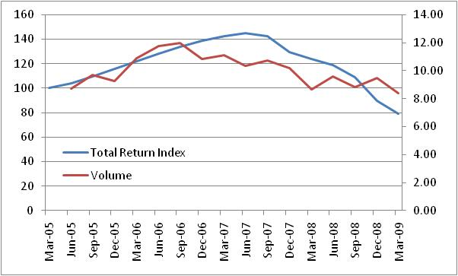
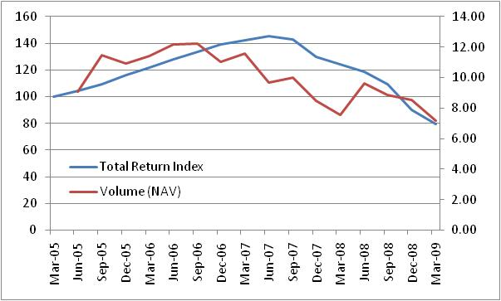
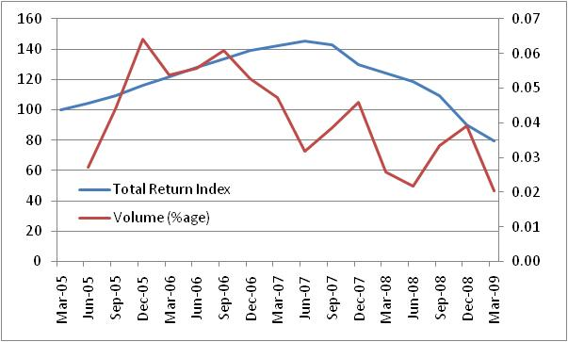
Liquidity: Volumes
Total return index falling from 08
Positive relationship
Liquidity leading returns
Unit and NAV are similar
Percentage of outstanding has volatile behaviour

Slide 4
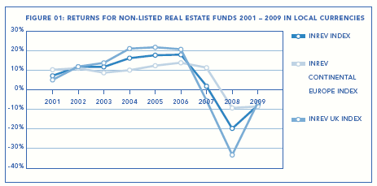
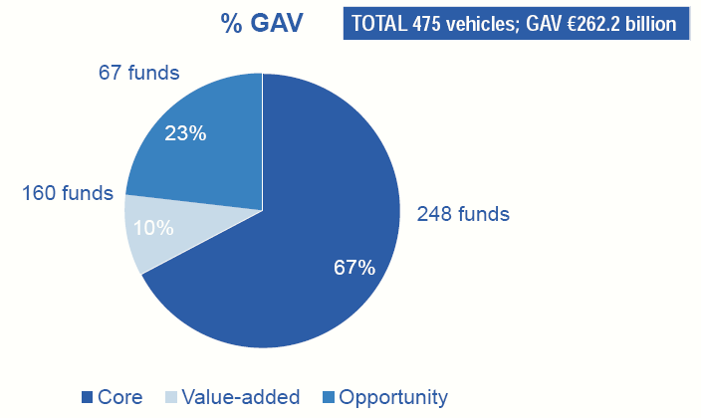
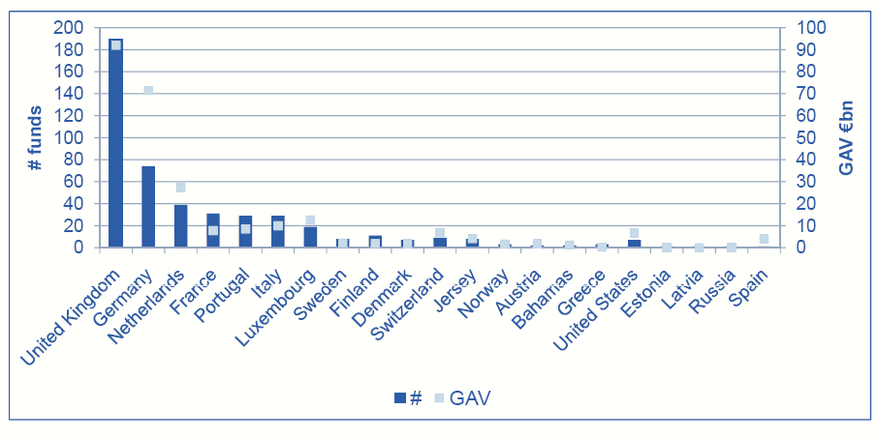
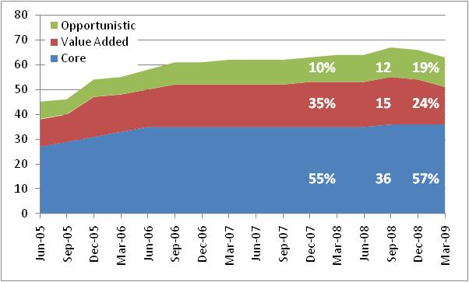
Return, manager and style
Return
Style
Style
Manager
Source: INREV

Slide 5
Research Questions
What are the risk driving factors for open ended unlisted fund?
How can we define liquidity?
Are returns and liquidity auto-correlated?
What is the causality between liquidity and returns?
Do manager’s characteristics and investor type bring better performances?

Slide 6
Results Overview
Volumes do not provide any pricing signal, while outflows and net flows do
Volumes do not suggest return chasing behaviour, while inflows and net flows do
Other fund characteristics have consistent effect in several models
Manager’s characteristics do not seem to play an important role
Using these results within an investment strategy helps to improve the performance of a fund of funds

Slide 7
Literature Review
Pricing signal in real estate markets:
  Movements of liquidity in REITs influence fund returns: Chui, Titman and Webb (2000)
  Reaction to fund liquidity shocks: Ooi, Ong and Li (2008)
  Common factors and different timing of liquidity effects on REITs and REMFs: Tuluca, Myer and Webb (2000)
  Private real estate market turnover has a price pressure effect on returns: Ling, Marcato and McAllister (2009)
Return chasing behaviour in real estate markets
  REIT and mutual funds: Ling and Naranjo (2003, 2006)
  Private real estate markets: Ling, Marcato and McAllister (2009)

Slide 8
Literature Review
Liquidity and total return in equity markets
  Away from optimal allocation (cash issue): Edelen (1998)
  Return chasing behaviour / money smart effect
    Redeem (invest in) -ve (+ve) past returns: Ivkovic and Weisbenner (2008)
    After-tax returns influence net fund flows: Poterba (2001)
Studies on Real Estate Mutual Funds (REMFs):
  Active REMFs beat passive funds: O’neal and Page (2000)
  Stock market performance influences REMF returns: Gullet and Redman (2005)
  Rising equity markets lead to an increase in redemptions and affect total returns: Brounen et al. (2007)
  REMFs are driven by the same sentiment driving the stock market: Tomperi (2009)

Slide 9
Data Description
Source: IPD property fund vision
84 UK Real estate mutual fund
  71 open ended funds (Specialised 31, Diversified 40)
  13 closed ended funds
Sample period: 1Q 2005 – 1Q 2009
  1100 quarterly observations
Outstanding value: £50 billion
  53% of UK market, 20% European market
Source for other variables: Thomson DataStream

Slide 10
How to Proxy Liquidity
Three definitions of liquidity:
  Volumes
  Inflows and outflows
  Net flows
Three definitions of flows:
  Number of units
  Net Asset Value (i.e. NAV)
  Percentage (%age) of total amount
 |  | Types of flows
 |  | # Units | NAV | %age
Types of Liquidity | Volumes | 1 | 2 | 3
 | In/Outflows | 4 | 5 | 6
 | Net flows | 7 | 8 | 9

Slide 11
Summary Statistics
Notes:
Size is Asset (NAV+ cash+ other net asset+ listed investment)
Asset conc by no. properties (100% is with 1 property, 0% is with 657 properties, i.e. max)
Liquidity measures in %age of no. of units
Leverage = Debt / NAV
Cash in %age of NAV

Slide 12
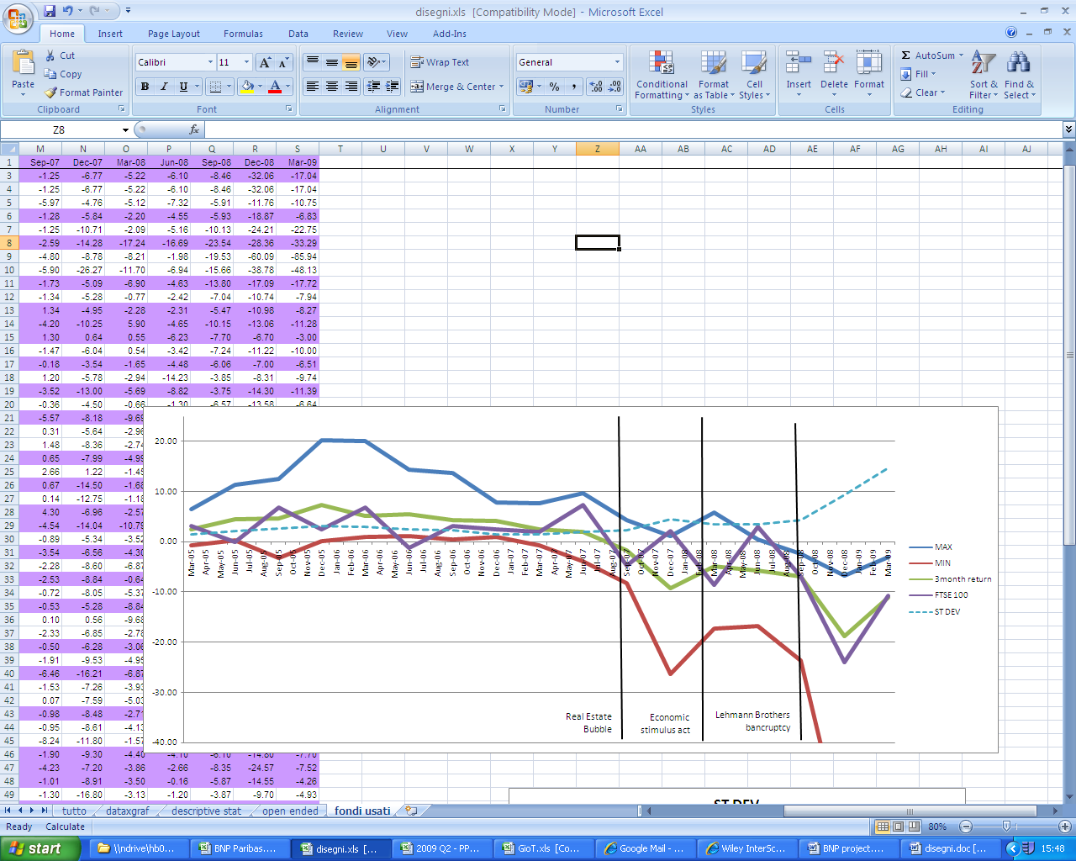
Sample Analysis
Total return and volatility
REMFs lag equity return by one quarter in the first part of the sample and are less volatile
Increasing volatility after Real Estate bubble
UK valuers have considered market sentiment

Slide 13
Vector AutoRegressive (VAR) Model
Uncertainty about causality (i.e. endogeneity) :
  VAR model with 4 lags (1 year) for liquidity
  Lag of 1 period for other variables
Joint effect of lags: Wald Test
Effect of manager on return: manager related variables

Slide 14
Model and Variables
Variables are divided following an idea of Ghosh and Sirmans (2005):
Endogenous
Exogenous
Investor
Stock market returns
Grow in GDP
Fund size
Debt
Specialization
Asset turnover
Vintage
Flows
Redemptions outstanding

Slide 15
Results: Liquidity
Trading
Pricing signal
Return chasing behaviour

Slide 16
Results: Total Return (Volumes)
Total
Return Liquidity
The dimension of the fund implies managerial difficulties rather than economies of scales
Turnover of assets does not grant any extra returns
The higher the leverage, the higher the absolute return ... Hence negative impact in late 2000s
Cash is seen as a valuable option to acquire investments with positive NPV (prevailing effect on lost returns)
Asset concentration does not improve returns.
Equity markets are positively related to REMFs
Surprisingly better GDP growth reduces returns in REMFs
Outstanding redemptions represent a risk which is priced

Slide 17
Results: asset manager related variables
Opportunistic funds are the only ones to show both different
  Performance (higher in absolute term) and
  Liquidity (higher than core and value added)

Slide 18
Conclusions
Liquidity effect on total return:
  Volumes do not contain any pricing information, but outflows and net flows do
  Better performing funds attract more capital (i.e. return chasing behaviour for inflows and net flows)
Exogenous and endogenous variable have consistent effect throughout different models
Manager’s characteristics do not seem to provide outperformance, but single managers may still do.

Slide 19
Thank you for your attention
Any questions?

