Slide 1
Non-Stationary Semivariogram Analysis Using Real Estate Transaction Data
Piyawan Srikhum
Arnaud Simon
Université Paris-Dauphine

Slide 2
Motivations
Problem of transaction price autocorrelation (Pace and al. 1998, Can and Megbolugbe 1997, Basu and Thibideau 1998, Bourassa and al. 2003, Lesage and Pace 2004)
Spatial statistic has two ways to work with the spatial error dependency: lattice models and geostatistical model (Pace, Barry and Sirmans 1998, JREFE)
We interested in geostatistical analysis
Computing covariogram and semivariogram function

Slide 3
Motivations
  Spatial stationary assumption should be made to allow global homogeneity
Many papers in others research fields take into account a violation of spatial stationary assumption (Haslett 1997, Ekström and Sjösyedy-De Luna 2004, Atkinson and Lloyd 2007, Brenning and van den Boogaart wp)
No article works under non-stationary condition in real estate research fields

Slide 4
Objectives and Data
Examine the violation of stationary assumption, in term of time and space
Show problem of price autocorrelation among properties located in different administrative segments
Use transaction prices, from 1998 to 2007, of Parisian properties situated 5 kilometers around Arc de Triomphe

Slide 5
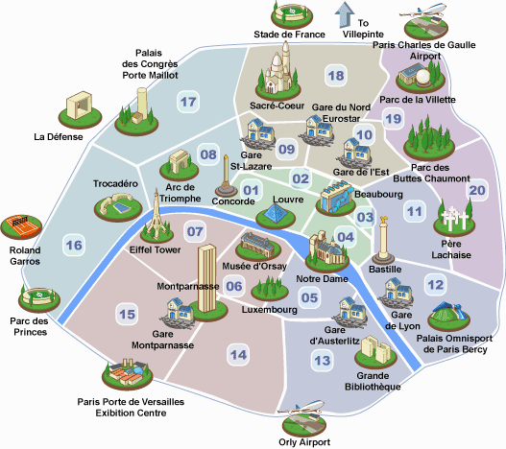
Data

Slide 6
Reviews of Geostatistical Model
Property price compose with 2 parts
  Physical caracteristics value
  Spatial caracteristics value
Physical Caracteristics: Hedonic regression
  Hedonic regression evaluate value for each caracteristic
  Y = c + (a*nb_room+ b*bathroom + c*parking +d*year +…)+ ε
  Physical Spatial
  Caracteristics Caracteristics

Slide 7
Reviews of Geostatistical Model
Spatial Caracteristics : Geostatistical model
For each with
  x : longitude
  y : latitude
Empirical semi-variogram is caculted from residuals :
number of properties pairs separating by distance « h »

Slide 8
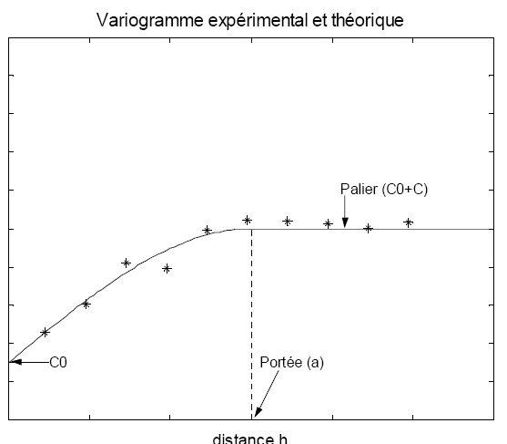
Reviews of Geostatistical Model
Semivariogramme is presented in plan

Slide 9
Reviews of Geostatistical Model
Fit estimated semivariogram with spherical semi-variogram function

Slide 10
Reviews of Geostatistical Model
Spherical semivariogram is an increasing function with distance separating two properties
Start at called « nugget » and increase until
called « sill »
Low semivariogram present high autocorrelation
Stable semivariogram present no more autocorrelation

Slide 11
Methodology
2 steps : Time stationary and spatial stationary
Time stationary : 1-year semivariogram VS 10-years semivariogram
Spatial stationary : 90° moving windows

Slide 12
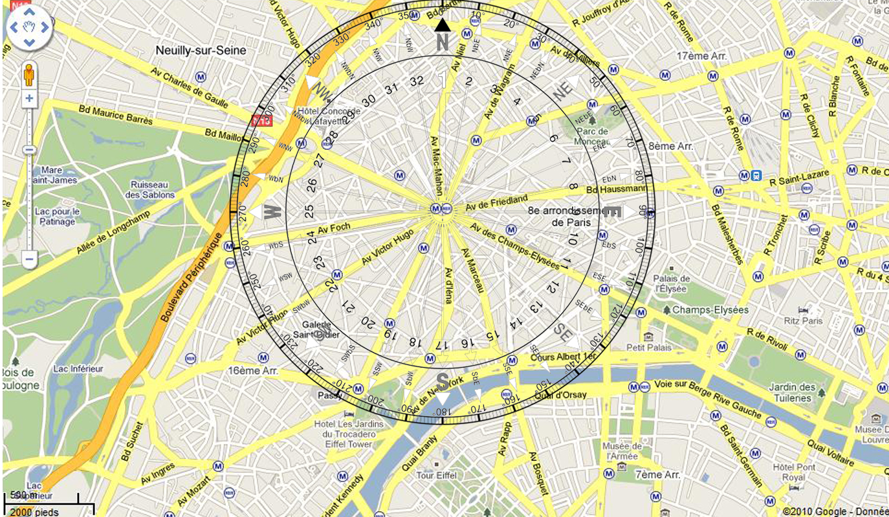

Slide 13
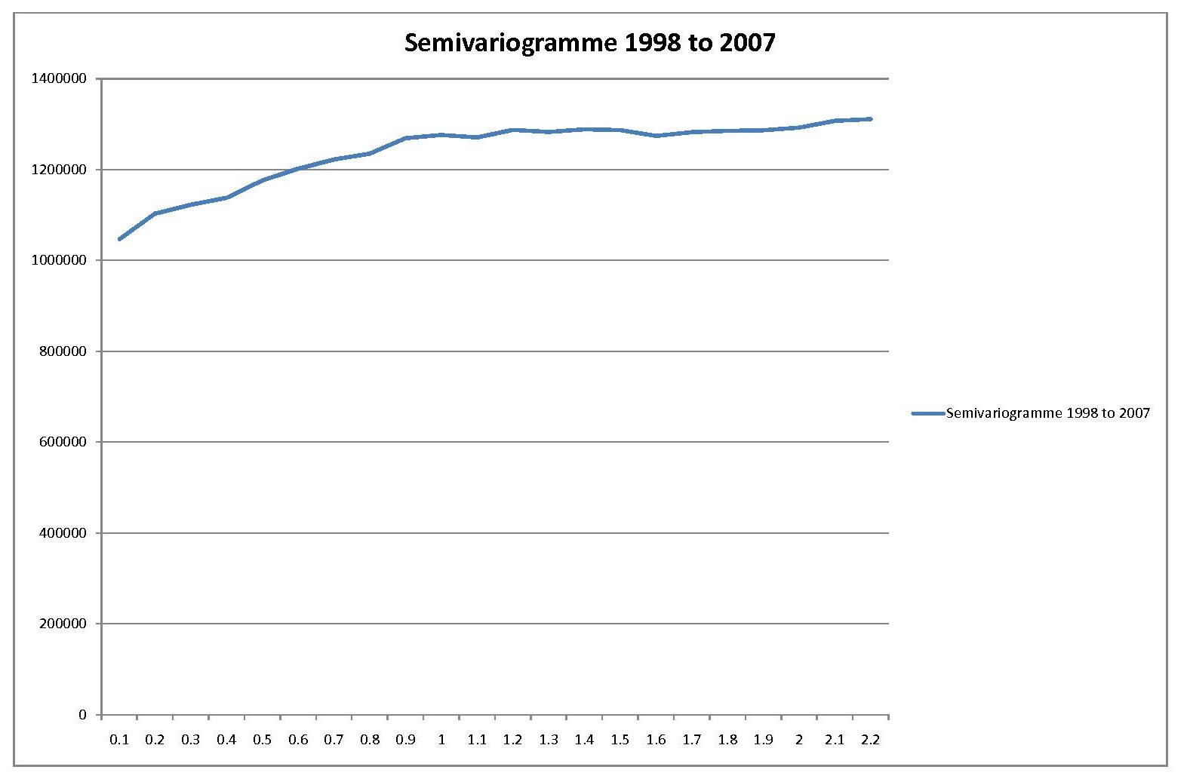
Results : 1-year semivariogram VS 10-years semivariogram
10-years semivariogram
Estimated range value equal to 1.1 kilometers

Slide 14
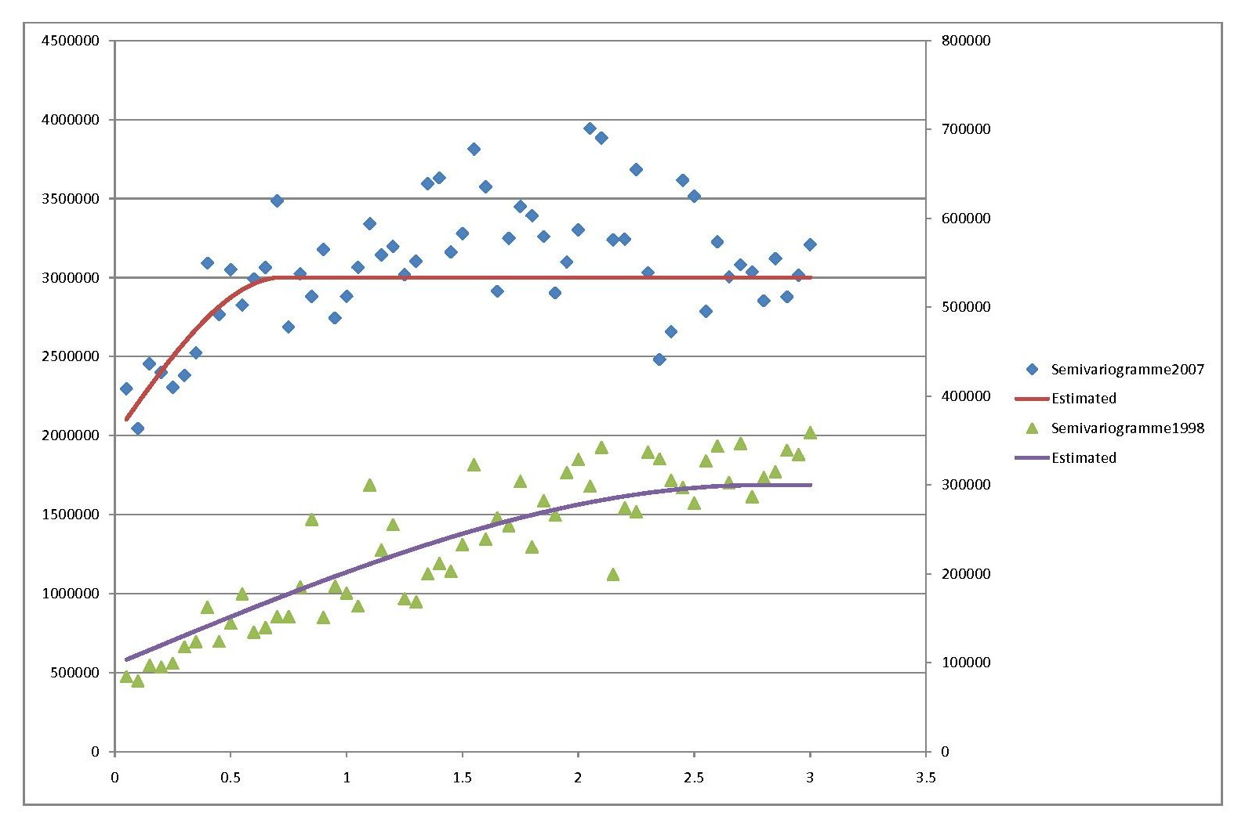
Results : 1-year semivariogram VS 10-years semivariogram
1- year semivariogram
Estimated range value : 2.3 km for 1998 and 720 m for 2007
Range value are different for each year
Range value are different from 10-years semivariogram

Slide 15
Results : 1-year semivariogram VS 10-years semivariogram
Period | 1998-2007 | 1998 | 1999 | 2000 | 2001 | 2002 | 2003 | 2004 | 2005 | 2006 | 2007
N | 307 346 | 28 418 | 34 898 | 32 583 | 31 188 | 30 761 | 27 930 | 31 830 | 31 429 | 29 513 | 28 796
R2 | 52.88% | 23.29% | 23.65% | 21.46% | 18.20% | 17.26% | 16.45% | 13.01% | 12.36% | 11.83% | 13.25%
Nugget | 1011911 | 98114.44 | 152454.6 | 133747.6 | 142532.4 | 254584.4 | 611983.5 | 905121.6 | 859615 | 956280 | 1999762
Sill | 261227.4 | 201859.4 | 203127.8 | 356984.7 | 312749 | 551073.7 | 603172.8 | 405215.4 | 402734.1 | 406339.6 | 1001402
Range | 1.111266 | 2.792266 | 2.352961 | 1.56426 | 0.920327 | 0.635223 | 1.873897 | 0.926698 | 0.715583 | 0.64452 | 0.720628

Slide 16
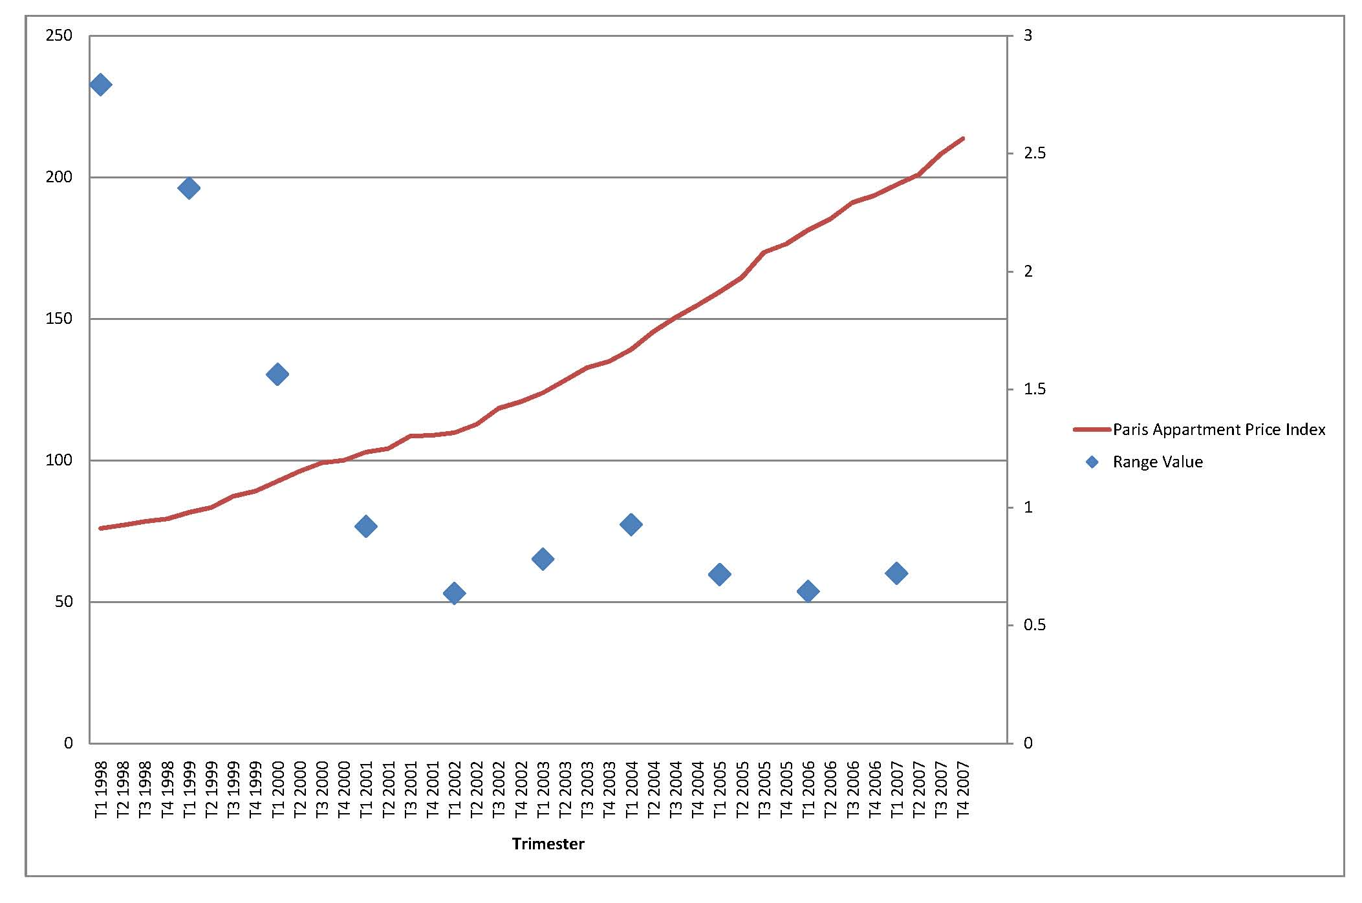
Results : Range values and Notaire INSEE price/m² index
Index increase, range value decrease
More market develop, more new segment

Slide 18
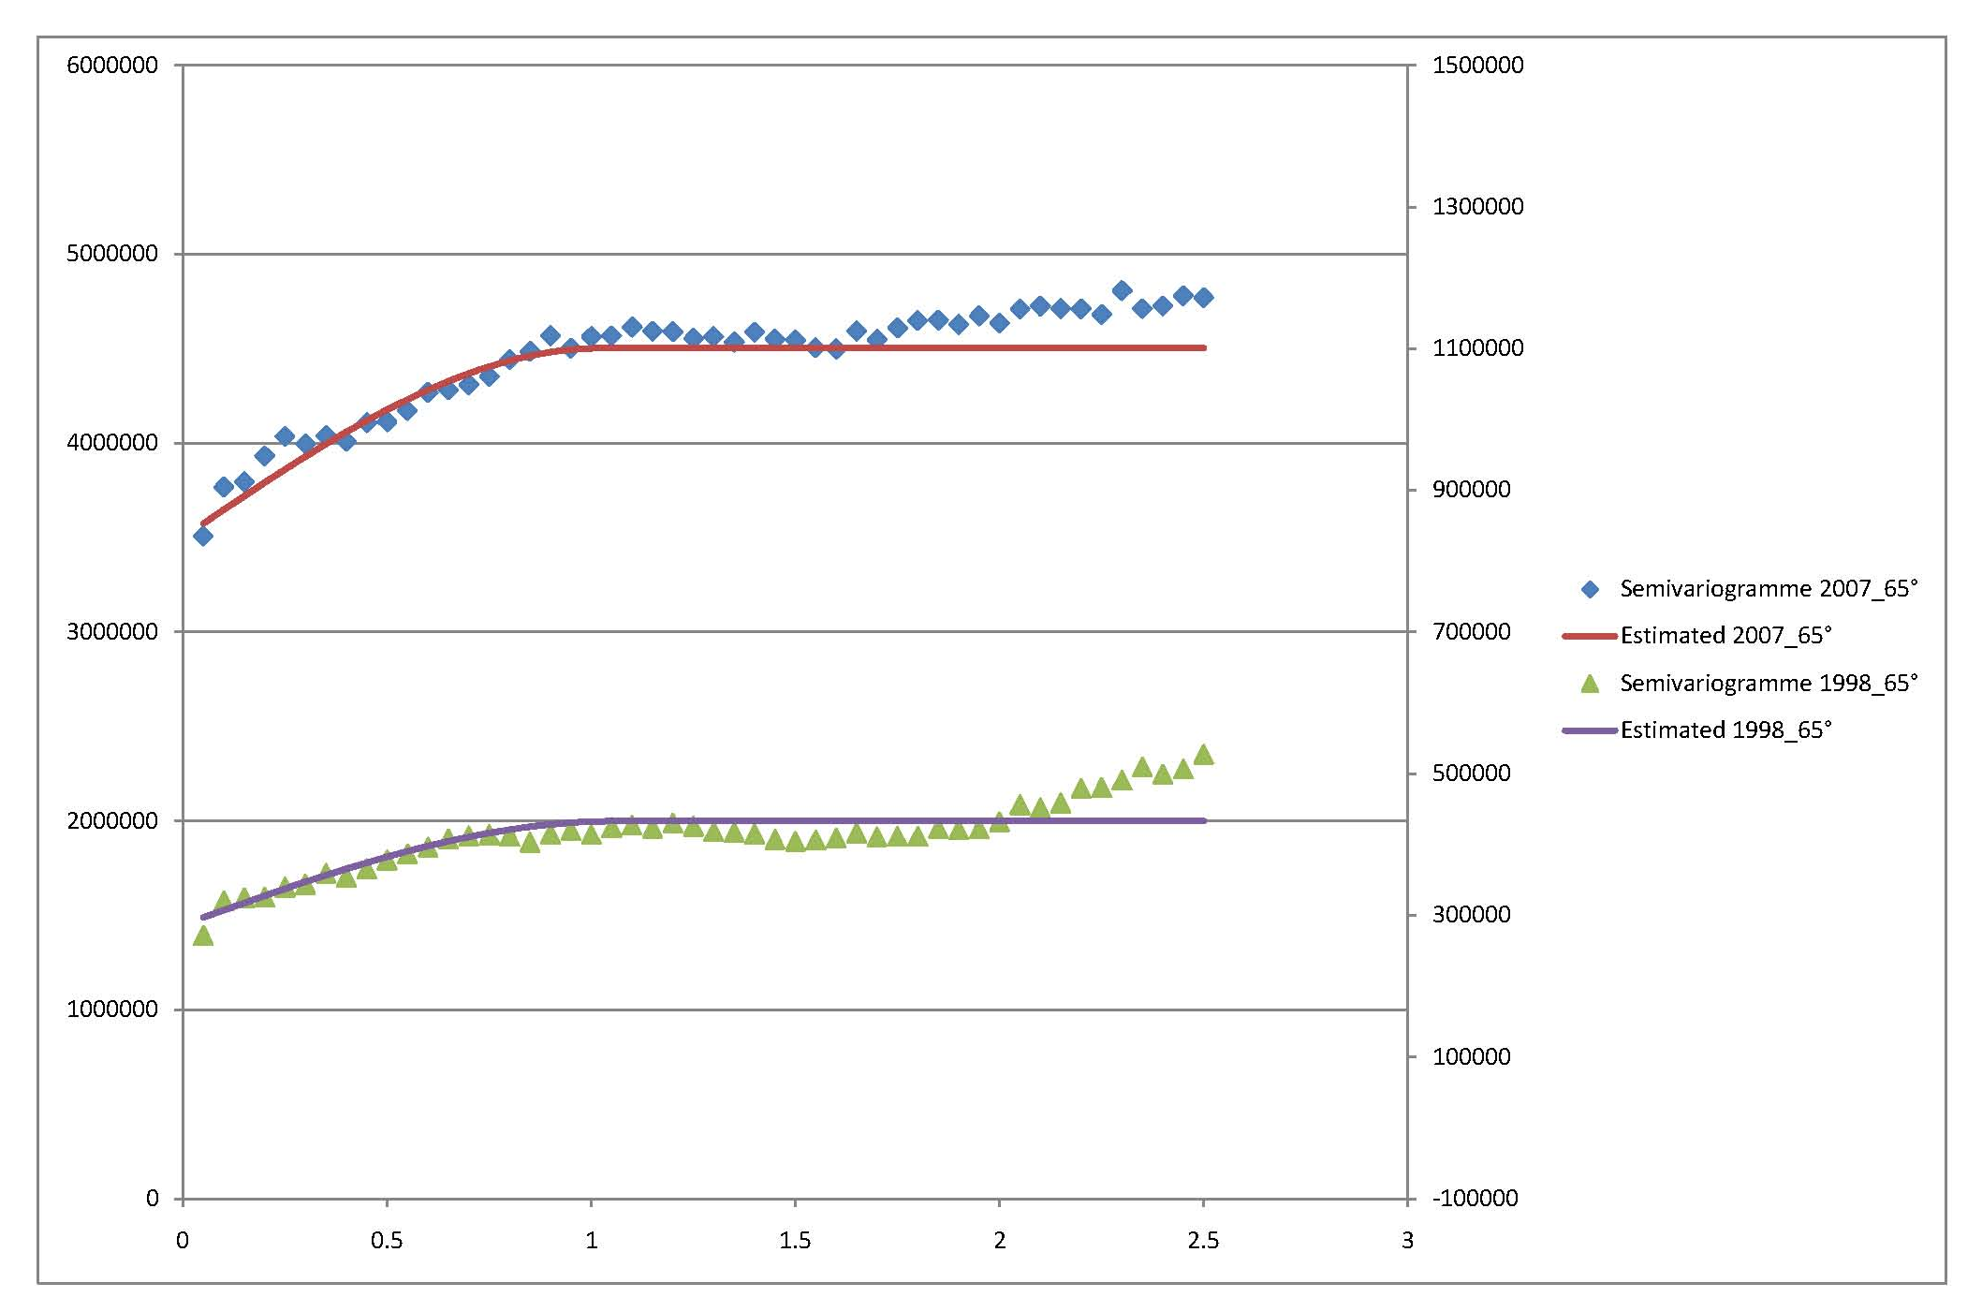
Results : 90° moving windows
65°: Parc de Monceau
Estimated range value : 1.05 km for 1998 and 1.02 km for 2007
Parc de Monceau is a segment barrier

Slide 20
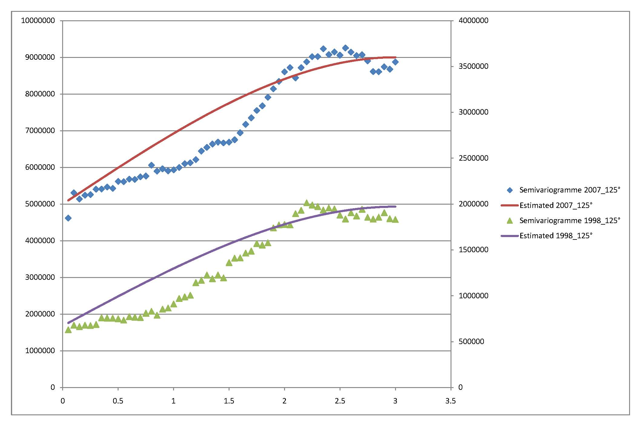
Results : 90° moving windows
115°: Avenue des Champs-Elysées
Fitted function is not spherical semivariogram

Slide 22
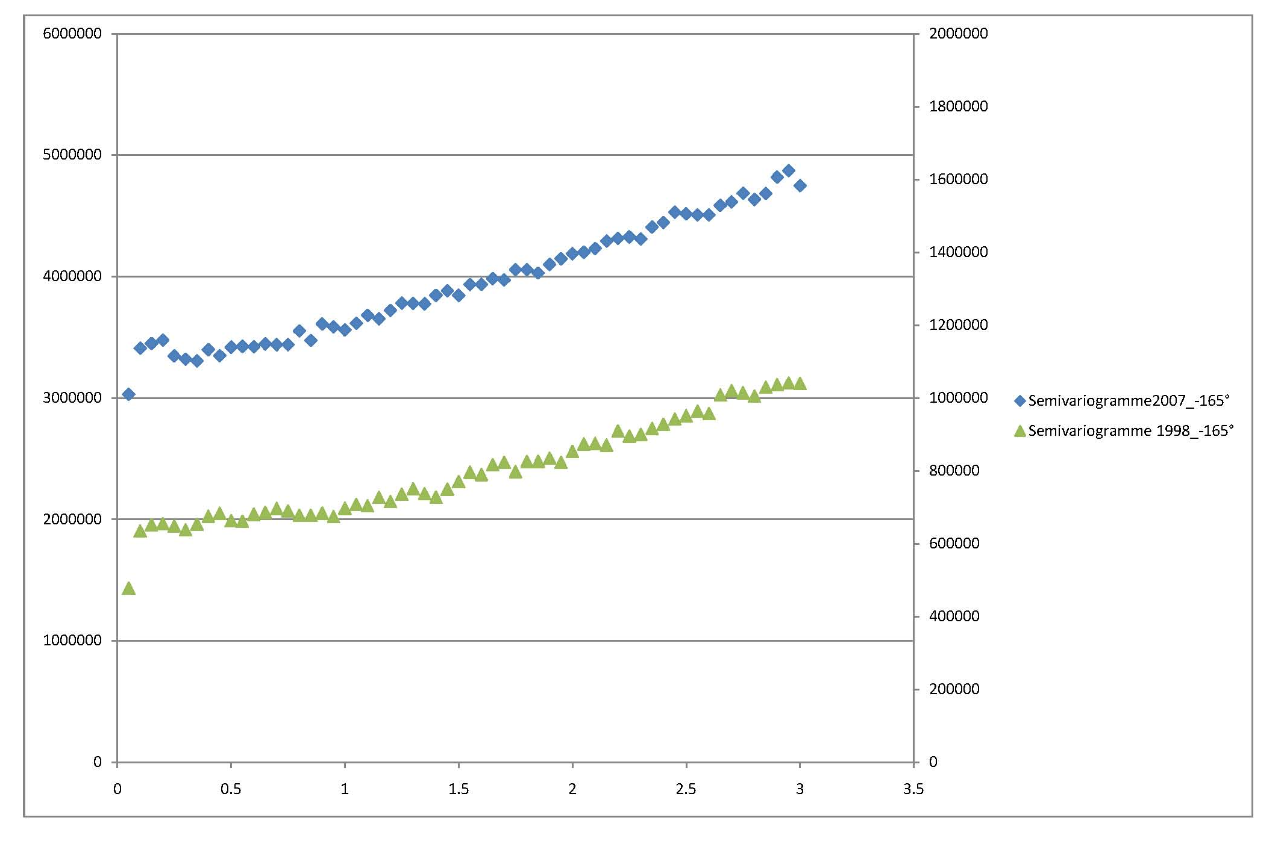
Results : 90° moving windows
-165°: Eiffel Tower
Range value is more than 3 kilometers

Slide 24
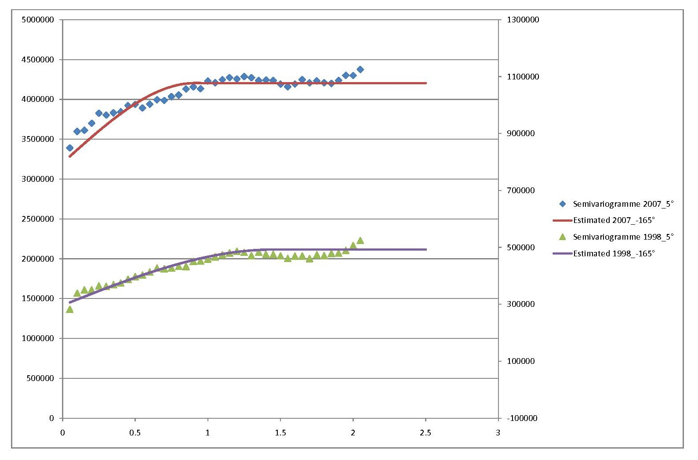
Results : 90° moving windows
5°: 17ème Arrondissement
Estimated range value: 1.4 km for 1998 and 920 m for 2007
17 arrondissement is divided in two segments

Slide 25
Conclusion and others approaches
Non-stationary in term of time and space
Different form of fitted semivariogram function
Several approaches for implementing a non-stationary semivariogram (Atkinson and Lloyd (2007), Computers & Geosciences)
  Segmentation
  Locally adaptive
  Spatial deformation of data

