Slide 1
Disclosing environmental and sustainability practices and initiatives in the annual reporting process of property investment organisations: Evidence from Malaysia
Ainoriza Mohd Aini
Prof. Sarah Sayce
School of Surveying & Planning, Kingston University London
ERES * MILAN * 23-26 JUNE 2010
Notes:
Coming to the end of my 2nd year PhD studies at Kingston University under the supervision of Prof Sarah Sayce.
This is not my main empirical work

Slide 2
The Agenda
Introduction
Research Methodology
Findings + Discussion
Conclusion

Slide 3
Introduction
Previously, behaving responsibly is seen as harming the investment performances.
But now, ignoring Environmental, Social & Governance issues can be very risky.
Increasing awareness of the importance of Socially Responsible Investment (SRI).
Previously SRI have been focusing on equity but lately have been applied to other asset classes including property.
Notes:
1)Previously behaving responsibly ...but not anymore, a point recently made very clear with the BP oil disaster.
2) As Investors today received pressure from customers, change in business practice, changes in gov legislation, employee expectations: These drive them change in the way they conventionally invest. And They believe that ignoring Environmental, social and governance issues in their investment decision can be very risky.

Slide 4
SRPI Definition
Sustainable and Responsible Property Investment can be defined as ..
“maximizing the positive effects and minimizing the negative effects of property ownership, management and development, on society and the natural environment in a way that is consistent with investor goals and fiduciary responsibilities.”
(Pivo & McNamara,2008) ¹
1 In Pivo & McNamara (2005, p.129), used the term Socially Responsible Property Investment

Slide 5
SRPI Criteria (1)
Energy conservation
conservation, retrofitting, green power generation and purchasing, energy-efficient design
Environmental protection
water conservation, solid waste recycling, habitat protection
Voluntary certification
infill development, flexible interiors, brownfield redevelopment
Public transport oriented developments
Urban revitalization and adaptability
green building certification certified sustainable wood finishes
transit oriented development, walkable communities, mixed-use development
Adapted from UNEPFI Property Working Group (2007)
Notes:
What acts are considered as sustainable / responsible property investment?
Mungkin sama, tp degree of importance maybe difference

Slide 6
SRPI Criteria (2)
Health and safety
site security, avoidance of natural hazards, first aid readiness
Worker well being
plazas, childcare on premises, indoor environmental quality, barrier-free design
Corporate citizenship
quality design, minimum neighbourhood impacts, considerate construction, community outreach historic preservation, no undue influence on local governments
Social equity and community development
Local citizenship
regulatory compliances, sustainable disclosure and reporting, independent boards, adoption of voluntary codes of ethical conduct, stakeholder engagement
fair labour practices, affordable/social housing, community hiring and training
Adapted from UNEPFI Property Working Group (2007)
Notes:
** not including governance!

Slide 7
Sustainable & responsible property investment
SRPI has made significant progress in the property industry.
ESG are now included in property ownership, management & development.
Real estate companies and trust have been listed in indices. Eg: Dow Jones sustainability world index
Dedicated sustainability property funds have been launched in the US, UK, Australia & Germany.

Slide 8
Literature surrounding environmental and sustainability initiatives in property investment is concentrated in more mature economies.
Property agenda has been dominated by ‘green’ concerns rather than social aspects.
- Pivo (2008) top criteria for investors are energy efficiency, public transport, daylight and natural ventilation.
..... What about developing countries? What are the agenda in Malaysia?
Notes:
Hang on a minute.. What about developing countries like Malaysia? What are they doing in response to the sustainability challenges? Do investors community concern about environmental issues?

Slide 9
Previous research?
Newell and Manaf (2008) - significance of sustainability practices by the Malaysian property companies.
No other attempt has been made to investigate the responsible and sustainability practices and initiatives in property investment organisations in Malaysia.
This paper seeks to contribute to the existing literature by reviewing the disclosure of those activities in property investment organisation using publicly available company literature.
Notes:
This paper seeks to contribute to the existing literature by reviewing the disclosure of those activities in property investment organisation using publicly available company literature.
Not to paint the picture of best practices but rather to identify activities, strategies contributing to the progress of sustainable and responsible property investment.

Slide 10
The Objective
More specifically, the objective of this present study is to elicit the answer of the following issues:
the extent to which disclosure of environmental and sustainability practices and initiatives in the annual reporting process of property investors in Malaysia.
the current practices contributing to SRPI among property investors in Malaysia;
the environmental and social issues concern property investors in Malaysia; and
their actions with regards to their property portfolio.
Notes:
The nature of the enquiry does not allow an in-depth analysis of the motivation or importance attached to the environmental and sustainability issues considered in property investment decision. Rather the aim of this paper is to provide some preliminary evidence of the progress made by property investors in Malaysia in embracing SRPI and allowing the identification of those property investors seeking to improve their portfolio.

Slide 11
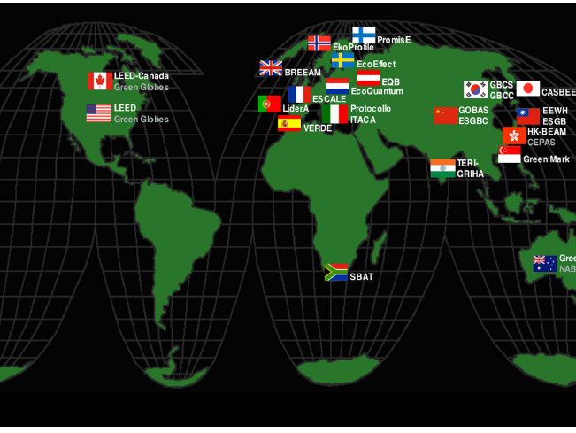

Slide 12
The Malaysian Scenario
Malaysia faces specific environmental problems : deforestation which has caused loss of biodiversity, erosion and pollution.
Malaysia is also not excluded from confronting the challenges of the growing needs of energy.
Carbon emissions in Malaysia have increased by 221 percent since 1990, the highest growth rate among the world‘s top emitters (United Nation Development Programme, 2007).
Notes:
.. Even though Malaysia ratified the Kyoto Protocol.
3) Malaysia is also confronted with the other end of this problem which is the impact of energy related CO₂ emission on climate change.

Slide 13
The Malaysian Scenario
Awareness of social issues: affordable housing needs, fair labour, workers safety and well-being, access for the disabled as well indigenous people rights has been growing.
At this point, it is important to understand how property investment communities reacted to these issues and their action against their portfolio.
Notes:
Apart from awareness of environmental issues...

Slide 14
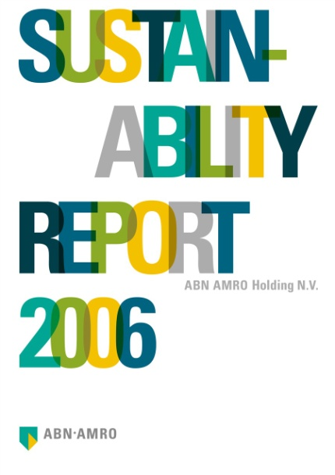
Social Responsibility & Sustainability Reporting
Disclosure of CSR and sustainability information has been mandated by a number of governments throughout the world including Malaysia.
In 2007, The Prime Minister of Malaysia announced that all companies listed on the Malaysia stock exchange would be required to disclose information on CSR activities in their annual financial report.
As minimum, public listed companies are required to include a CSR statement in their annual reports, however there is no restriction to the content.
Notes:
Why look at their annual report?
Since 2007,

Slide 15
Introduction
Research Methodology
Findings + Discussion
Conclusion
Notes:
- I

Slide 16
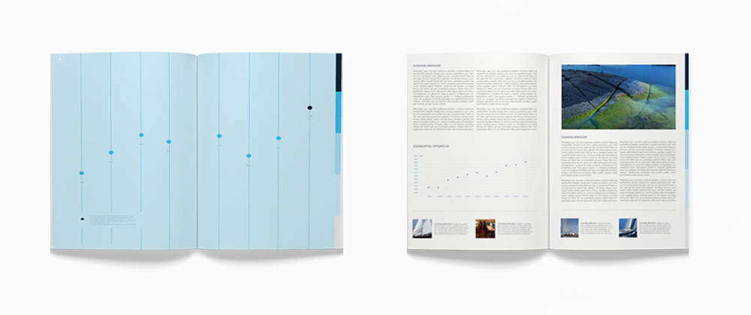
Methodology
Content Analysis of publicly available company literature
Annual Reports & stand alone CSR /Sustainability reports (if published) from year 2007-2009
Annual reports are more than just a statutory documents
Primary communication vehicles for company environmental reporting.
Notes:
I thought, how do I know what these property organisations in Malaysia are doing with their operation? They certainly going to report ‘good news’ in their annual report!
So I ‘dig’ into their annual reports. These reports are either available on their website or Bursa Malaysia website.
Although company websites were also examined, focus was given to the reports as disclosure in other media do not provide permanent evidence of corporate disclosure.

Slide 17
Methodology
Target Information:
background information relating to the structure, type of properties as well as general organisation mission.
The extent of environmental and sustainability disclosure
Any property specific practices contributing to sustainable and responsible property investment which have been implemented or planning to be implemented.
Sample:
Real Estate Investment Trusts (REIT)
#13
Listed Property Investment Companies
#9
Key institutional Investors
#5

Slide 18
Malaysia Real Estate Investment Trusts
REITS | Type of Properties
Amfirst REIT | Office
Hektar REIT | Shopping Complex
Amanah Raya REIT | Private Colleges, Warehouse, Factory
UOA REIT | Office
Starhill REIT | Shopping Complex, Hotels
Atrium REIT | Office & warehouses
Quill Capital Trust | Office, Commercial (Incl. Hypermarket,)
Tower REIT | Office
Axis REIT * | Commercial, Office, Warehouse
KPJ Al-Aqar REIT * | Private Hospitals
Al-Hadharah Boustead REIT * | Plantations
Amanah Harta Tanah PNB | Office, Shop Offices,
Amanah Harta Tanah PNB 2 | Office, Commercial Buildings
* Islamic REITs

Slide 19
Property Investment Companies
For the purpose of this study only property companies involved with long-term property investment, as opposed to development or trading, have been selected for this study.
Property Companies | Portfolio
Selangor Property Berhad | Retail, Office, Hotel
IGB Corporation Berhad | Retail, Office
Asia Pacific Land Berhad (AP Land) | Office,Retail, hotel
Lien Hoe Berhad | Retail, Office
Selangor Dredging Berhad | Office
UDA Holdings Berhad | Retail
KLCC Properties Holdings Berhad | Office, Hotel, Retail
Goldis Berhad | Office, Hotel
Malaysia Resources Corporation Berhad (MRCB) | Office, Shopping Complex, Retail, Residential & Industrial
1. Ting (2002) Listed Property Companies in Malaysia, In PRRES.

Slide 20
Key Institutional Investors¹
Institutional Investors | Type
Employee Provident Fund (EPF) | Pension fund for all employees
Permodalan Nasional Berhad (PNB) | Unit trust
Lembaga Tabung Angkatan Tentera | Superannuation fund for Armed Forces²
Lembaga Tabung Haji | Saving for pilgrimage (Muslims only)
Social Security Organisation (Pertubuhan Keselamatan Sosial) (SOCSO) | Insurance scheme for all working in public and private sectors
¹ 5 largest institutional investors in Malaysia ( A Wahab et al, 2009)
2 Only 30% can be invested in other than trust.

Slide 21
Introduction
Research Methodology
Findings + Discussion
Conclusion
Notes:
-

Slide 22
(1) Amount of CSR or sustainability and environmental disclosure
 | No of companies studied | No of companies having separate CSR/sustainability report | No of companies having CSR or sustainability statement /section in annual report
Real estate investment trust | 13 | 0 | 6
Property Investment Companies | 9 | 1 | 9
Key institutional investors | 5 | 0 | 5
* MRCB Berhad has published standalone ‘environmental and social report’
Notes:
None have separate ‘Sustainability Report’ or clear policy on the integration of ESG in investment decisions and management.
Only 6 have special on CSR/Statement on CSR in the annual report (2007-2009) (Axis, Al-Hadharah, Quill Capita, Amfirst REITs, Starhills).
LISTED PROPERTY INVESTMENT COMPANIES:
All have special section on CSR or Statement on CSR in the annual report.. 1 company actually has published standalone “Environment

Slide 23
(2) Disclosure of sustainable and responsible investment practices
Annual reports were assessed against:
UNEPFI (2007) 10 Elements of RPI.
any other forms of good practices including corporate philanthropy were also examined.
Notes:
Whether they have implement or planning to implement!

Slide 24
MALAYSIAN REITS
 | (A) Energy conservation | (B) Environmental protection | (C) Voluntary certification | (D) Public transport oriented developments | (E) Urban revitalization and adaptability | (F) Health and safety | (G) Worker well being | (H) Corporate citizenship | (I) Social equity and community development | (J) Local citizenship | Corporate Philanthropy | Total
Amfirst | x | x | x | x | x | x | x | x | x | x | x | 0
Amanah Harta Tanah PNB (AHPNB) | x | x | x | x | x | x | x | x | x | x | x | 0
Amanah Harta Tanah PNB (AHPNB 2) | x | x | x | x | x | x | x | x | x | x | x | 0
Hektar REIT | x | x | x | x | x | x | x | x | o | x | o | 2
Amanah Raya | x | x | x | x | x | x | x | x | x | x | x | 0
UOA | x | x | x | x | x | x | x | x | x | x | x | 0
Axis* | x | x | x | x | x | x | x | x | x | x | o | 1
Starhill REIT | x | x | x | x | x | x | x | x | x | x | o | 1
Atrium REIT | x | x | x | x | x | x | x | x | x | x | x
Quill Qapita Trust | o | o | x | x | x | x | x | x | x | x | o | 3
Tower REIT | o | x | x | x | x | x | x | x | x | x | o | 2
AL-Aqar REIT* | x | x | x | x | x | x | x | x | x | x | x | 0
AL-Hadharah Boustead* | n/a | x | n/a | x | x | x | x | x | x | x | o | 1
Total | 2 | 1 | 0 | 0 | 0 | 0 | 0 | 0 | 1 | 0 | 6
Notes: o=Included in the report x =Not included in the report/not examples found N/A= not applicable – do not have buildings in the portfolio

Slide 25
LISTED PROPERTY INVESTMENT COMPANIES
 | (A) Energy conservation | (B) Environmental protection | (C) Voluntary certification | (D) Public transport oriented developments | (E) Urban revitalization and adaptability | (F) Health and safety | (G) Worker well being | (H) Corporate citizenship | (I) Social equity and community development | (J) Local citizenship | Corporate Philanthropy | Total
Selangor Property Berhad | x | x | X | x | x | x | x | x | x | x | o | 1
IGB Corporation Berhad | x | x | X | x | x | x | x | x | x | x | o | 1
Asia Pacific Land Berhad (AP Land) | x | x | X | x | x | x | o | x | x | x | o | 2
Lien Hoe | x | x | X | x | x | x | x | x | x | x | o | 1
Selangor Dredging Berhad | o | o | X | x | x | x | o | x | x | o | o | 5
UDA Holdings | x | x | X | x | x | x | x | x | x | x | o | 1
KLCC Properties Holdings Berhad | o | o | X | x | x | o | x | x | o | o | o | 6
Goldis Berhad | o | o | o | x | x | x | x | x | x | x | o | 4
Malaysia Resources Corporation Berhad (MRCB) | o | o | o | x | x | o | o | o | o | o | o | 9
Total | 4 | 4 | 2 | 0 | 0 | 2 | 3 | 1 | 2 | 3 | 9
Notes: o=Included in the report x =Not included in the report/not examples found

Slide 26
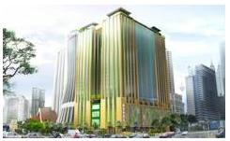
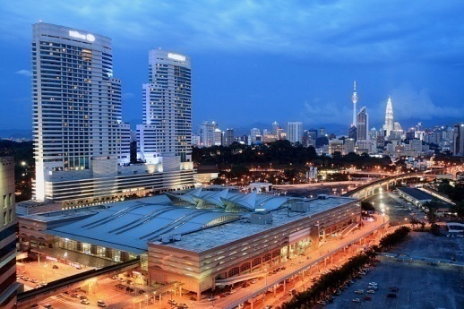
Voluntary Certification
Malaysia’s Green Buildings Index (GBI) was recently launched in April 2009.
No single REITS or key institutional investors declare that they owned buildings certified with green building certification or mentioned any plan to apply for sustainable or green buildings certifications.
Property investment companies are showing better effort in voluntary certification:
Only MRCB explicitly mentioned about strategy to implement green building certifications.
Gtower (Goldis Berhad)
BCA Greenmark
KL Sentral (MRCB)
LEEDS & BCA Greenmark
Notes:
MRCB Board has issued a directive that all future projects be obtained either LEEDS, GreenMark Scheme or Malaysia’s Green Buildings Index certifications. MRCB (2008) Environmental & Social Reporting 2008.

Slide 27
Corporate philanthropy
6 REITS involved in corporate philanthropy i.e: contribution to education and social welfare: (YTL, Tower, Quill, Al-Hadharah, Axis, Hektar )
All listed property investment companies and all key institutional investors are involved in corporate philanthropy
In the form of: cash donation, contribution to education eg: providing scholarships and practical training and social welfare.
Why report on corporate philanthropy:
- activities to enhance their corporate image (Zulkifli & Amran, 2006)
- quantifiable and easier to implement and to report (Mohd Yusof, 2008).
- tax deduction (Amran, Ling & Sofri, 2007).

Slide 28
Conclusion
Environmental and sustainability disclosure is deplorably low across the property investment sector.
Evidence some of the Malaysian REITs and property investment companies are beginning to adopt sustainability practices
Next Stage: In-depth investigation
The Malaysian sustainability agenda is skewed more to notion of corporate philanthropy than environmental issues, which is in fairly sharp contrast to the approach of many developed countries where the property agenda has been dominated by ‘green’ concerns rather than social aspects of sustainability.
Notes:
.3) .although some of the Malaysian REITs and property investment companies are beginning to adopt sustainability practices this is less embedded than in other developed countries.

Slide 29
THANK YOU
a.mohdaini@kingston.ac.uk
School of Surveying & Planning
Faculty of Art, Design & Architecture
Kingston University London
Acknowledgement:
Producing Leaders Since 1905
Producing Leaders Since 1905

