Slide 1
Public Sector Asset Management Planning to Mitigate Climate Change Driven Natural Disasters – A Study of UK Disaster and Business Continuity Planning
Clive M J Warren
Peter Elliott
Simon Huston
University of Queensland – Business School
ERES 2010 - Milan

Slide 2
Climate Change and the increasing occurrence of natural disasters
Notes:
Acknowledge A/Prof Hamish McGowan as source of some slides.
Prof Susan Roaf Herriot Watt for some slides
Linking Climate change to Disaster Management and property.
Forstly set the scean with a drief discusssion on the drivers – climate change and what might a prudent asset manager expect.
Then look at my research to see what prudent asset managers are actually doing.

Slide 3
“The worst-case IPCC projections, or even worse, are being realised. Emissions are soaring, projections of sea level rise are higher than expected, and climate impacts around the world are appearing with increasing frequency”
Katherine Richardson (University of Copenhagen, 2009).
Notes:
IPCC Intergovernmental Panel on Climate Change
3

Slide 4
“If atmospheric CO² concentrations peak at 450–600 ppm(current CO² concentration is about 387 ppm) over the 21st century, this will likely lead to irreversible rainfall reductions in some regions, as well as to irreversible global sea‑level rise that could reach 1.0 m due to thermal expansion alone and could exceed several metres when the contributions from glaciers and ice sheets are included”
(Steffen 2009; Aust Govt. Dept. Of Climate Change).
Notes:
1 m sea level rise

Slide 5
Natural Disasters
Increasing Frequency
258 million/year suffer
Up from 74 million in 70’s
326 disasters (2008)
235,736 killed
Notes:
Each year past decade 258 m suffered up from 74m in 1970s
2008 figures are most recent and second highest in a decade – 2004 Tsunami year 241,366 died
2010 is already off to a very bad start with the Haiti earthquake.

Slide 6
Natural Disasters
Economic Loss (2008)
US$ 181 billion
Hurricane Katrina
US$ 140 billion
Largest losses in developed countries
Notes:
While loss of life is clearly the most significant impact of disasters the economic losses are also significant and often more acutely felt in developed countries.
Nine of the fifteen natural disasters with damage costs of US$ 1 billion or greater occurred in North America, a further two occurred in Europe.

Slide 7
Natural Disaster Impacts by sub group
Notes:
Graph showing victim and economic loss by subgroup of disasters. Clear that Hydrological, meterological and Climate are very significant contributors to disasters and economic loss

Slide 8
Natural Disasters Europe
Past Decade
953 disasters
88,671 deaths
US$269 billion in economic loss
11% of Europe GDP lost
Per capita Europe leads the world in economic loss
4 of top ten countries in 2009 were in Europe
Source: Guha-Sapir 2010
Notes:
During the past decade there have been 953, disasters in Europe resulting in 88,671 deaths and US$269 billion in economic loss. Per capita Europe leads the world in disaster related economic loss. This is largely attributed to the region being more densely populated and the greater investment in infrastructure (Guha-Sapir 2009).
UK Flood in North in November reported by environment minister as 1/1000 year but actually 1/125year flood cut off town downed bridges and resulted fortunatly in only one death.

Slide 9
Number of Natural Disasters in Europe
Source: (Guha-Sapir 2009)
Notes:
Slide show that the major risks are from weather related events Floods and storms leading the list

Slide 10
Disaster Management
UNISDR - Hyogo Framework for Action 2005-2015 identified specific gaps:
(a) Governance: organizational, legal and policy frameworks;
(b) Risk identification, assessment, monitoring and early warning;
(c) Knowledge management and education;
(d) Reducing underlying risk factors;
(e) Preparedness for effective response and recovery.
Notes:
UNIDR – working to raise awareness of climate driven natural disasters particularly in developing countries
Hyogo -

Slide 11
Disaster Management
UNISDR - Hyogo Framework for Action 2005-2015 Objectives:
Ensure that disaster risk reduction is a national and a local priority with a strong institutional basis for implementation.
Identify, assess and monitor disaster risks and enhance early warning.
Use knowledge, innovation and education to build a culture of safety and resilience at all levels.
Reduce the underlying risk factors.
Strengthen disaster preparedness for effective response at all levels.
Notes:
UNIDR – working to raise awareness of climate driven natural disasters particularly in developing countries
Hyogo -

Slide 12
Disaster Risk Reduction
Disaster Risk Reduction
the conceptual framework of elements considered with the possibilities to minimize vulnerabilities and disaster risks throughout a society, to avoid (prevention) or to limit (mitigation and preparedness) the adverse impacts of hazards, within the broad context of sustainable development.
Source: UNISDR
Notes:
United Nations. International Strategy for Disaster Reduction
- (UNISDR 2005). In 2008, UNISDR reiterated the need for preparation of mitigation and preparedness strategies for future disaster events and the need to systematically integrate disaster risk reduction and adaptation into national development strategies (UNISDR 2008).

Slide 13
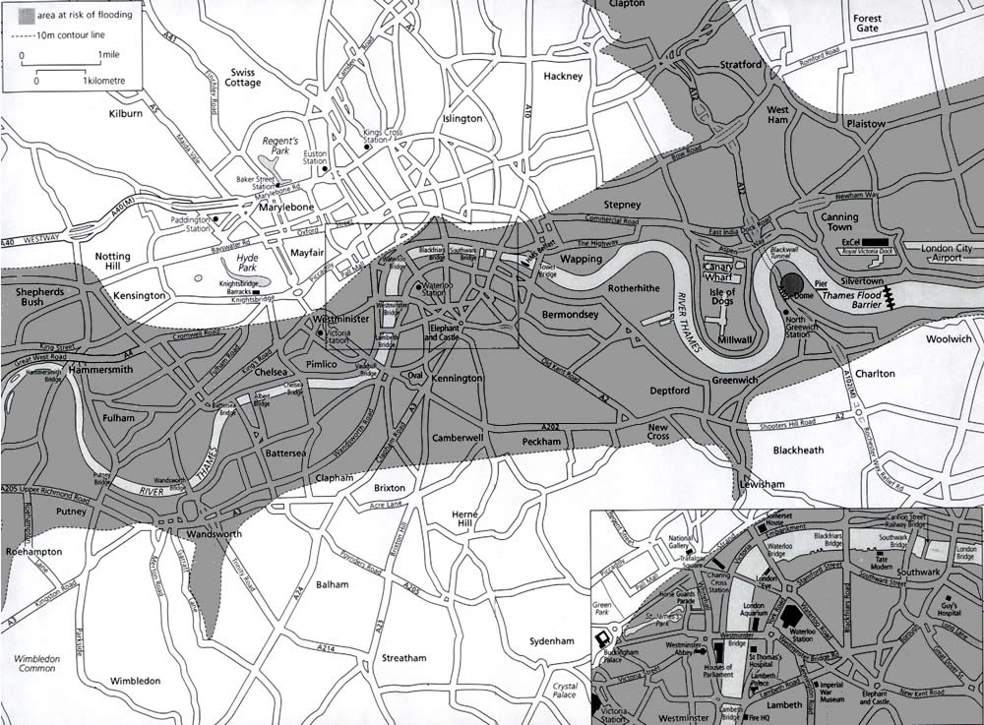
London Flood Map
Notes:
UK has some mitigation but if the Greenwich barrier fails what could be the consequences?
2 of 5 major emergency hospitals gone, City devastated and probably the end of UK.Inc as an economic centre.

Slide 14
Disaster Plans and CRE
High Reliability Organisations
Public Services
Disaster Management Planning
Business Continuity Planning
Resilience
Competitive advantage
Communication
Notes:
Putting aside to some degree the wider implications of Energy Security, and continuity of supply,
High Reliability – power plants defence airlines some public services.
Public service buildings one would think would be up there in terms of disaster resilience planning
BC Plans driven by IT - Competative advantage. Must be supported and well communicated.

Slide 15
CRE Planning
BCM
IT / Property
60% of businesses have BCM plans
Location Resilience
Vulnerability 1 or many – hot sites
Transport
Occupiers
Notes:
Turnball Report Uk recommends strongly that public companies include environmental risk assessments within business planning process
IT well established Herbane 95 found 41% included buildings so 59% don’t?
Pitt & Goyle Uk 60% have plans of these 95% include property.

Slide 16
CRE Planning
Disaster Planning
Will the organisation survive
Employee Plans
Lack of Guidance on Property
RICS
FM
Notes:
Literature shows that after major disasters many business do not trade again.
Not an option for public sector.
Edwards Hawai medical 26% planned to work post disaster. Katrina 247 of 1700 police dept employees absent 1 week after.
Employee contacts alternative sites family facilities.

Slide 17
UK Public Sector Planning
Leading to way in Disaster Planning?
Central Government
Regional Government
Local Government
Survey of Senior Asset managers
Senior Managers (37%)
Managers (31%)
Technical advisors (32%)
Disaster Planning Responsibility / Involvement 39%
Notes:
Survey of leading professionals within UK public service.
Survey C 13% Rg 5% Local 65%
Senior positions 37%

Slide 18
UK Public Sector Planning – Business Impact Analysis
78% have Business Impact Analysis
22% don’t
71% of BIA include property.
29% don’t
41% include extreme weather events as a risk factor
59% don’t
24% considered building vulnerability to extreme weather events a risk factor

Slide 19
UK Public Sector Planning – Business Continuity / Disaster Plans
83% have BCP
5% of BCP with no BIA?
60% of BCP include property plans.
40% don’t
81% with direct property responsibility aware of property BCP
Only 19% don’t know

Slide 20
UK Public Sector Planning – Business Continuity / Disaster Plans
Integrating Property IT HR and Finance
53% with a plan have integrated disciplines
Senior management lead?
74% Yes
11% No

Slide 21
UK Public Sector Planning – Business Continuity / Disaster Plans
Disaster Plan Features
Hot sites 52%
Alternate Reporting location 68%
Key Worker accommodation 67%
Including Family 21%
Well resourced 34%
Property in Disasters not understood 85%

Slide 22
Conclusions
Climate Change =
Potential for disasters
mitigation
Disaster Planning
Limited Guidance / Leadership
Public sector
Professional bodies
market evidence

Slide 23
Climate Change Measurement
Notes:
Despite recent events in UK and Europe only 37% thought Climate change is likely to increase disaster incidence.

Slide 24
Thank you and
Questions
Clive M J Warren – University of Queensland – Business School
c.warren@uq.edu.au

