Slide 1
Workspace Appraisal – a model for Corporate Real Estate Managers
Bob Thompson, RETRI group
Qiulin Ke, Nottingham Trent University

Slide 2
Technology changes quickly….

Slide 3
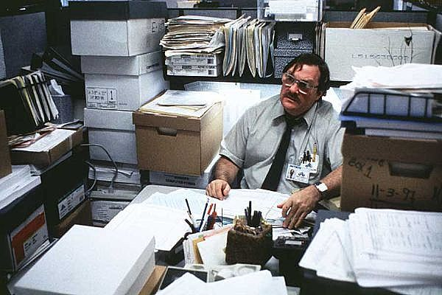
Workplaces don’t….

Slide 4
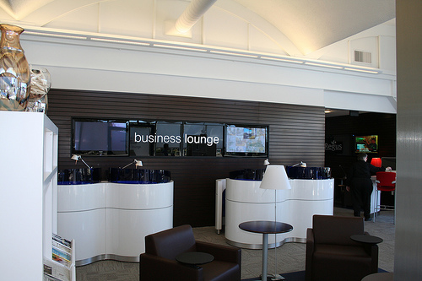
But workspaces do

Slide 6
Serviced offices meet the need…
Postal Address
Meeting rooms
Telephone answering
Operational support
Connectivity
Copying
Storage
Comfort
Refreshment

Slide 7
…but workplaces need to cater for all stakeholders.
Workplace
Owners, Investors, CRE Manager, Architect, Designer
Staff resources, Suppliers, support services
Local community, Police, Shops etc
Local Government, Charities, Central Government
Consumers, Distributors
Enabling linkage
Input
Diffused linkage
Functional linkage
Output
Normative linkage

Slide 8
Workplaces are a collection of workspaces
Procurement
Resources
Resource management
Facilities
Access
Support management
Interface
Secretarial
Operational
Management
Social
Contracts
Frameworks
WORKSPACE
WORKSPACE
WORKSPACE
WORKSPACE
WORKSPACE
WORKSPACE
WORKSPACE
WORKSPACE
WORKPLACE

Slide 9
Workplace appraisal
Location focus
Access to raw materials;
Access to labour;
Connectivity; and
Proximity to market
Resource focus
Cost efficiency;
Global workforce;
Connectivity; and
Global market

Slide 10
Locational metrics
Rental cost
Local taxes
Utility cost

Slide 11
Resource appraisal
Resource efficiency
Unit contribution

Slide 12
Framework
Comfort
Connectivity
Access to resources
Concierge services
Secretarial support
Operational support
Management support
Physical support
PROCUREMENT
OPERATION
SUPPORT

Slide 13
Summary
Workplace appraisal
is reactive, but needs to be proactive
needs to take into account the needs of all stakeholders
tends to be location based rather than resource based
A workspace model
Defines a taxonomy for resource
Facilitates regular reappraisal as part of business planning
Simplifies comparative performance

