Slide 1
CAPITAL STRUCTURE AND INVESTMENT IN REAL ASSETS
Jon Wiley
Clemson University
Peter Chinloy
American University

Slide 2
Houses & Apartments
Substitutes in production & consumption
Starkly different investment behavior
Investment in houses is highly volatile
Apartment investment has remained stable since 1990
Possible explanation:
Differences in contract design & financial variables

Slide 3
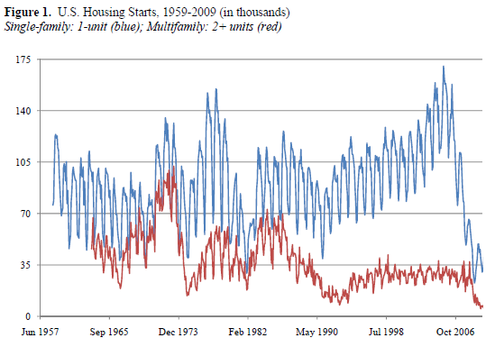
US Housing Starts
Leamer (2007)
Investment in housing leads GDP fluctuations
Accounts for more than 60% of GDP volatility
Trend GDP growth is 3% plus a term related to
residential investment

Slide 4
Capital Structures Single-family
Houses:
Times when underwriting spigots on:
Nonrecourse debt
Fully prepayable
Low default costs
Highly leveraged + a call option
Traditional pecking order
(Maximize debt; equity is residual)

Slide 5
Capital Structures Multifamily
Apartments:
Owned by investors
Policy not targeted on-off
Loan instruments differ
Lower LTV
Some recourse
Not fully prepayable (without penalty)
→ Reverse pecking order
High equity; debt is the residual

Slide 6
Modified User Cost
User cost = Interest rate – Capital gains
q = Market value / Replacement cost
With constraints and illiquidity, financial variables impact investment
Alternative is the yield-price ratio
Treated as a function of:
Capital gains
Interest rates
Term structure
Capital structure

Slide 7
Approach
If capital structure varies, then it alone can affect different performance – even if assets are similar
Differences caused by the capital structure should travel through yield-price ratio
Price = f {D, L, Financial variables}
Rent = f {Vacancy(L), D, Financial variables}
R/P ratio = f (Capital gains, Financial variables)
Investment = f (D, R/P)

Slide 8
Summary of Data

Slide 9
Rent-Price Ratio

Slide 10
Residential Investment

Slide 11
Results Capital Structure: Rents & Prices
Yield-price ratio:
Increasing in capital gains
Decreasing in interest rates
Increasing with the use of leverage

Slide 12
Results Investment: Houses & Apartments
Investment in Houses:
Triggered by the yield-price ratio
Increasing with the debt ratio (LTV)
Investment in Apartments:
Unaffected by capital structures

Slide 13
Determinants of LTV

Slide 14
Values for Housing Starts

Slide 15
Vacancy-Rent

Slide 16
Investment: Actual Values

Slide 17
Investment: First Difference

Slide 18
Financial Variables
Variable Source
12-month LIBOR Wall Street Journal
Term structure Federal Reserve
Capital gains Census values
S&P500 returns Standard & Poor’s
LTVs for Houses FHFA
LTVs for Apartments* Residential Finance Survey (2001)
LTVs for Apartments** Bloomberg CMBS
*1990-1999
**2000-2007

Slide 19
MSA Data
25 MSAs from 1990-2007
Variable Source
Employment (D) BLS
Income (D) BEA
Undevelopable (L) Saiz (2010)
WRI (L) GSS (2008)
Housing starts HUD
Values (authorized) Census
Rents BLS
Vacancies Census

