Slide 1
THE PERFORMANCE OF PROPERTY COMPANIES ON THE AIM STOCKMARKET
GRAEME NEWELL
University of Western Sydney
and
ANDREW BAUM
University of Reading
JUNE 2010

Slide 2
PURPOSE OF PAPER
Assess significance of AIM stockmarket
Assess significance of property
companies on AIM stockmarket
Assess performance of property companies on AIM stockmarket
Assess impact of GFC on AIM property companies

Slide 3
SIGNIFICANCE OF AIM
AIM = Alternative Investment Market
Purpose: small, growth companies: 1995⁺
Benefits
Regulatory structure
Role of NOMADs
• IPO • ongoing support
Other “growth” stockmarkets
• Europe • Asia • Americas

Slide 4
SIGNIFICANCE OF AIM
June 1995: # = 10 @ £80 million
Dec 2007: # = 1694 @ £98 billion
Feb 2010: # = 1268 @ £58 billion
Sectors (10): eg: financial, oil & gas, mining
Sub-sectors (42): eg: property
Distribution
• < £10M @ 41% • £10M - £50M @ 38%
• £50M - £100M @ 9% • £100M - £500M @ 11%
• > £500M @ 1%
UK versus international

Slide 5
# COMPANIES @ AIM: 1995-2009

Slide 6
£B @ AIM: 1995-2009

Slide 7
UK (#) and international (#) over 1995-2009

Slide 8
% UK (# companies)

Slide 9
SIGNIFICANCE OF AIM
Capital raised ✓✓
• IPO • further issues
• £66 billion • £16B @ 2007
• £4B @ 2008 • £6B @ 2009
International exposure (# = 238 @ 19%)
• US • Canada • Australia • Cayman Island
• BRIC • mining, property, oil and gas
Indices @ AIM: FTSE
• AIM All Share • AIM 100
• sub-sectors (18) • property ✓✓✓

Slide 10
PREVIOUS RESEARCH @ AIM
Regulatory issues ✓
Sub-sector: apparel
Finance industry reports ✓✓
• NOMADs
• AIM commissioned (eg: LSE) ✓
Property companies @ AIM

Slide 11
SIGNIFICANCE OF PROPERTY @ AIM
1998: # = 19 @ £0.35 billion
Dec 2007: # = 108 @ £12.9 billion
Feb 2010: # = 90 @ £6.1 billion
Distribution
• < £10M @ 39% • £10M - £50M @ 33%
• £50M - £100M @ 8% • £100M - £500M @ 19%
• > £500M @ 2%

Slide 12
# PROPERTY COMPANIES @ AIM: 1998-2009

Slide 13
£B PROPERTY COMPANIES @ AIM: 1998-2009

Slide 14
% PROPERTY (£) @ AIM: 1998-2009

Slide 15
% PROPERTY (#) @ AIM: 1998-2009

Slide 16
SIZE OF PROPERTY SECTOR (£)
Size of property sector: Feb 2010
• £6.1 billion
• 10.5% (#3 sector)
Average property company size: Feb 2010
• £68M (versus £46M @ AIM)
£ raised
• 2007: £3.7B @ 23% AIM (#1)
• 2008: £7M @ 0.2% AIM
• 2009: £1.4B @ 25% AIM (#1)

Slide 17
PROPERTY @ TOP 50 @ AIM
2004: # = 1
2005: # = 3 (4th largest sector)
2006: # = 10 (1st)
2007: # = 11 (1st)
2008: # = 5 (3rd)
2009: # = 5 (3rd)

Slide 18
LEADING PROPERTY COMPANIES @ AIM
Songbird Estates: £1,103M (#2)
London & Stamford: £596M (#12)
Dolphin Capital: £355M (#22)
Vinaland: £266M (#43)
Max Property: £261M (#45)
Raven Russia: £248M (#49)
+ 9 others @ > £110M

Slide 19
REGIONAL PROFILE (#)
UK @ 31%
Central/Eastern Europe @ 22%
Western Europe @ 20%
Asia @ 20%
Global @ 5%
Other @ 2%

Slide 20
PROPERTY SECTOR PROFILE
• Residential • Office
• Retail • Industrial/logistics
• Hotel • Diversified
• Tourism/resort • Healthcare
• Ski resorts • Self storage
• Entertainment • Windfarms

Slide 21
METHODOLOGY
Aug 2005 – Feb 2010: monthly
AIM All Share
AIM Property Companies
Other assets @ UK markets
stocks
property companies
bonds
Risk-adjusted returns
Portfolio diversification
Impact of GFC: sub-periods (2)
• pre GFC • during GFC

Slide 22
AIM PROPERTY SERIES
Established: Dec 2008
Start: Aug 2005
FTSE EPRA/NAREIT index
# constituents: 13
Total market cap: £1.812 billion
Major constituents
• London & Stamford • Dolphin Capital
• Raven Russia • Mirland
• Conygar • China RE Opportunities

Slide 23
AIM SERIES

Slide 24
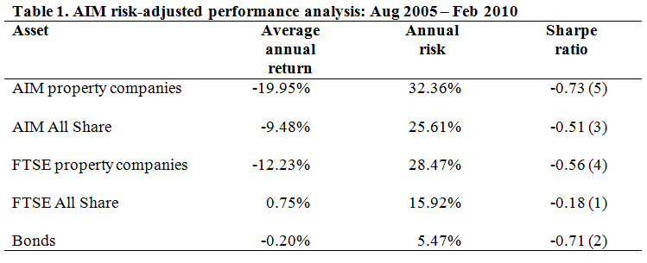

Slide 25
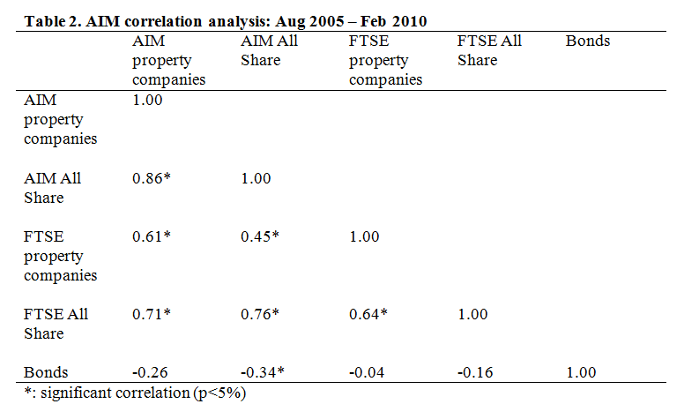

Slide 26
IMPACT OF GFC
Pre-GFC @ Aug 2005 – Aug 2007
GFC @ Sept 2007 – Feb 2010
Investment dynamics re: GFC

Slide 27
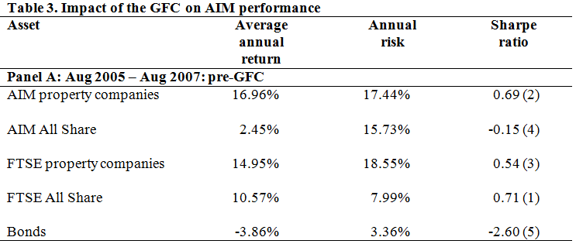

Slide 29
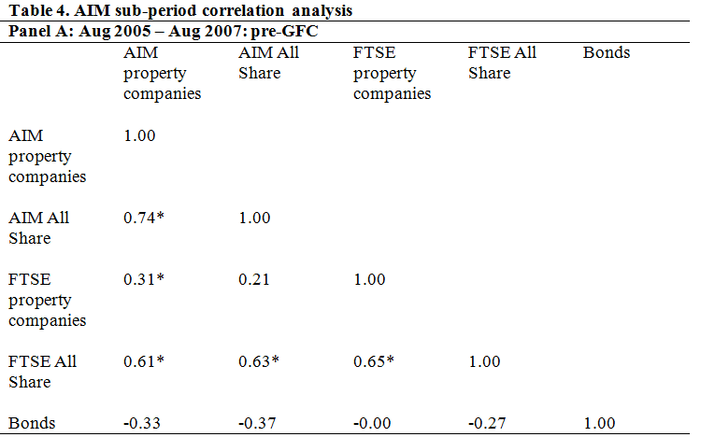

Slide 30
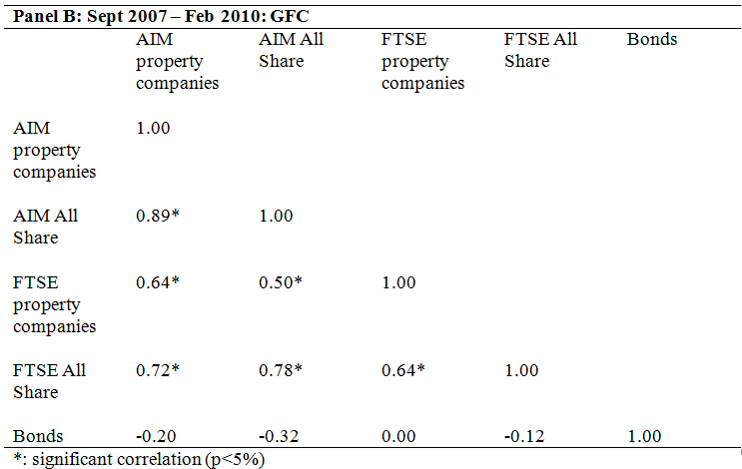

Slide 31
IMPACT OF GFC
Returns: 16.96% → - 41.63%
Risk: 17.44% → 39.39%
Risk-adjusted returns: #2 → #5
Diversification: 0.74 → 0.89
Comparison to other asset classes

Slide 32
FUTURE OUTLOOK
Impact of GFC
Capital raising
Recovery @ 2009 – 2010
Future prospects
Risk factors
Operational issues

