Slide 1
The impact of high-rise condos on residential prices:
An analysis for Nunoa (Santiago de Chile)
Carlos, Marmolejo Duarte;
Esteban, Skarmeta Cornejo &
Carlos, Aguirre Nunez
Centre for Land Policy and Valuations
Polytechnic University of Catalonia
XVI EUROPEAN REAL ESTATE SOCIETY CONGRESS | Milan, Italy 23th, 26th of June 2010

Slide 2
The impact of high-rise condos on residential prices:
An analysis for Nunoa (Santiago de Chile)
Carlos, Marmolejo Duarte;
Esteban, Skarmeta Cornejo &
Carlos, Aguirre Nunez
Centre for Land Policy and Valuations
Polytechnic University of Catalonia
XVI EUROPEAN REAL ESTATE SOCIETY CONGRESS | Milan, Italy 23th, 26th of June 2010

Slide 3
Research question
The impact of high-rise condos on residential prices

Slide 4
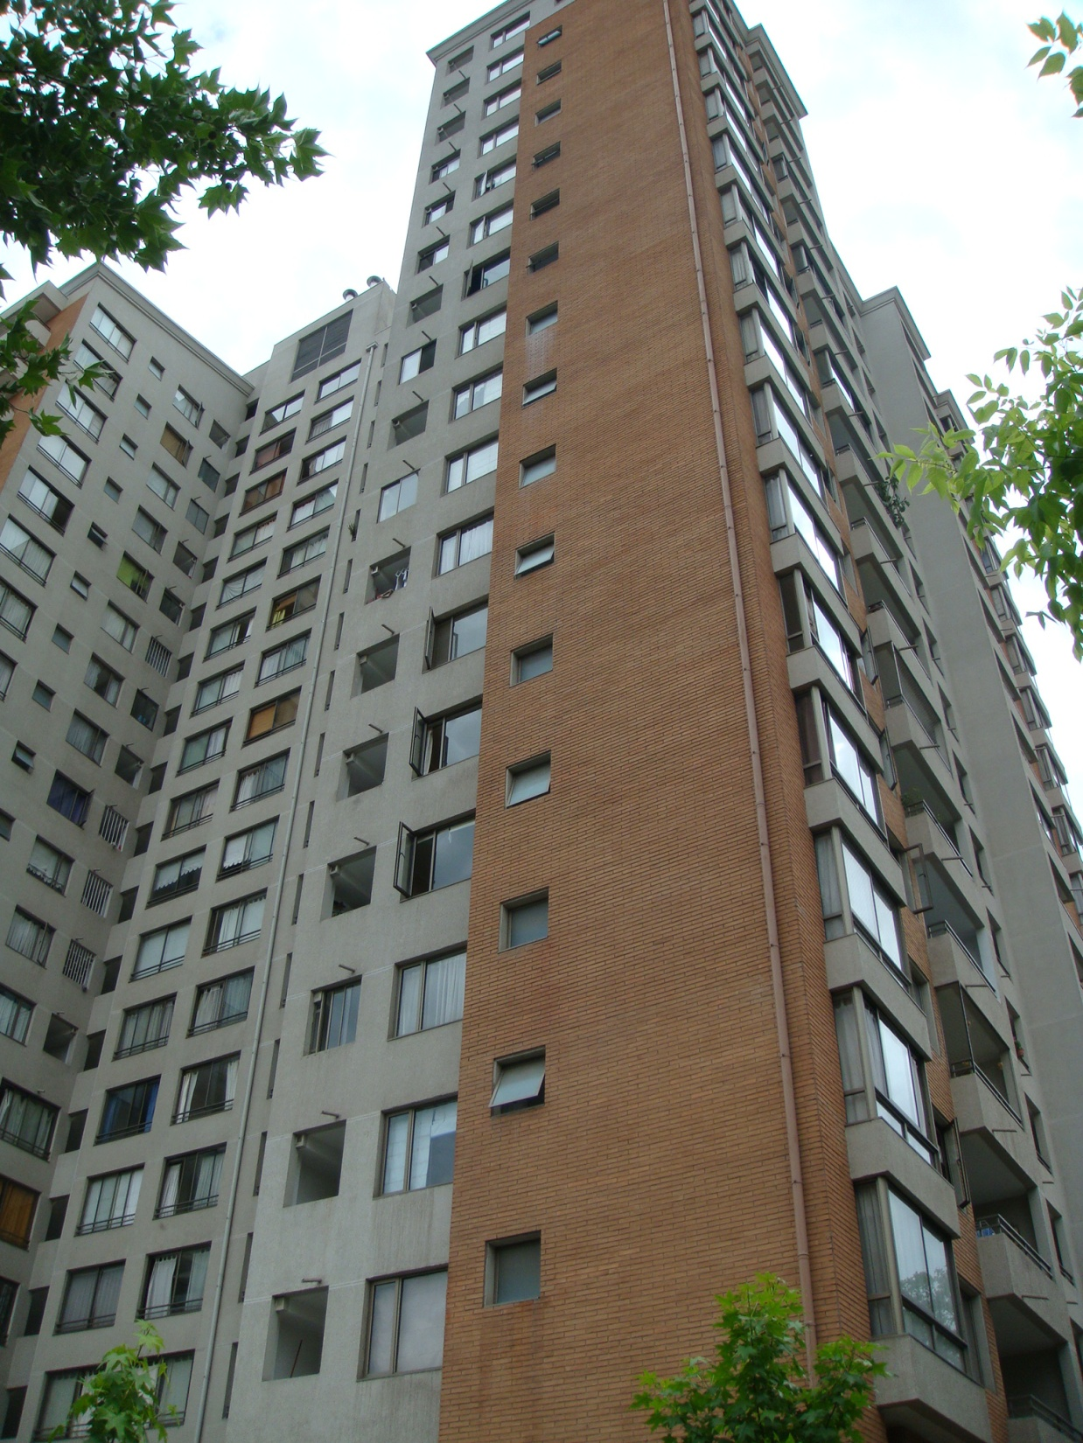
Research question
Whether or not high-rise resindential condos impact on real estate prices of neighbouring housings?

Slide 5
Case study
El ruido mensurado
A borough in Santiago de Chile Metropolitan Area
16 sqKm
163.000 inhabitants
Medium inconme population
Not homogeneous income level
Formerly single-family housing
2000-2003 59 “high rise” apartment built
All of them redeveloping the land formerly occupied by single-family houses
Up to 19 stories
Up to 47.000 sqMeters

Slide 6
Case study
El ruido mensurado
Typical apartment building in Nunoa

Slide 7
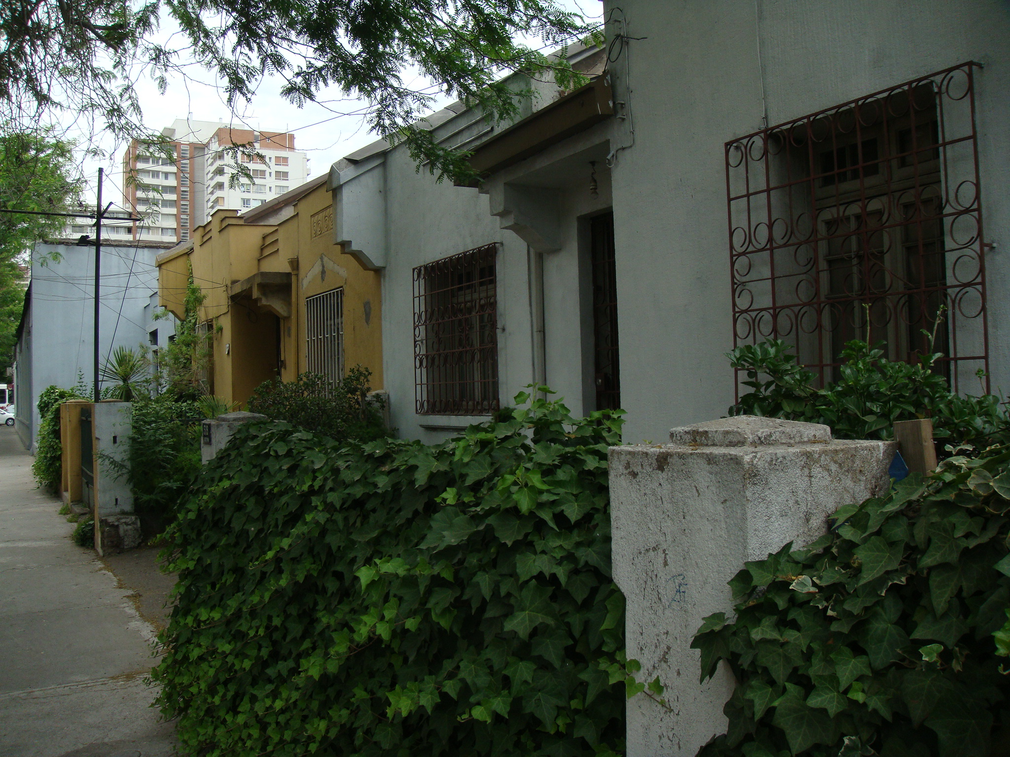
Case study
Typical apartment building in Nunoa

Slide 8
Prostest of original settlers
Eldo
Again gentrification, and other externalities (e.g. shadow & congestion)

Slide 9
Hypothesis & theory
The impact of high-rise condos on residential prices

Slide 10
Hypothesis
High-rise apartment buildings, may produce negative externalities, but they do produce a positive impact on real estate prices of neighboring detached houses.

Slide 11
Theoretical framework
El ruido mensurado
Sabatini, Cáceres & Cerda (2001); Cáceres & Sabatini (2004), Salcedo & Torres (2004)
There is an improvement in the urban landscape, produced by the emergence of new high-quality buildings and the construction of new, but small, infrastructures around those new residential buildings (e.g. street pavement). Both factors do produce an externality, in the short run, with a positive impact on neighboring real estate prices.
The supply of dwellings orientated to medium-high income households produce an gentrification process, which may produce a revalorization process.
The increase of population density, produces an emergence of new services in the neighboring areas.
The construction of new buildings do impact on the perception of original settlers-owners, and their willingness to ask for their properties (to be redeveloped) increases.

Slide 12
Research agenda
The impact of high-rise condos on residential prices

Slide 13
Research agenda
El ruido mensurado
Does the impact depends on the size of the condominium?
Which is the spatial extend of the impact?
Is the impact stationary across all the municipal area of Nunoa?

Slide 14
Used methodology & data
The impact of high-rise condos on residential prices

Slide 15
Methodology
OLS Hedonic price model
Structural
Social
Externalities
Accesibility
Geographical weighted regression Hedonic price model
Wij=ponderation factor
Dij distance between each observation i and j point
Hi distance of farest case j

Slide 16
Data (55 covariables)
1.185 sales of single-family houses (Property registry)
Demographics
Socioeconomics
Economic activity premises
Hosing quality
Land use and building potential (Master Plan)
Residential condos features (Municipal buildings permits)
Accesibility indexes (Transcad GIS)
National Census

Slide 17
Main results
The impact of high-rise condos on residential prices

Slide 18
Does the impact depends on condominiums size?
El ruido mensurado
Lot size (+)
Sq Lot size (-)
Lower income population (-)
Population density (+)
Dist. to private schools (+)
Dummy presence of neighbouring condominiums (n.s.)
Built floor area of neighbouring condos (+)

Slide 19
2. Which is the spatial extend of the impact?
Single family house

Slide 20
3. Is the impact stationary across all the municipal area of Nunoa?
Division of Nunoa in socioeconomic homogeneous areas using factor and cluster analysis

Slide 21
Final remarks
The impact of high-rise condos on residential prices

Slide 22
Final remarks
Despite negative externalities, high-rise apartment buildings seems to produce a positive impact, in the short run, on real estate prices of neighboring houses
The impact do depends on condominium size, the bigger is the neighboring condo, the bigger is the positive impact.
The impact do deeply decrease with the distance.
The wealthiest areas in Nunoa, are the most benefited from high-rise building construction. So there is not a spatial convergence on real estate prices, but a divergence produced by a laissez faire urban policy

Slide 23


Thank you
carlos.marmolejo@upc.edu
Centre for Land Policy and Valuations
Polytechnic University of Catalonia

