Slide 1
The Structure of Urban Residential Housing Sub-markets of Hong Kong
Presented by Daniel LO, PhD
The University of Hong Kong
Email: daniello@hku.hk

Slide 2
Introduction
Widely acknowledged that housing submarkets should be adopted as a working hypothesis.
Objective:
Using geo-referenced property transaction data to define the housing submarket structure of Hong Kong.
Hypothesis:
Submarkets defined by geo-referenced property transaction data can improve forecasting accuracy of housing prices, compared with prevailing submarket structure.

Slide 3
How did we define housing submarkets?
Physically
e.g. structural types (Adair et al. 1996), number of rooms (Schnare and Struyk, 1976), floor areas (Bajic 1985)
Socioeconomically
e.g. income (Strazheim 1975), race and ethnic groups (Palm 1978), religious parishes (Adair et al. 2000)
Spatially/geographically
e.g. natural boundaries (Munro 1986), political boundaries (Adair et al. 1996), school catchment areas (Goodman and Thibodeau 1998), neighborhood characteristics (Galster 1987; Schnare 1980)
Using expert knowledge
Defined by real estate professionals (Michael and Smith 1990)
Hybrid

Slide 4
Problems with previous definitions of housing submarket.
Imposed rather than derived.
No. of submarkets defined, shape and size of the submarkets are fixed.
Cannot capture the dynamics of economic activities involved.
Some neighborhood information are incomplete/unquantifiable/unobservable.
No rule to know that the submarket structure is defined in an optimal way.

Slide 5
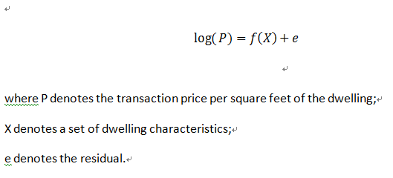
Research Method
Following Basu & Thibodeau(1998), Dubin et al. (1998, 1999) and Tu et al. (2007)
Step 1:

Slide 6
Step 2
Estimate residual variance-covariance matrix, Ω, to reflect residual correlation.
Assume they are isotropic
Choose Spherical Semi-variogram functional form(Basu and Thibodeau 1998, Tu et al. 2007) to estimate the variance and co-variance matrix.
The co-variogram for the distribution of residuals:
For all (li, lj) where
li =(xi, yi) is the coordinates of dwelling i;
e(li) is the hedonic price equation residual for li;
li-lj is the Euclidean distance between li and lj.
Cov{e(li),e(lj)} is the covariance between two residuals.

Slide 7
Following Matheron (1963),The semi-variogram is given by:
which is an increasing function of the distance between the two dwellings.
γ(h)= γ(-h)
γ(h)→θ0 >0 when h→0.
θ0 is called the nugget.
The observations will become spatially uncorrelated as the distance h increases.
At h0, γ becomes level-off at C*. h0 is called the range and C* is the sill (the variance of the residuals).

Slide 8
Step 3: Estimate the semi-variogram
The spherical semi-variogram is given by:
where
θ0 is the nugget,
θ0+ θ1 is the sill and
θ2 is the range
Estimated by Method of Moments.

Slide 9
With estimated nugget, sill, and range, together with the distance matrix, the estimates of elements of variance-covariance matrix, Ω, is derived:

Slide 10
Step 4:Clustering the dwellings
Begin with l1 , if the distance between l1 and l2is shorter than the estimated range, then they are grouped into one cluster, say cluster1.
If the distance from l3 tol2 is greater than the estimated range, but the distance from l3 to l1 is shorter than the estimated range, we still group into cluster1.
Repeat the above processes for all observations.
We then can obtain many different clusters based on the spatial autocorrelation structure of the residuals.

Slide 11
Step5: Forming housing submarkets
Applied a standard submarket test, Choｗ (F) test, to each pair of clusters defined.
Step6:
Adopt weighted mean square test to calculate the forecasting accuracy of the derived submarket structure.
Compare it with that of the prevailing submarket structure.

Slide 12
Our data
Urban housing market of Hong Kong, i.e. Hong Kong Island (pop: approx.1,250,000)
All data are geo-coded
January 1, 2006 to December 31, 2006
13700 transaction data
Source of data: A database from a local real estate agent

Slide 13
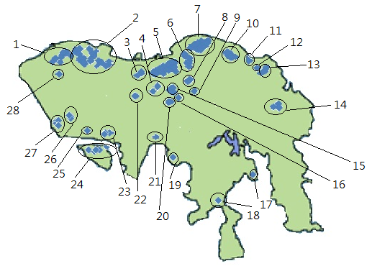
Clusters in Hong Kong Housing Market

Slide 14
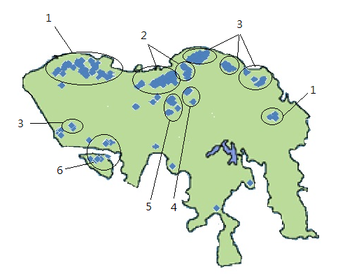
Derived Housing Submarket Structure

Slide 15
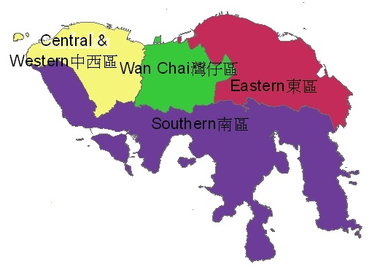
Prevailing urban submarket structure of Hong Kong
Source: Census and Statistic Department of Hong Kong, 2007

Slide 17
Results
More submarkets are defined.
The patterns are dissimilar.
Submarkets need not be geographically adjacent to each other.
Some clusters are unclassified.
Physical boundaries can not delineate submarkets.
R-squared of Hedonic regression increases from 18% to 59% when compared with the prediction against the whole market.
The submarket structure significantly improves forecasting power by 46% if compare with the prediction against whole market, or by 23% if compared with the prediction against prevailing submarkets.

Slide 18
Interpretation and Implication
The prevailing submarket is administratively or politically imposed.
As a result of history, or for the sake of administrative convenience.
Verify that spatial autocorrelation is crucial in modeling housing prices.
Practical applications
Property valuation, housing analysis, government urban planning, etc.

Slide 19
Future Studies
1 Compare with more submarket structures.
2 Temporal stability of the submarket structure.
3 Anisotropic rather than isotropic.
4 Delineation of submarkets in terms of housing price changes.

Slide 20
Thank you!
If you have any comments, please send email to daniello@hku.hk

